Slide 1




On the 3-Tree Core of Plane Graphs
Debajyoti Mondal
Visualization-Geometry-Algorithms Lab
Department of Computer Science
University of Saskatchewan, Saskatoon, Canada
Md. Saidur Rahman
Graph Drawing and Information Visualization Laboratory
Department of Computer Science
Bangladesh University of Engineering and Technology, Dhaka, Bangladesh

Slide 2
On the 3-Tree Core of Plane Graphs
The term 3-tree core is motivated from a subclass of plane graphs called plane 3-tree
What is a Plane 3-tree?

Slide 3
On the 3-Tree Core of Plane Graphs
The term 3-tree core is motivated from a subclass of plane graphs called plane 3-tree
What is a Plane 3-tree?
b
b
j
j
k
k
e
d
i
e
d
i
l
h
l
h
o
f
g
o
f
a
g
a
n
m
c
n
m
c
A triangulated plane graph that can be constructed by starting with a triangle, and then repeatedly adding a vertex and triangulating that face

Slide 4
Properties of Plane 3-trees
A plane 3-tree
The representative vertex of G
b
c
A plane 3-tree
j
j
k
k
e
e
i
d
i
d
d
h
l
h
l
o
f
o
f
g
a
g
n
n
m
m
c
c
A plane 3-tree G
A plane 3-tree
Every plane 3-tree has a representative vertex that is adjacent to all its outreverices

Slide 5
Plane 3-trees have been well studied in graph drawing literature.
For many graph drawing styles, the aesthetic qualities that have been achieved for plane 3-trees are much better than the ones known for general plane graphs.
Straight-line Drawing of Plane Graphs
a
a
d
b
c
f
e
b
g
c
b
c
a
A planar graph G
A straight-line drawing of G on a 5×5 grid
A straight-line drawing of G with height 4

Slide 6
Dynamic Program for Minimizing Area [MNRA 2011]
b
c
j
j
k
k
e
e
i
d
i
d
d
h
l
h
l
o
f
o
f
g
a
g
n
n
m
m
c
c
A plane 3-tree can be decomposed
into three smaller 3-trees

Slide 7
How can we leverage plane 3-tree structure to obtain results for general planar graphs?
How about the plane graphs that are “not too far” from a plane 3-tree?.... bounded treewidth is not enough for minimizing area [Biedl 2014].ree

Slide 8
Contribution
We introduce “3-Tree Core”, which is a plane 3-tree like structure in a 3-connected plane graph
Let G be a plane graph with a 3-tree core H such that the distance between G and H is d.
    If H admits a flat visibility drawing with height k then
    G admits an ortho-path visibility drawing of height O(k 2^{d})

Slide 9
Contribution
We introduce “3-Tree Core”, which is a plane 3-tree like structure in a 3-connected plane graph
Let G be a plane graph with a 3-tree core H such that the distance between G and H is d.
    If H admits a flat visibility drawing with height k then
    G admits an ortho-path visibility drawing of height O(k 2^{d})
a
a
a
distance d=2
e
f
a
f
e
e
g
d
g
f
b
c
b
c
d
f
3-tree core H
Drawing with height k
d
g
b
c
g
A plane graph G
b
c
Drawing with height O(k 2^{d})

Slide 10
Construction of a 3-Tree Core
Repeatedly finding 3 vertex disjoint paths from an unvisited vertex v of G
Insert v into the 3-tree H and create edge labels
v₁₂
v₁₂
v₁₂
v₁₁
v₁₁
v₁₀
v₁₀
v₉
v₉
v₁₁
v₇
v₇
v₁₀
v₈
v₈
v₅
v₆
v₅
v₆
v₄
v₃
v₄
v₃
v₁
v₂
v₁
v₂
v₁
v₂

Slide 11
Construction of a 3-Tree Core
Repeatedly finding 3 vertex disjoint paths from an unvisited vertex v of G
Insert v into the 3-tree H and create edge labels
v₁₂
v₁₂
v₁₂
v₁₂
v₁₂
v₁₁
v₁₁
v₁₁
v₁₀
v₁₀
v₁₀
v₉
v₉
v₉
v₁₀
v₁₁
v₇
v₈
v₁₀
v₁₁
v₇
v₈
v₇
v₈
v₅ ,v₇ ,v₁₀
v₅
v₆
v₅
v₆
v₅
v₆
v₄
v₃
v₄
v₃
v₄
v₃
v₄
v₃
v₁
v₂
v₁
v₂
v₁
v₂
v₂
v₁
v₂
v₁

Slide 12
Construction of a 3-Tree Core
Repeatedly finding 3 vertex disjoint paths from an unvisited vertex v of G
Insert v into the 3-tree H and create edge labels
v₁₂
v₁₂
v₁₂
v₁₂
v₁₂
v₁₁
v₁₁
v₁₁
v₁₀
v₁₀
v₁₀
v₉
v₉
v₉
v₁₀
v₁₁
v₇
v₈
v₁₀
v₁₁
v₇
v₈
v₇
v₈
v₅ ,v₇ ,v₁₀
v₅
v₆
v₅
v₆
v₅
v₆
v₄
v₃
v₄
v₃
v₄
v₃
v₄
v₃
v₁
v₂
v₁
v₂
v₁
v₂
v₂
v₁
v₂
v₁
v₁₂
v₁₂
v₁₁
v₁₀
v₉
v₁₀
v₁₁
v₇
v₈
v₅ ,v₇ ,v₁₀
v₉ ,v₁₁
v₅
v₆
v₅
v₆
v₄
v₃
v₄
v₃
v₃
v₁
v₂
v₂
v₁

Slide 13
Construction of a 3-Tree Core
Repeatedly finding 3 vertex disjoint paths from an unvisited vertex v of G
Insert v into the 3-tree H and create edge labels
v₁₂
v₁₂
v₁₂
v₁₂
v₁₂
v₁₁
v₁₁
v₁₁
v₁₀
v₁₀
v₁₀
v₉
v₉
v₉
v₁₀
v₁₁
v₇
v₈
v₁₀
v₁₁
v₇
v₈
v₇
v₈
v₅ ,v₇ ,v₁₀
v₅
v₆
v₅
v₆
v₅
v₆
v₄
v₃
v₄
v₃
v₄
v₃
v₄
v₃
v₁
v₂
v₁
v₂
v₁
v₂
v₂
v₁
v₂
v₁
v₁₂
v₁₂
v₁₂
v₁₂
v₁₁
v₁₁
v₁₀
v₁₀
v₉
v₉
v₁₀
v₈
v₁₁
v₇
v₉ ,v₁₁
v₁₀
v₁₁
v₈
v₅ ,v₇ ,v₁₀
v₇
v₈
v₅ ,v₇ ,v₁₀
v₉ ,v₁₁
v₅
v₆
v₅
v₆
v₅
v₆
v₅
v₅
v₆
v₄
v₃
v₄
v₃
v₄
v₃
v₃
v₄
v₃
v₃
v₁
v₂
v₂
v₁
v₂
v₁
v₁
v₂

Slide 14
Pseudopath Augmented 3-Tree Core
Subdivide the edges and connect consecutive division vertices of same label with an edge
v₁₂
v₁₂
v₁₂
v₁₁
v₁₀
v₁₀
v₁₀
v₁₁
v₉
v₁₀
v₁₁
v₁₁
v₇
v₉ ,v₁₁
v₇
v₈
v₈
v₈
v₅ ,v₇ ,v₁₀
v₅
v₉
v₅
v₆
v₅
v₆
v₅
v₆
v₅
v₄
v₅
v₃
v₄
v₃
v₃
v₃
v₄
v₃
v₁
v₂
v₁
v₂
v₁
v₂
A plane graph G
A 3-tree core H
Pseudopath augmentation of H

Slide 15
Pseudopath Augmented 3-Tree Core
Subdivide the edges and connect consecutive division vertices of same label with an edge
Add the edges that are in G but not represented in H
v₁₂
v₁₂
v₁₂
v₁₁
v₁₀
v₁₀
v₁₀
v₁₁
v₉
v₁₀
v₁₁
v₁₁
v₇
v₉ ,v₁₁
v₇
v₈
v₈
v₈
v₅ ,v₇ ,v₁₀
v₅
v₉
v₅
v₆
v₅
v₆
v₅
v₆
v₅
v₄
v₅
v₃
v₄
v₃
v₃
v₃
v₄
v₃
v₁
v₂
v₁
v₂
v₁
v₂
A plane graph G
A 3-tree core H
Pseudopath augmentation of H

Slide 16
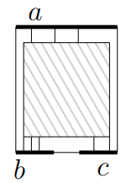
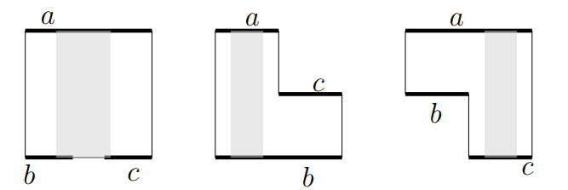
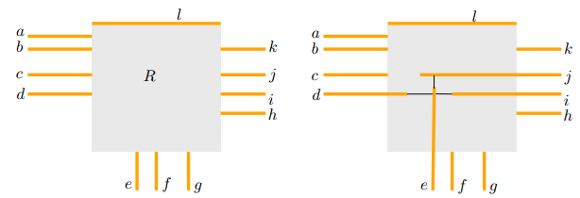
From Flat Visibility Representation of H to Ortho-Path Visibility Drawing of G
Schematic representation of a given flat Visibility representation of a 3-tree core
Allocation of slab region in each face to draw missing edges later
Current Drawing

Slide 17
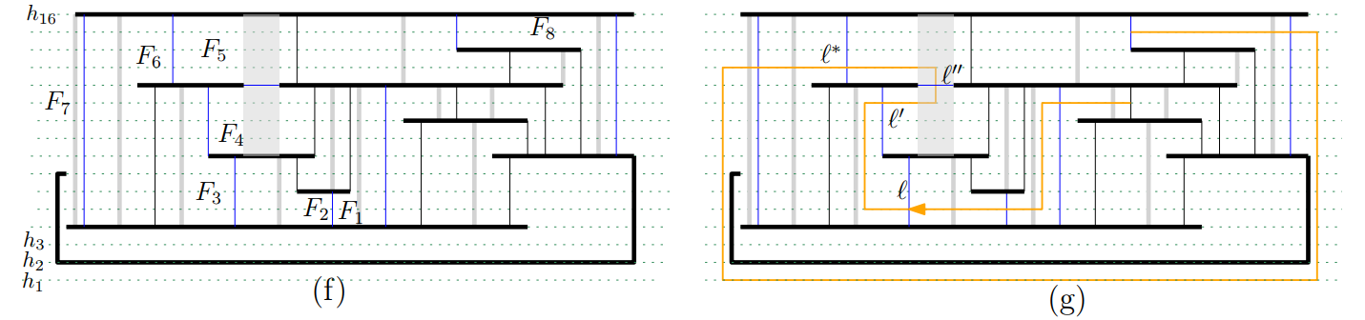
From Flat Visibility Representation of H to Ortho-Path Visibility Drawing of G
Current Drawing
Insertion of a pseudopath shown in orange

Slide 18
From Flat Visibility Representation of H to Ortho-Path Visibility Drawing of G
A flat visibility representation of the 3-tree core H with height k
An ortho-path visibility representation of G with height O(k2^{d}), where d is the distance between G and H
Current Drawing
Each time we insert a pseudopath into the current drawing, we scale up the drawing by a factor of two. How many pseudopaths do we insert?

Slide 19
Can we always find a large 3-tree core? Equivalently, can we always find a 3-tree core that is not very far from G?

Slide 20
Can we always find a large 3-tree core? Equivalently, can we always find a 3-tree core that is not very far from G?
Yes.
Every plane triangulation has a 3-tree core with at least ⌈(n + 1)/2⌉ vertices

Slide 21
Tool: Decompose a Triangulation into Trees
v_{n =} v₈
v_{n =} v₈
v_{i}
v₆
v₆
v₇
v₇
v₄
v₅
v₄
v₅
v₃
v₁
v₃
v₁
v₂
v₂
v₁
v₂
A Canonical Ordering of G
[De Fraysseix et al. 1988]
A Schnyder realizer of G
[Schnyder 1990]
v_{n =} v₈
v_{n =} v₈
v_{n =} v₈
v₆
v₆
v₆
v₇
v₇
v₇
v₅
v₄
v₅
v₅
v₄
v₄
v₃
v₃
v₃
v₂
v₁
v₂
v₁
v₂
v₁
T_{mid}
T_{left}
T_{right}

Slide 22
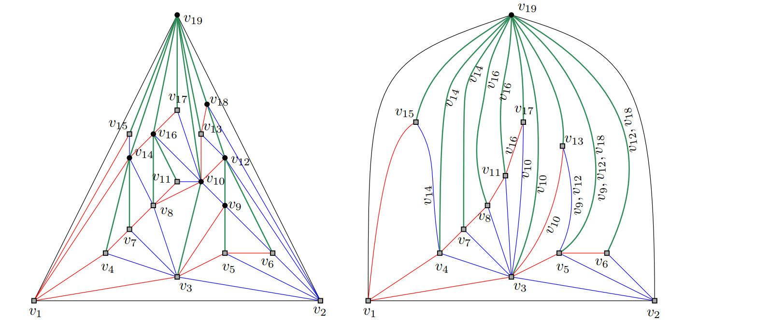
Every plane triangulation has a 3-tree core with at least ⌈(n + 1)/2⌉ vertices

Slide 23
Direction for Future Research
What are the other graph drawing styles that allow for similar results?
Can we design fixed-parameter tractable algorithms for graph-theoretic problems parameterized by the 3-tree core distance?
Does every n-vertex planar triangulation admit a 3-tree core with larger than n/2 + O(1) vertices?
Can we find the minimum 3-tree core distance in polynomial time?

Slide 24

Direction for Future Research
What are the other graph drawing styles that allow for similar results?
Can we design fixed-parameter tractable algorithms for graph-theoretic problems parameterized by the 3-tree core distance?
Does every n-vertex planar triangulation admit a 3-tree core with larger than n/2 + O(1) vertices?
Can we find the minimum 3-tree core distance in polynomial time?
Thank You!

Slide 25
Straight-line Drawing of Plane Graphs
Upper Bounds
Lower Bounds
Triangulations
Area Height
2n² + O(1) n − 2 [de Fraysseix et al. 1990]
n² + O(1) n − 2 [Schnyder 1990]
1.78n² + O(1) 0.66n [Chrobak and Nakano 1998]
0.88n² + O(1) 0.66n [Brandenburg 2008]
0.44n² + O(1) 0.66n (polyline) [Bonichon et al. 2003]
Nested Triangles Graph
Area Height
0.44n² +O(1) 0.66n [Dolev et al. 1984]
A class of planar 3-trees
Area Height
0.44n² + O(1) 0.66n [Frati and
Patrignani 2008,
Mondal et al. 2010]

