Slide 1
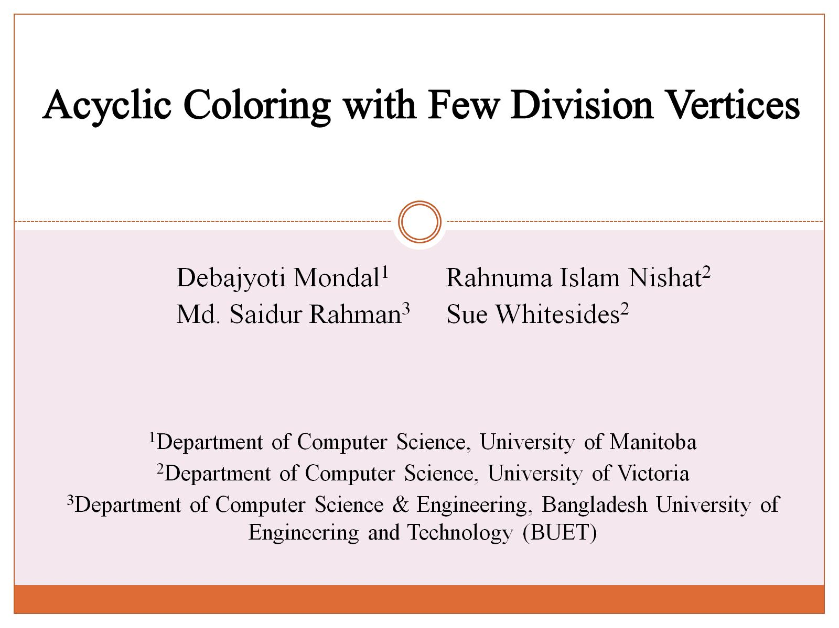

Slide 2
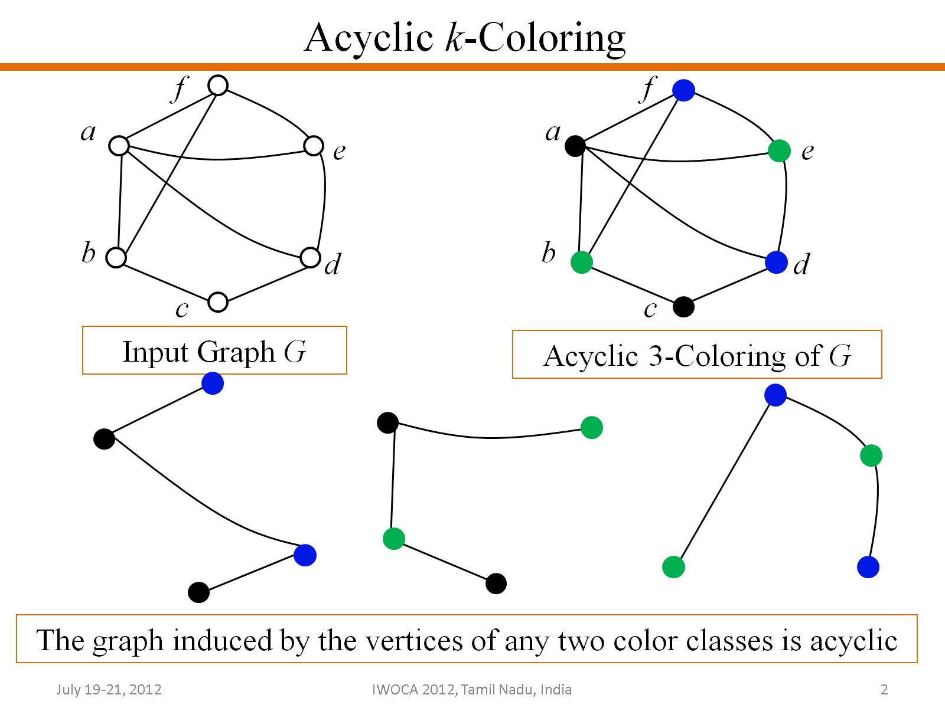
Acyclic k-Coloring

Slide 3
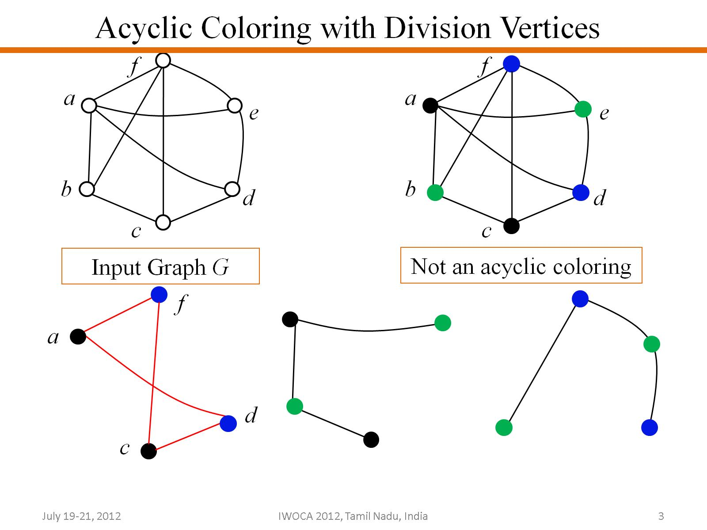
Acyclic Coloring with Division Vertices

Slide 4
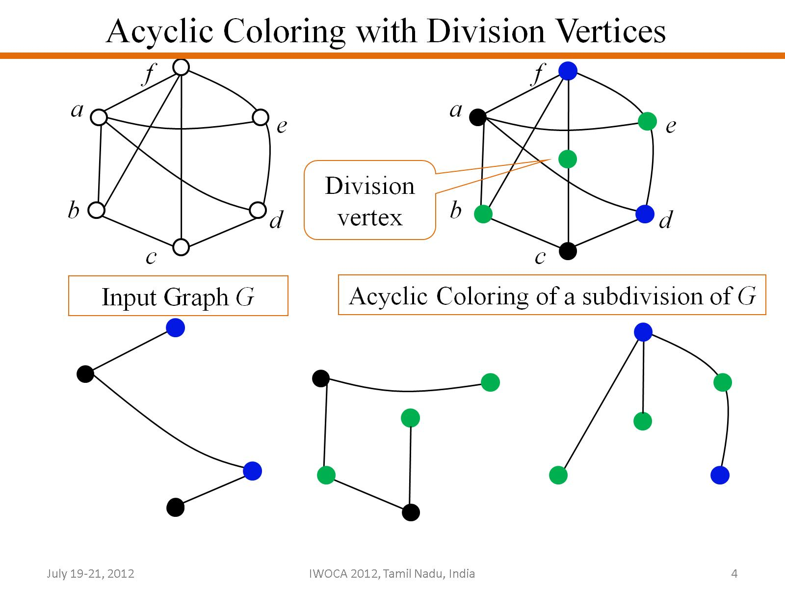
Acyclic Coloring with Division Vertices

Slide 5
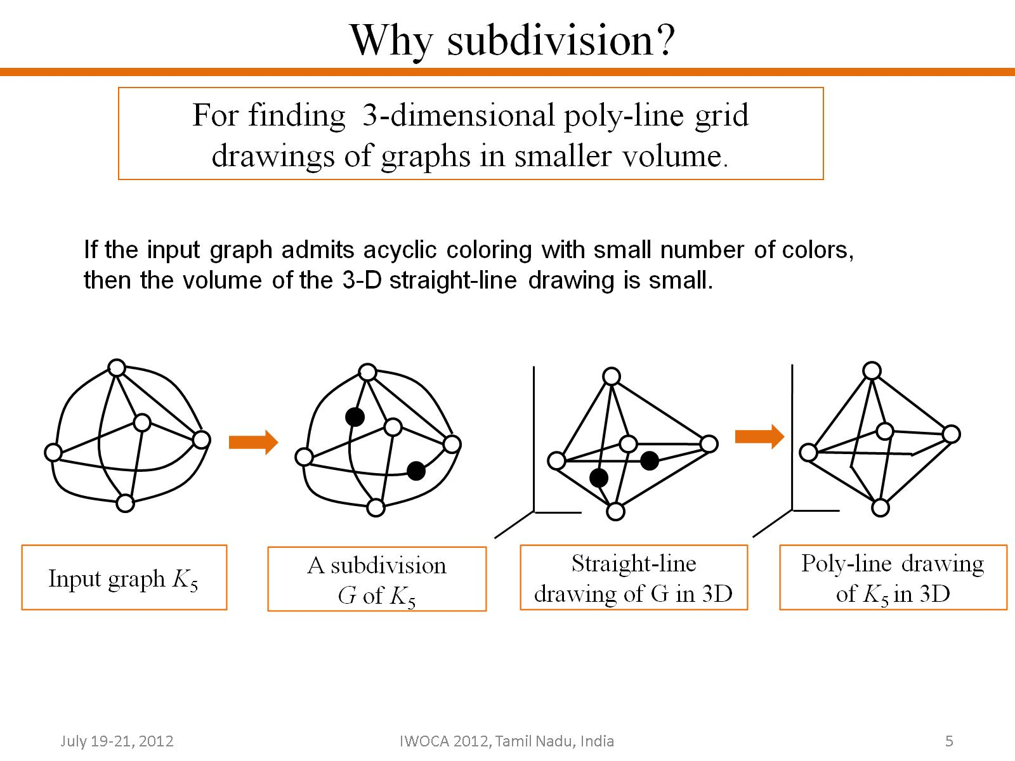
Why subdivision ?

Slide 6
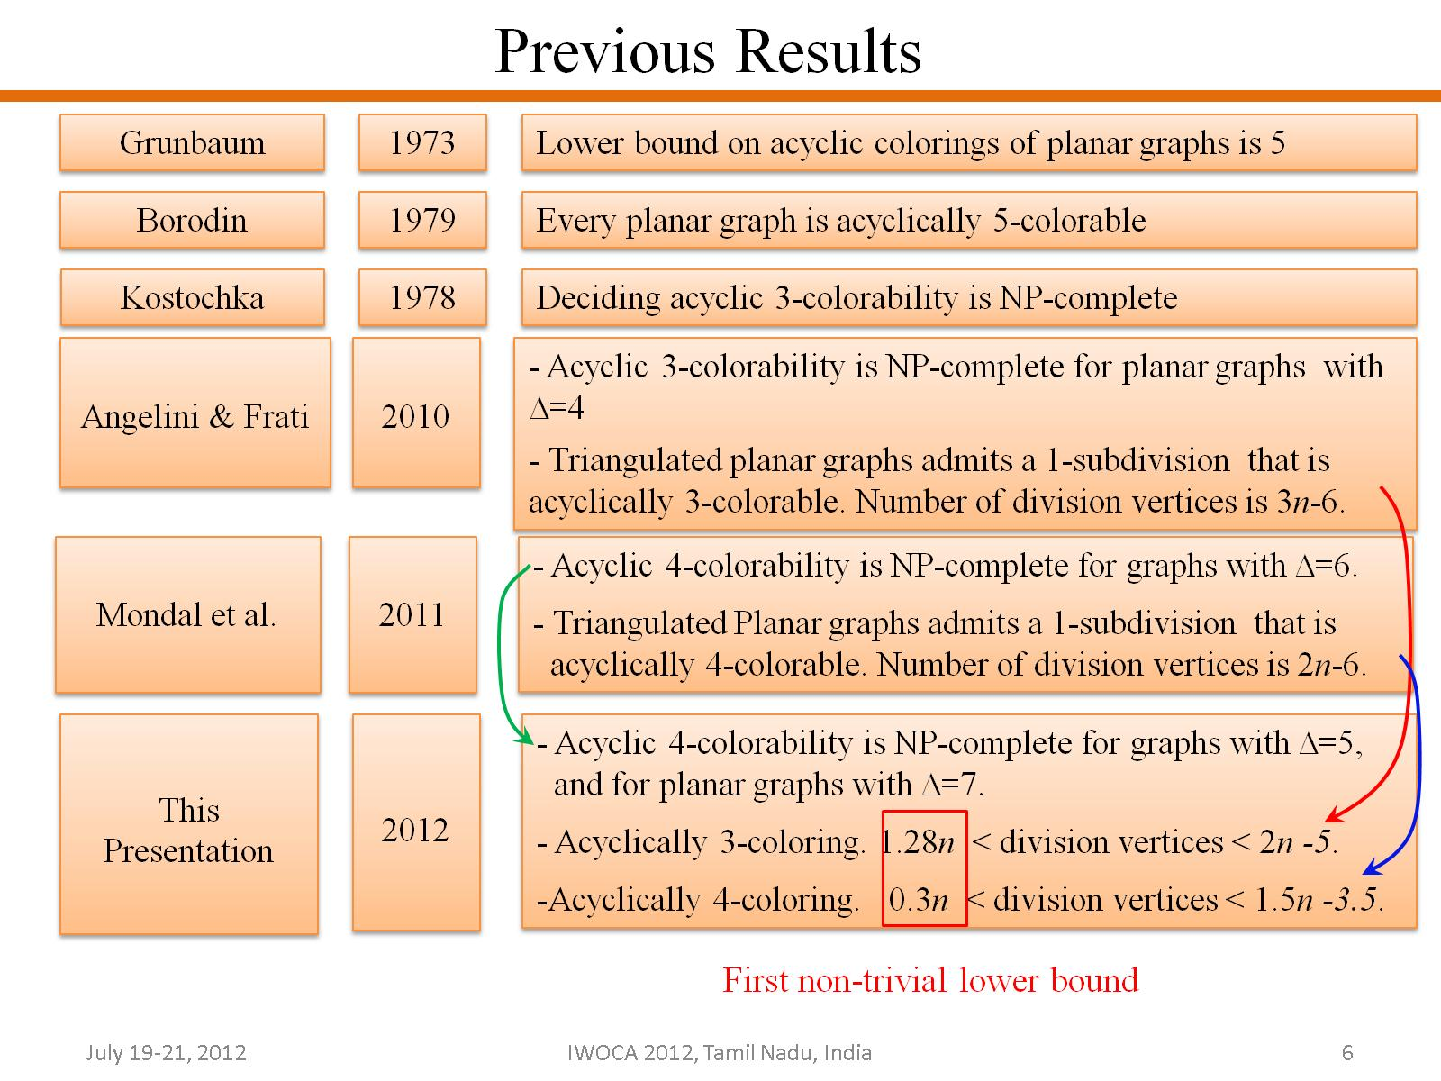

Slide 7
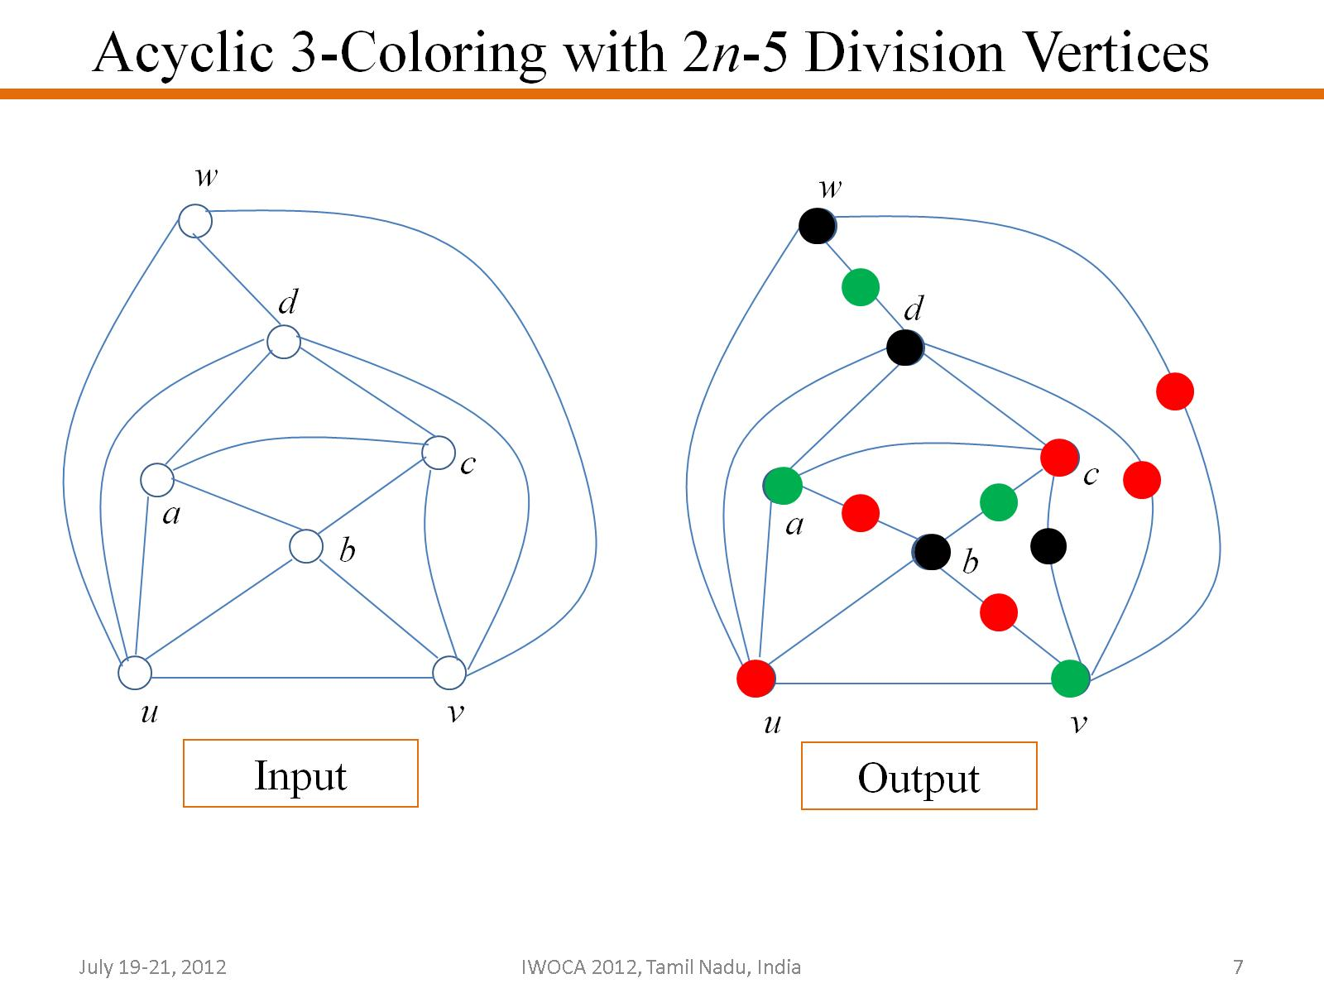
Acyclic 3-Coloring with 2n-5 Division Vertices

Slide 8
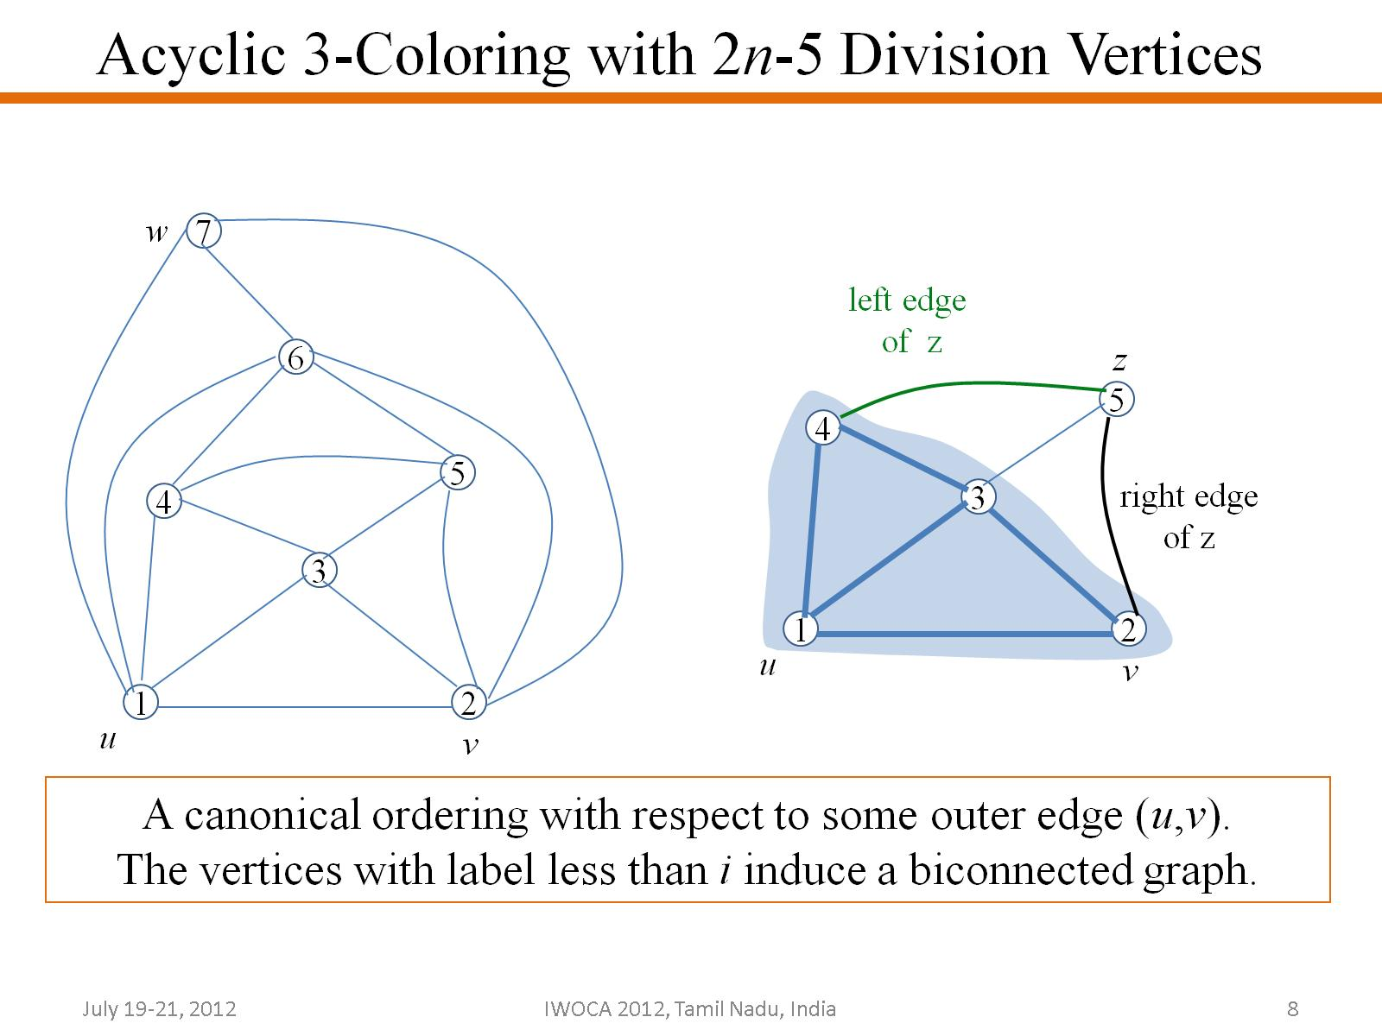
Acyclic 3-Coloring with 2n-5 Division Vertices

Slide 9
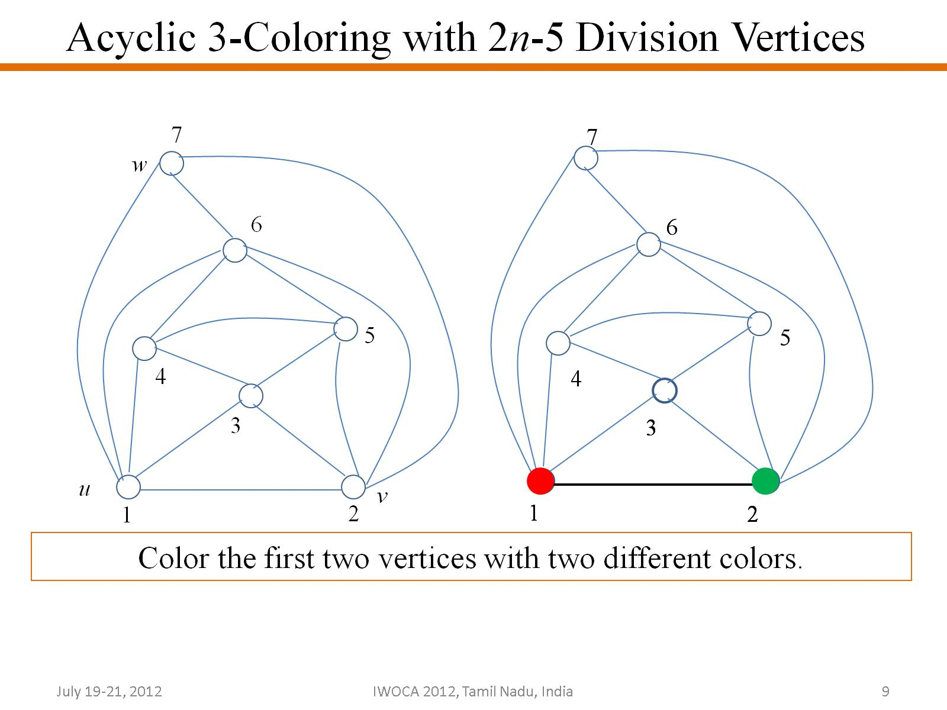
Acyclic 3-Coloring with 2n-5 Division Vertices

Slide 10
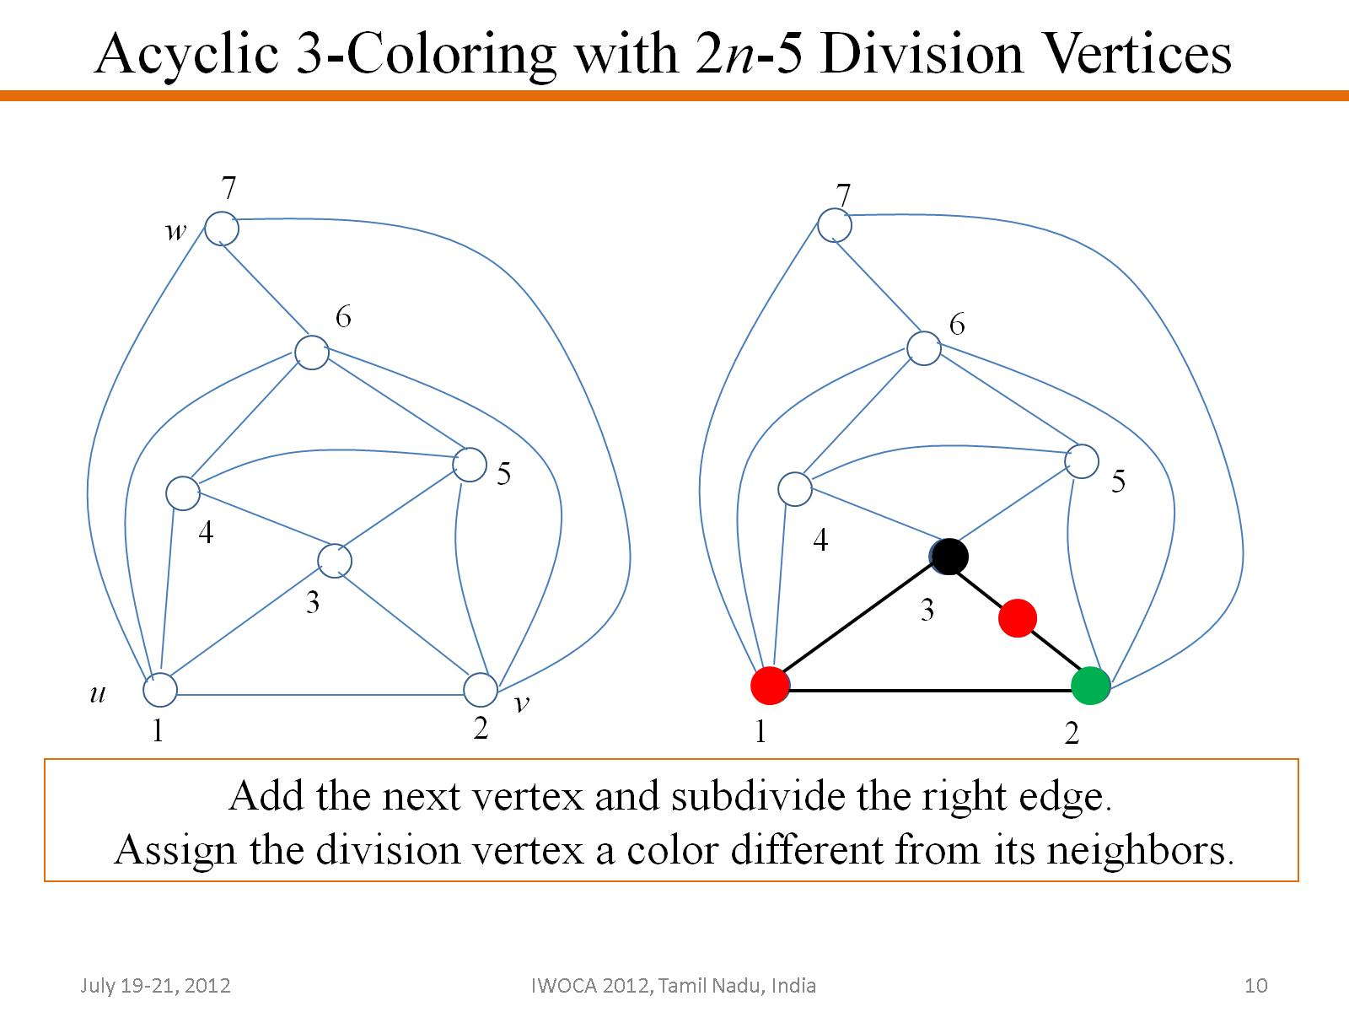
Acyclic 3-Coloring with 2n-5 Division Vertices

Slide 11
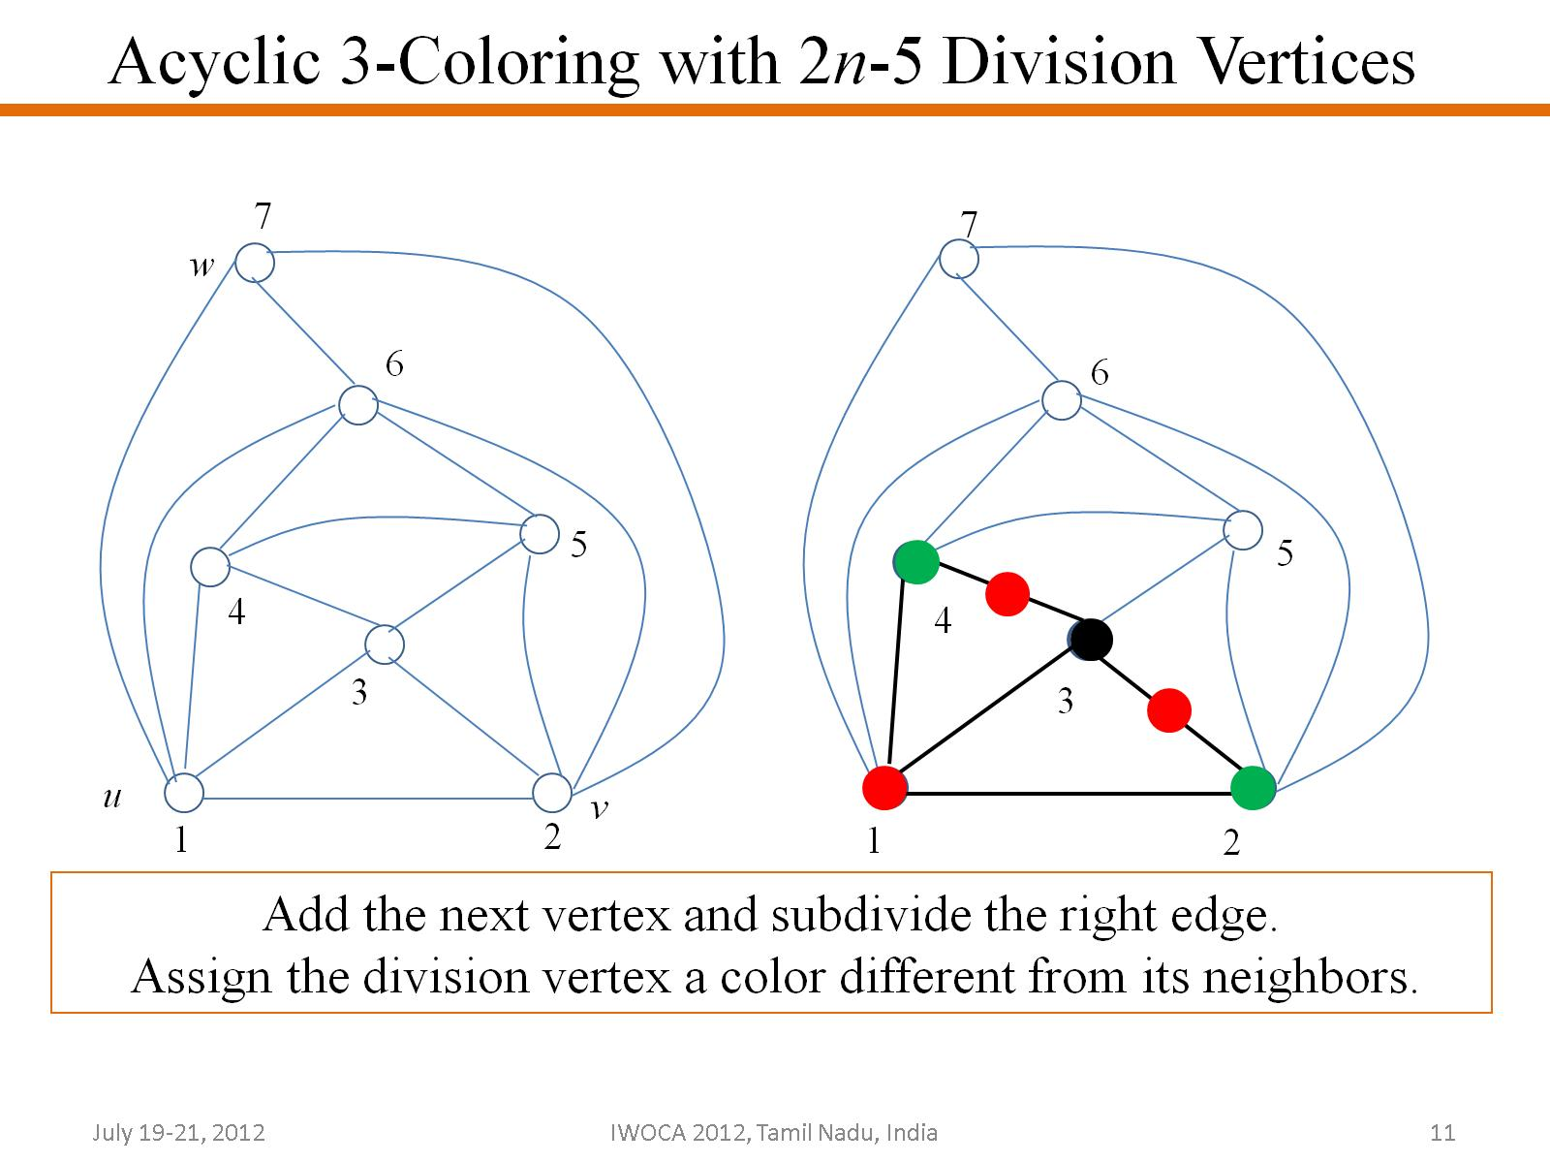
Acyclic 3-Coloring with 2n-5 Division Vertices

Slide 12
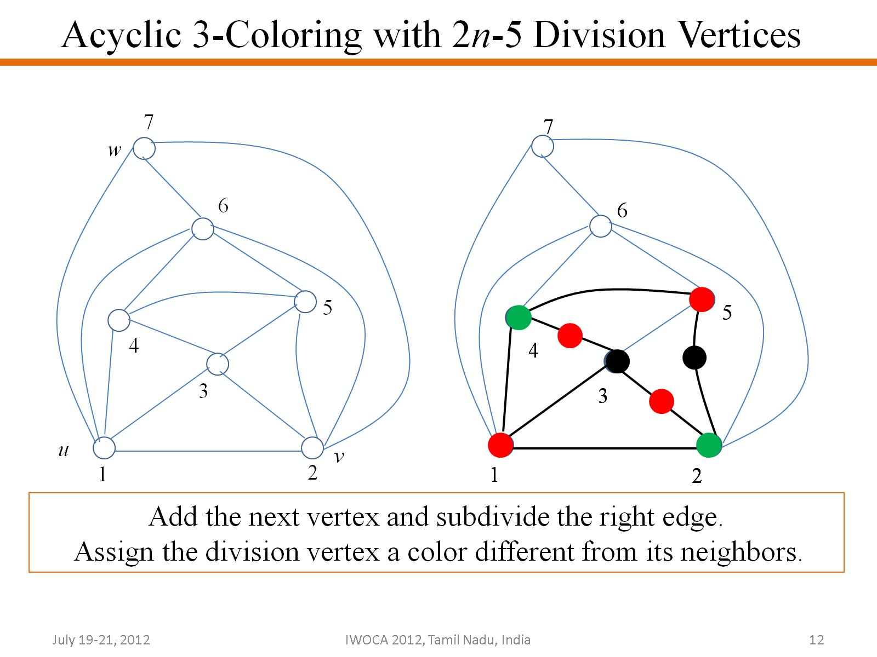
Acyclic 3-Coloring with 2n-5 Division Vertices

Slide 13
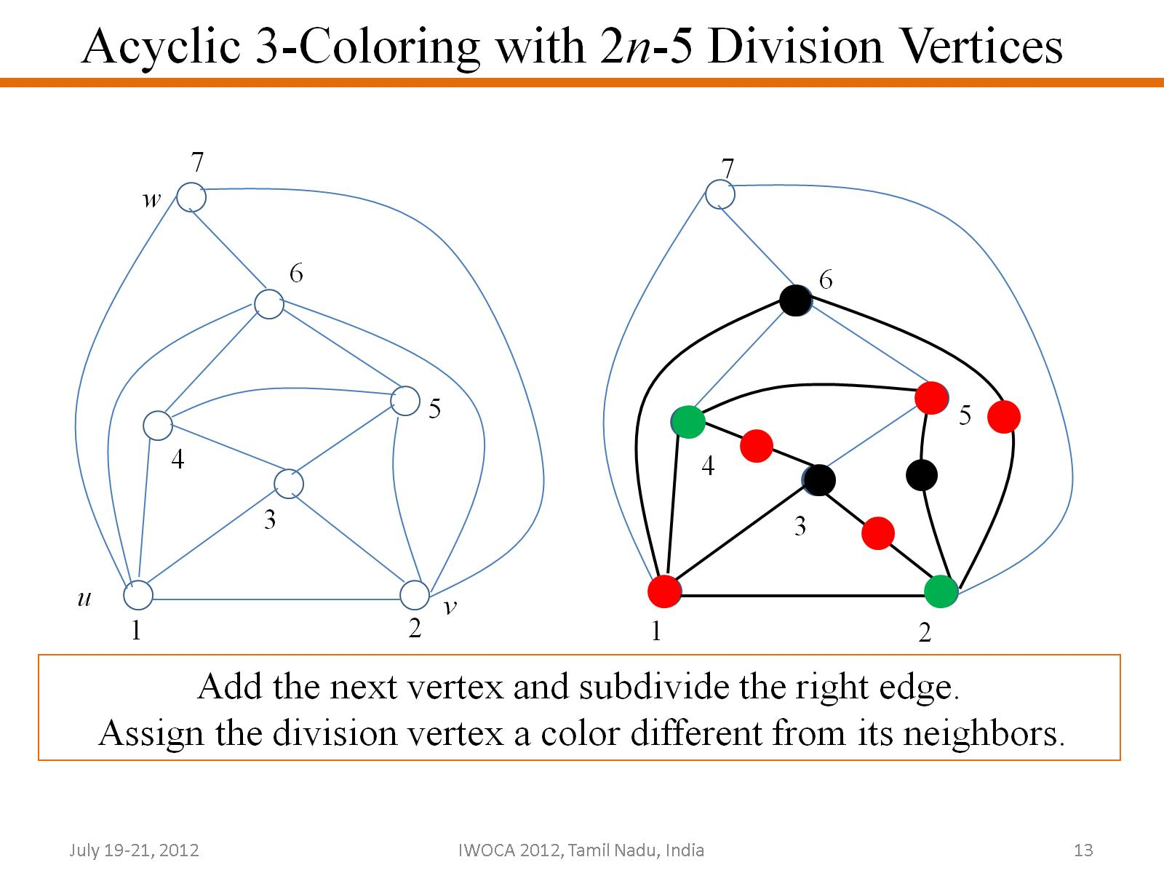
Acyclic 3-Coloring with 2n-5 Division Vertices

Slide 14
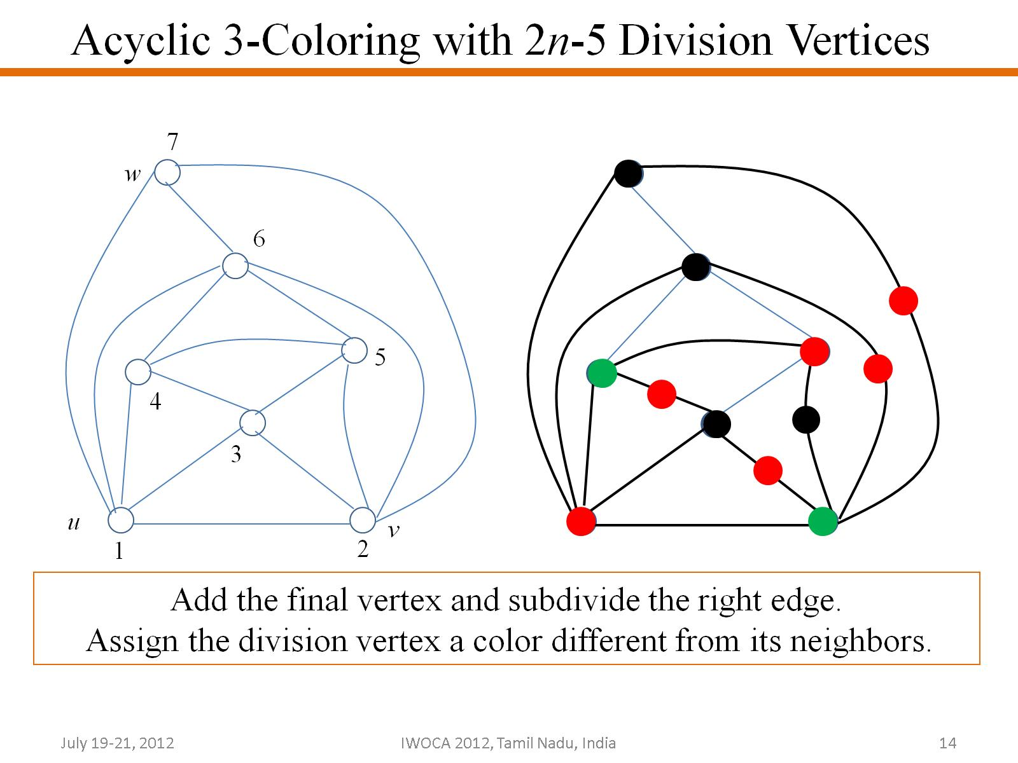
Acyclic 3-Coloring with 2n-5 Division Vertices

Slide 15
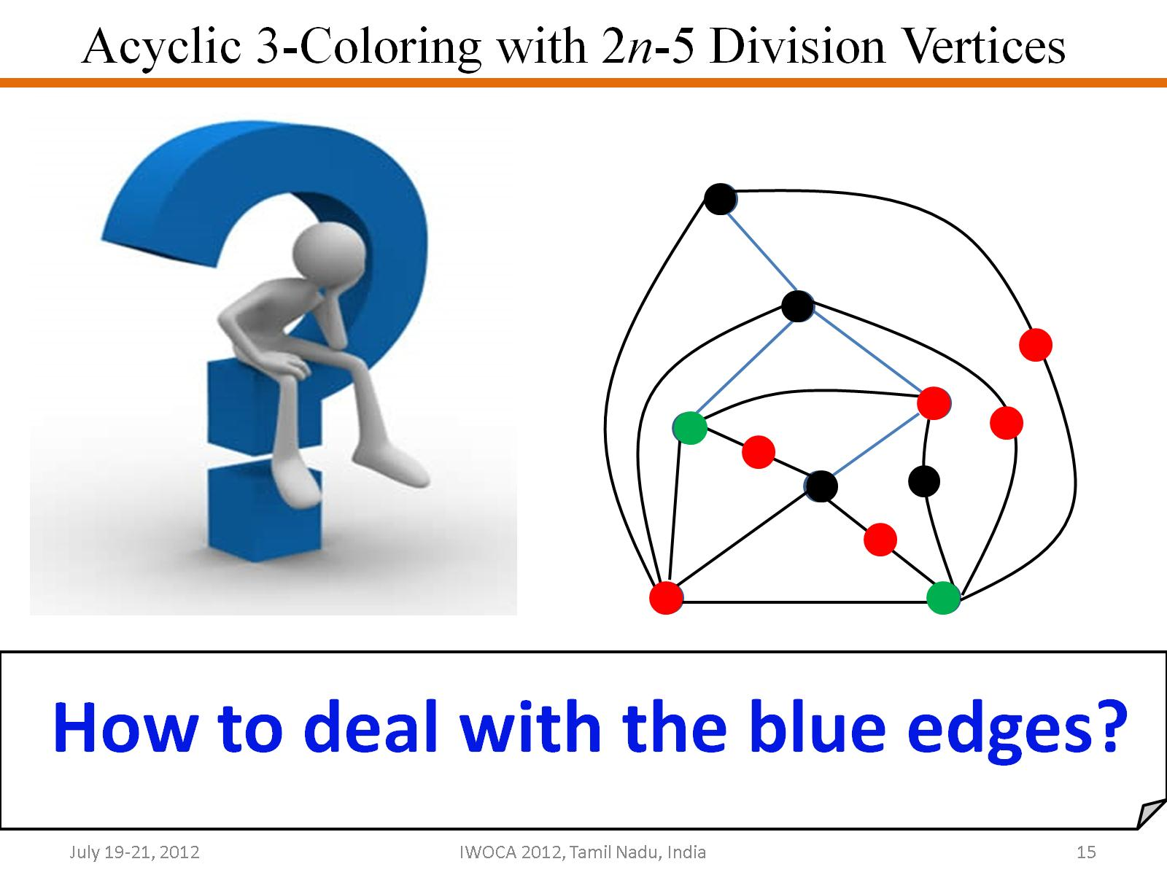
Acyclic 3-Coloring with 2n-5 Division Vertices

Slide 16
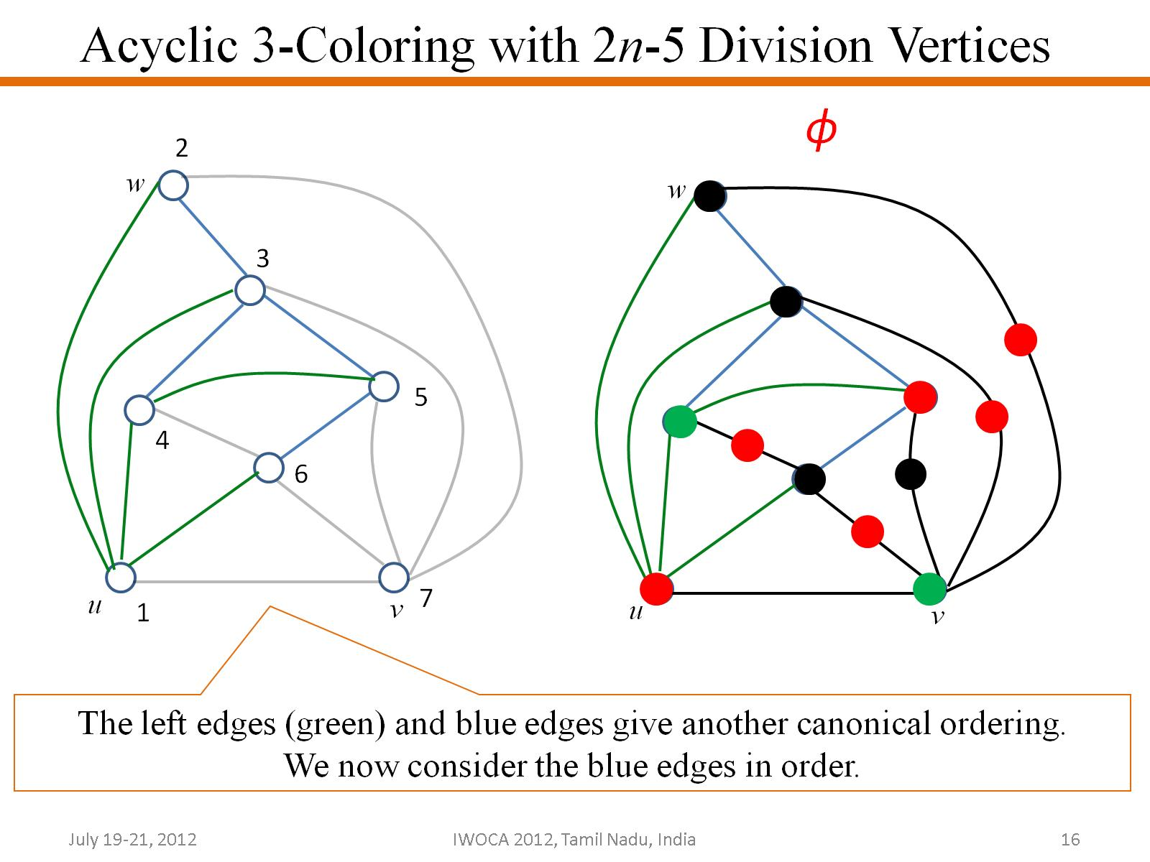
Acyclic 3-Coloring with 2n-5 Division Vertices

Slide 17
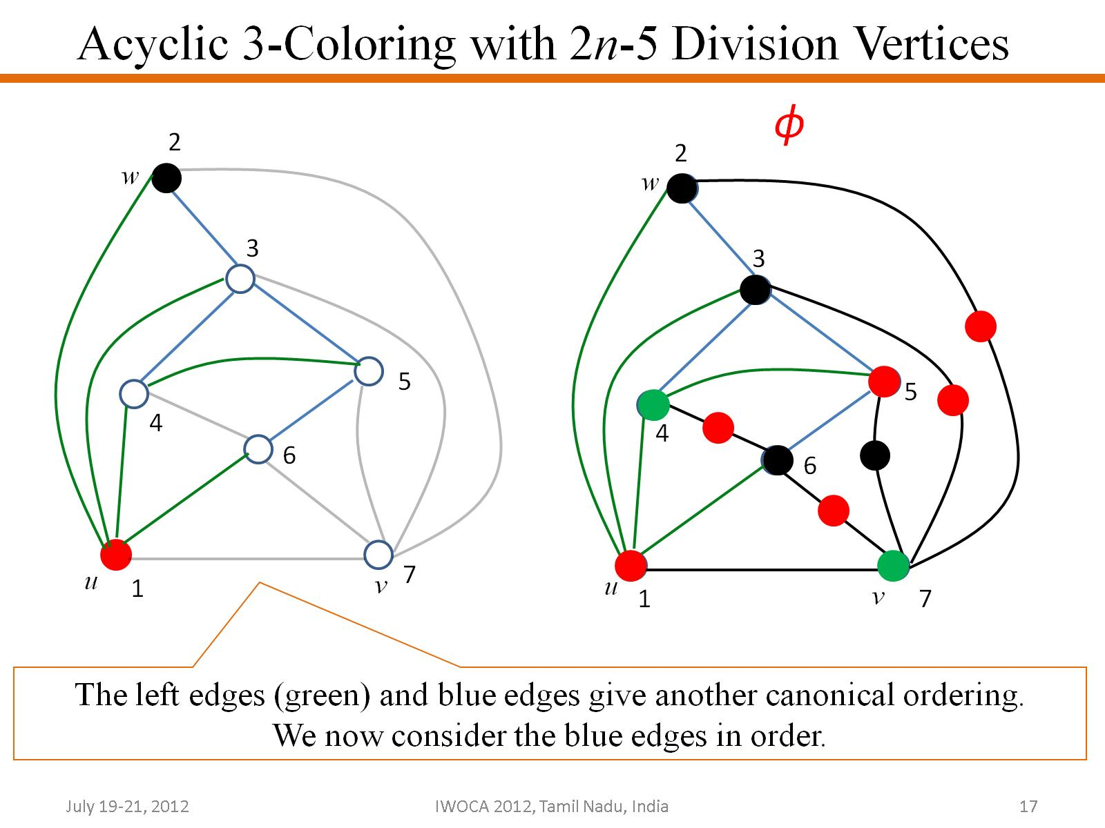
Acyclic 3-Coloring with 2n-5 Division Vertices

Slide 18
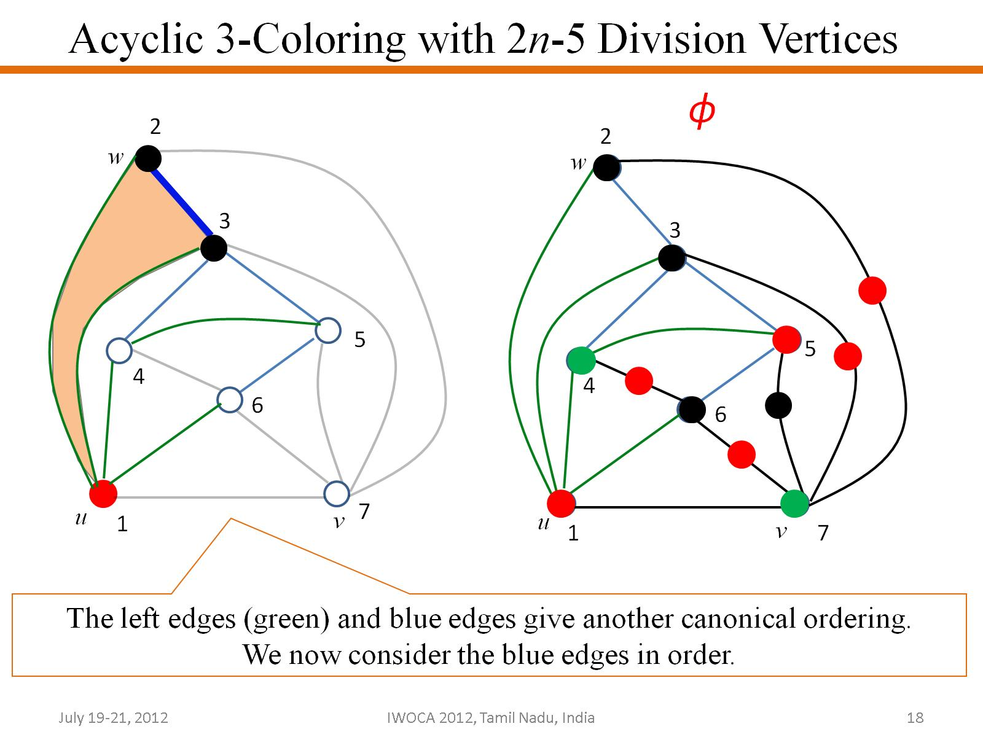
Acyclic 3-Coloring with 2n-5 Division Vertices

Slide 19
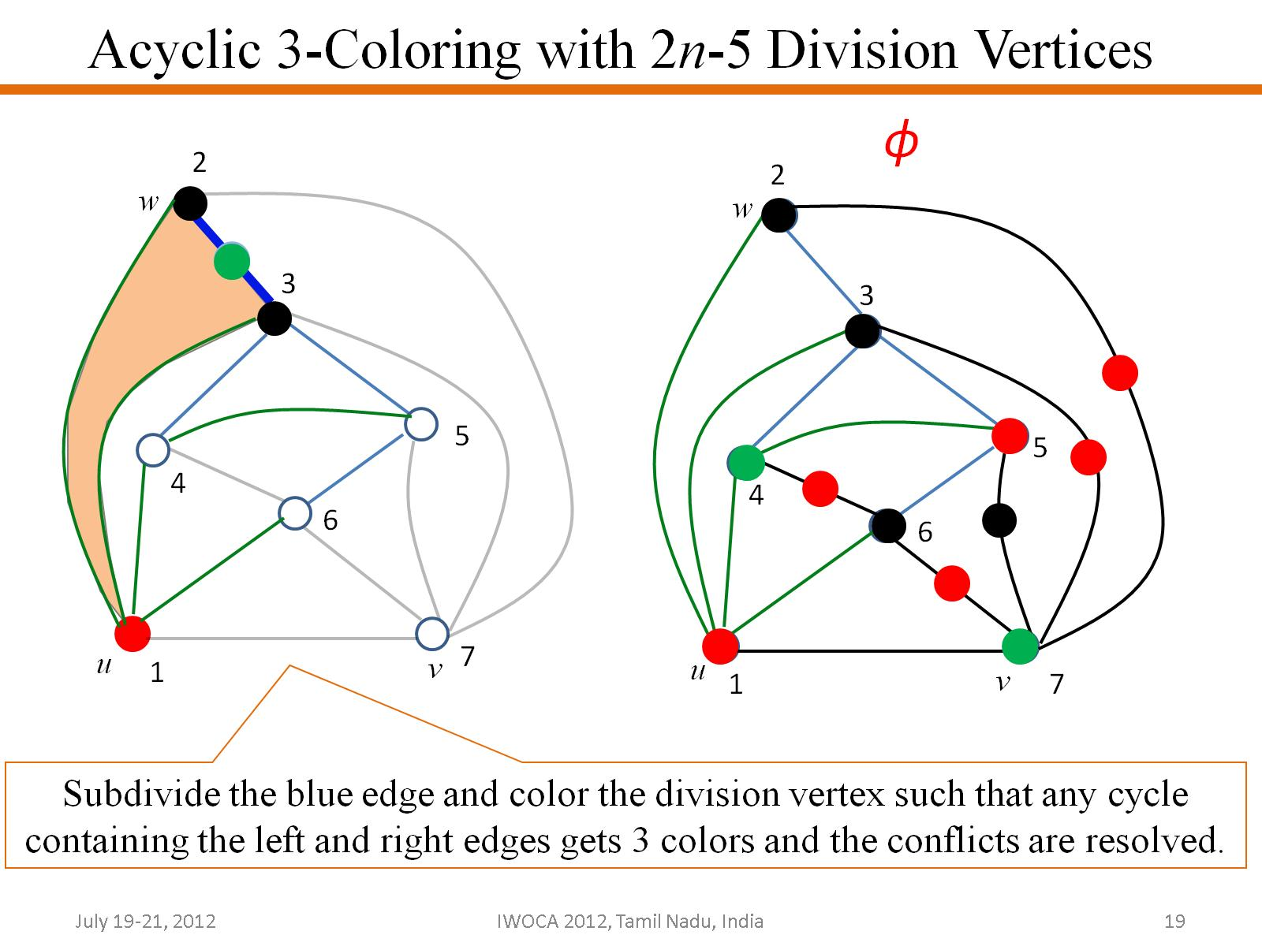
Acyclic 3-Coloring with 2n-5 Division Vertices

Slide 20

Acyclic 3-Coloring with 2n-5 Division Vertices

Slide 21
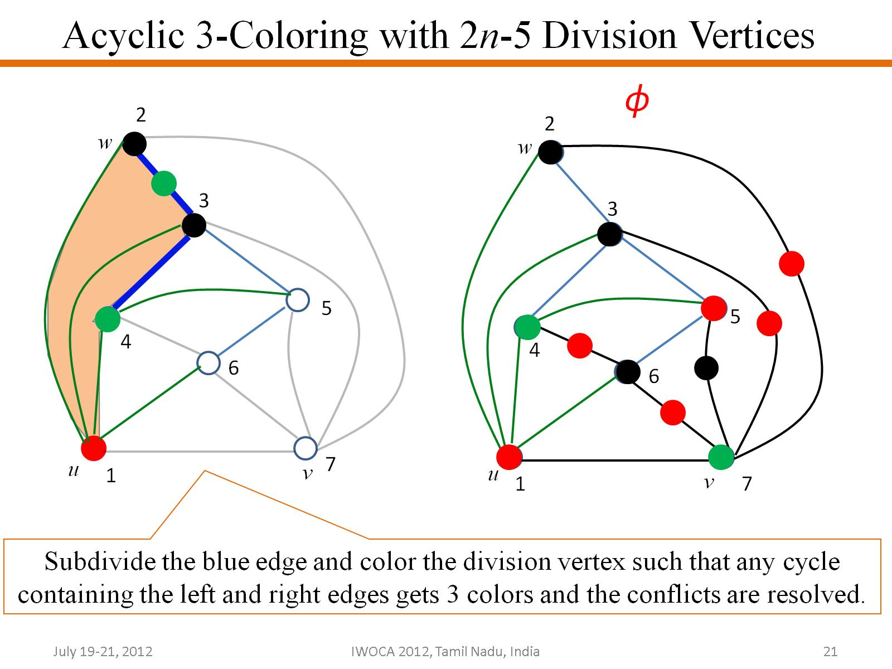
Acyclic 3-Coloring with 2n-5 Division Vertices

Slide 22
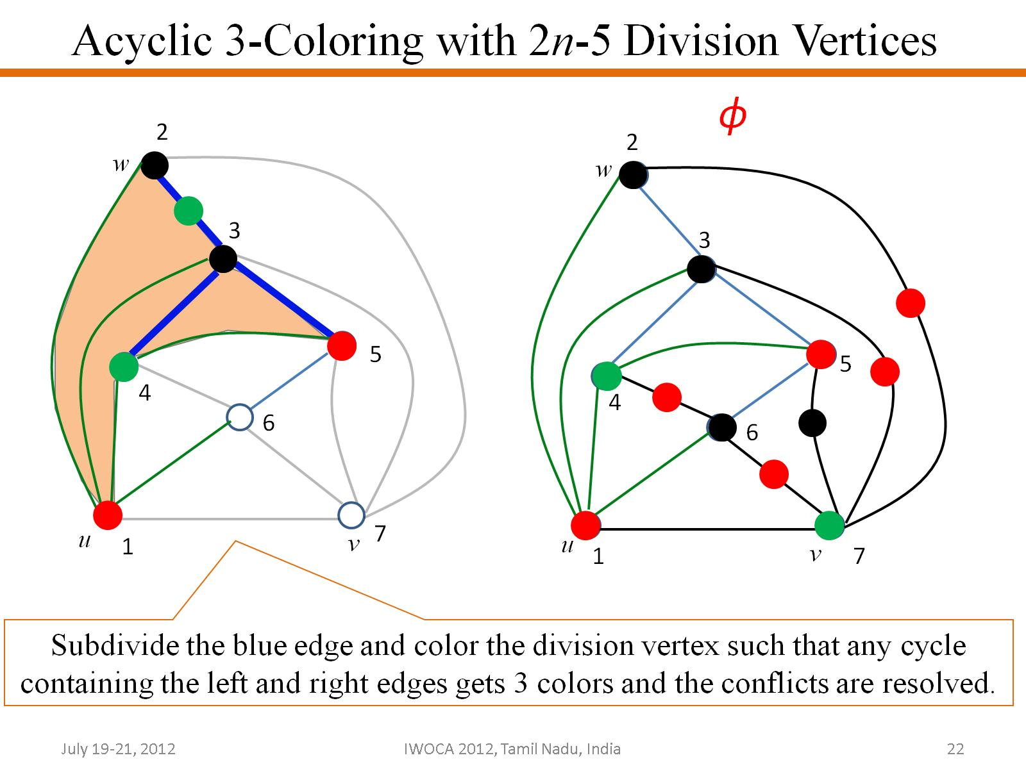
Acyclic 3-Coloring with 2n-5 Division Vertices

Slide 23
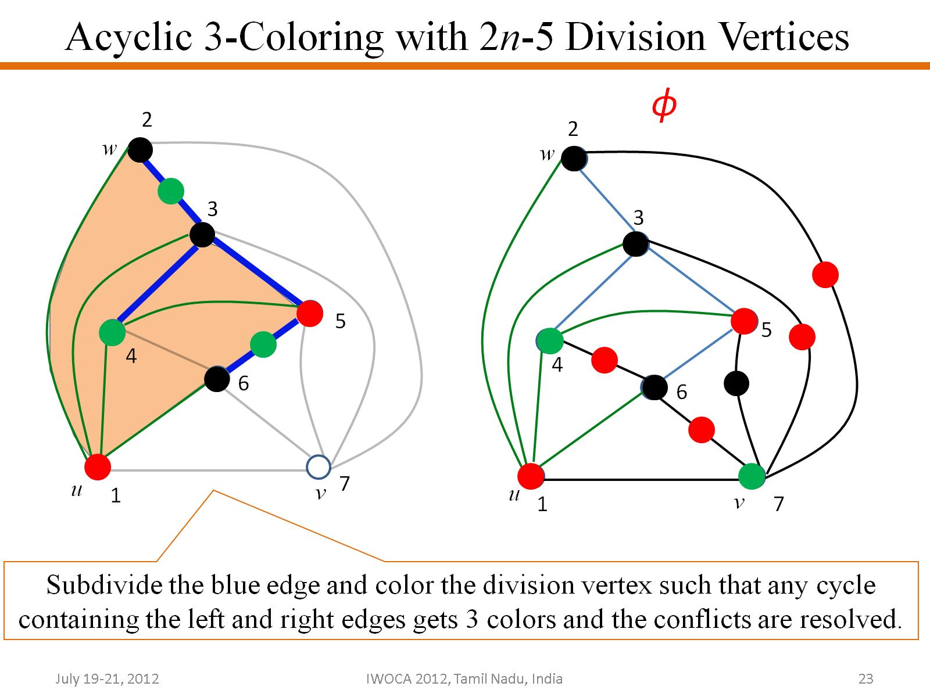
Acyclic 3-Coloring with 2n-5 Division Vertices

Slide 24
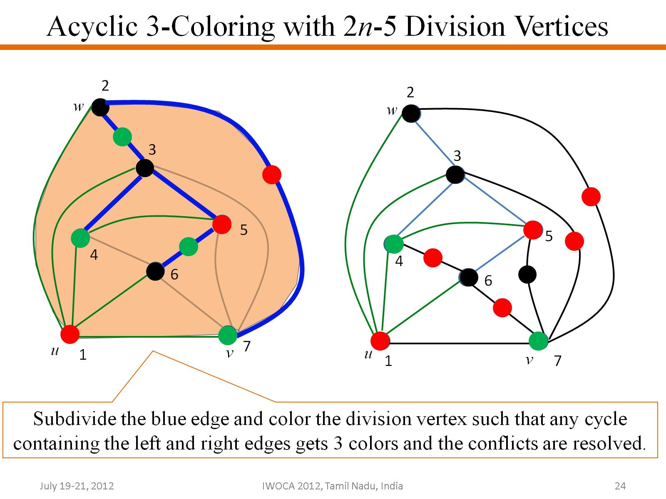
Acyclic 3-Coloring with 2n-5 Division Vertices

Slide 25
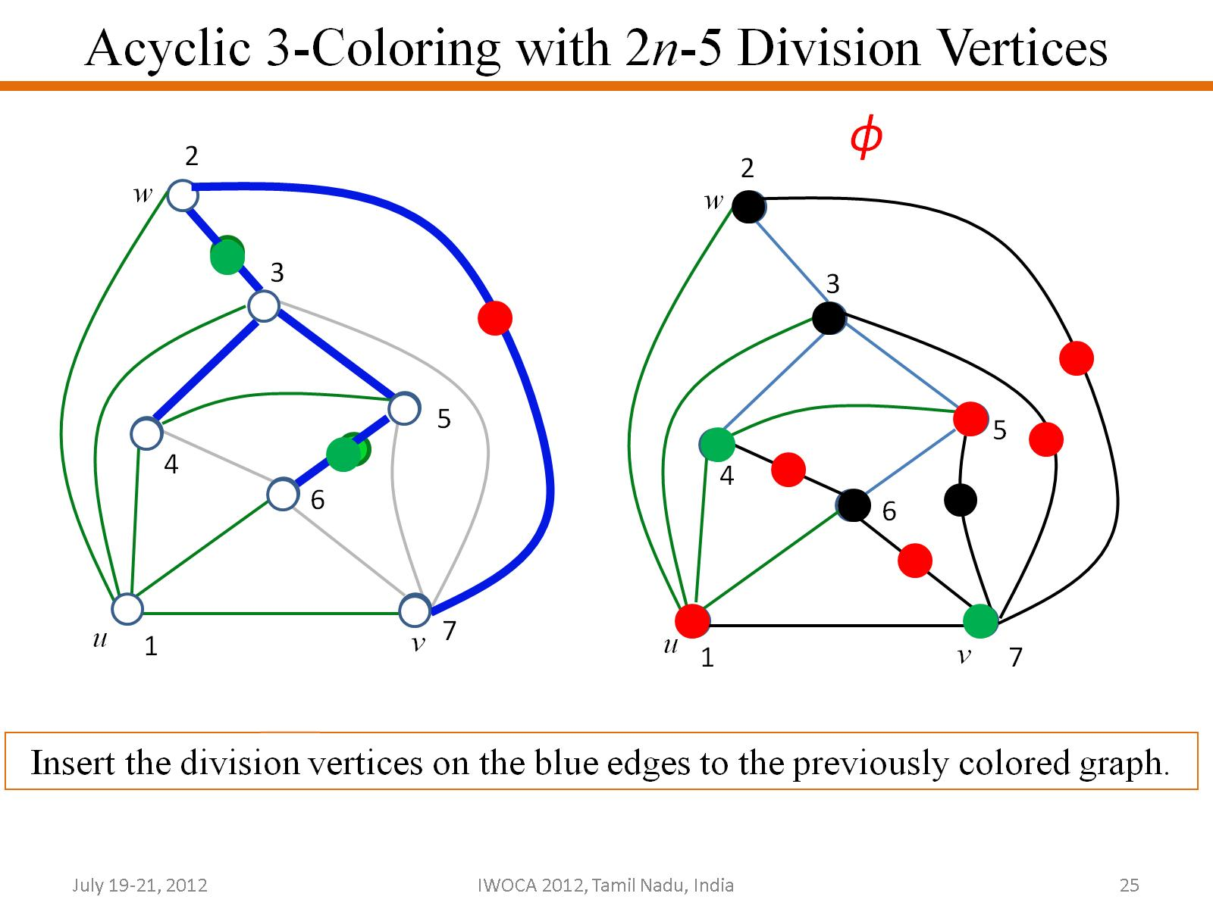
Acyclic 3-Coloring with 2n-5 Division Vertices

Slide 26
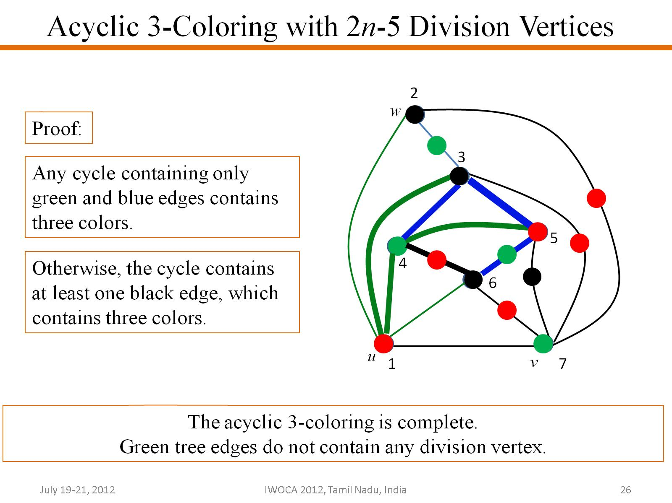
Acyclic 3-Coloring with 2n-5 Division Vertices

Slide 27
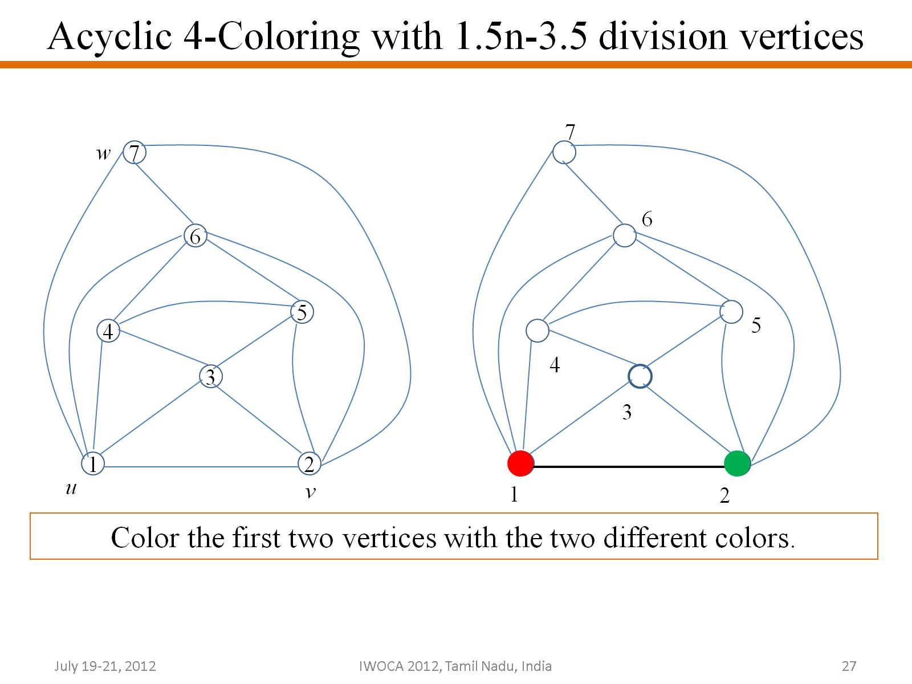
Acyclic 4-Coloring with 1.5n-3.5 division vertices

Slide 28
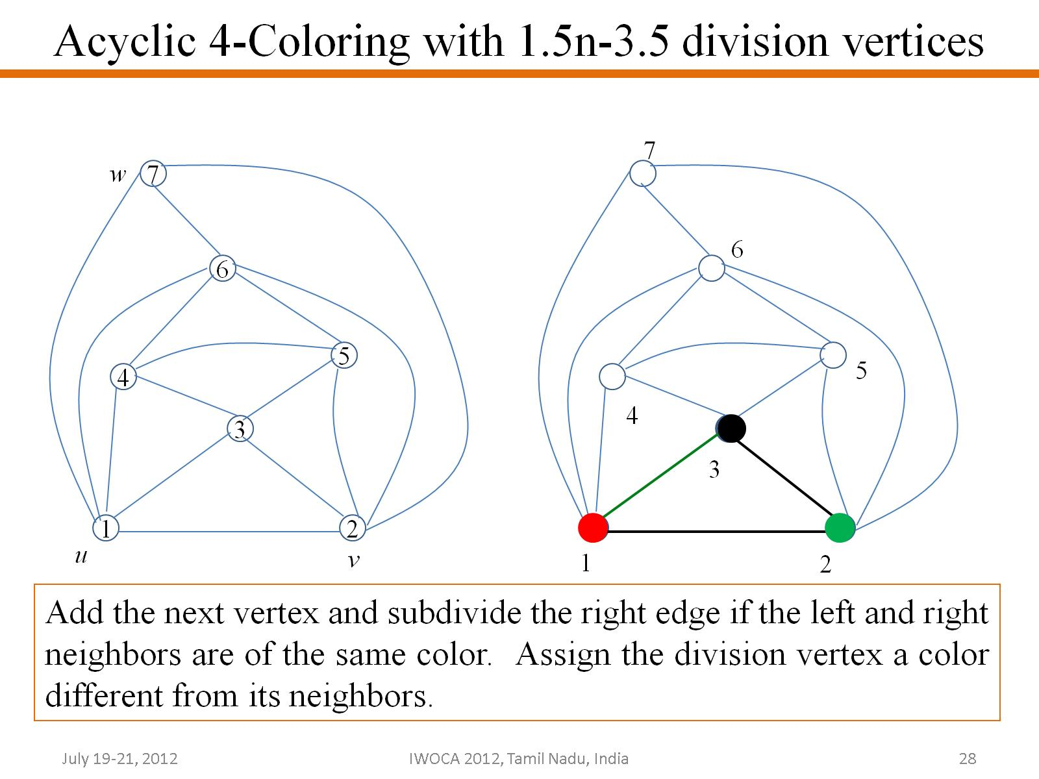
Acyclic 4-Coloring with 1.5n-3.5 division vertices

Slide 29
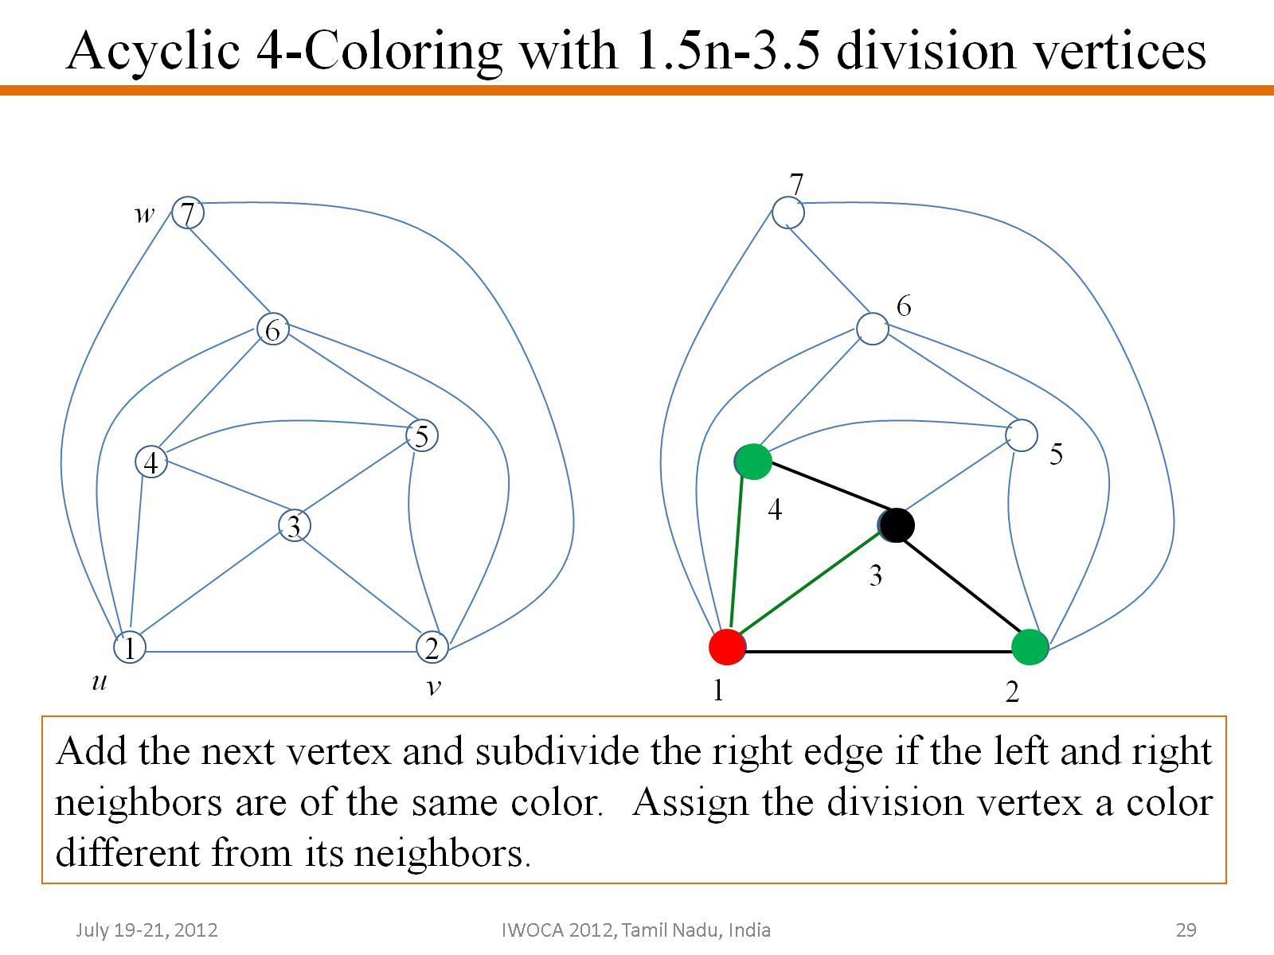
Acyclic 4-Coloring with 1.5n-3.5 division vertices

Slide 30
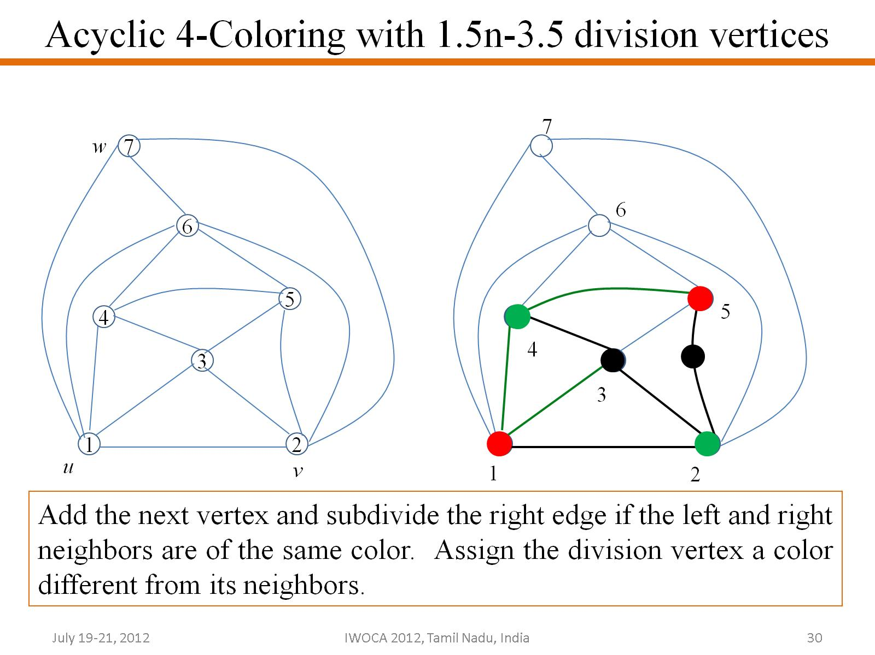
Acyclic 4-Coloring with 1.5n-3.5 division vertices

Slide 31
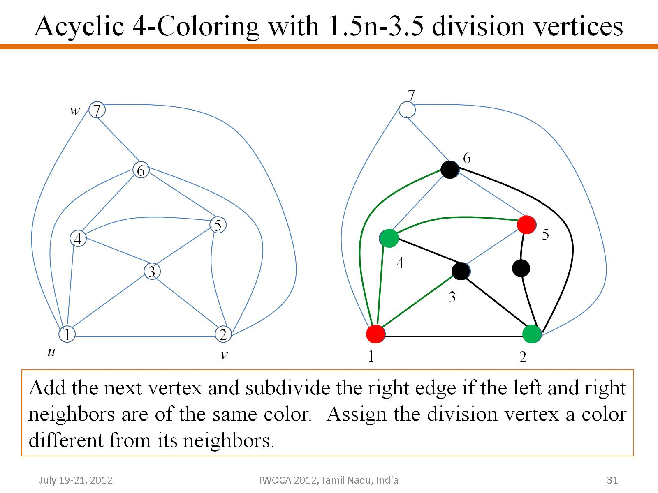
Acyclic 4-Coloring with 1.5n-3.5 division vertices

Slide 32
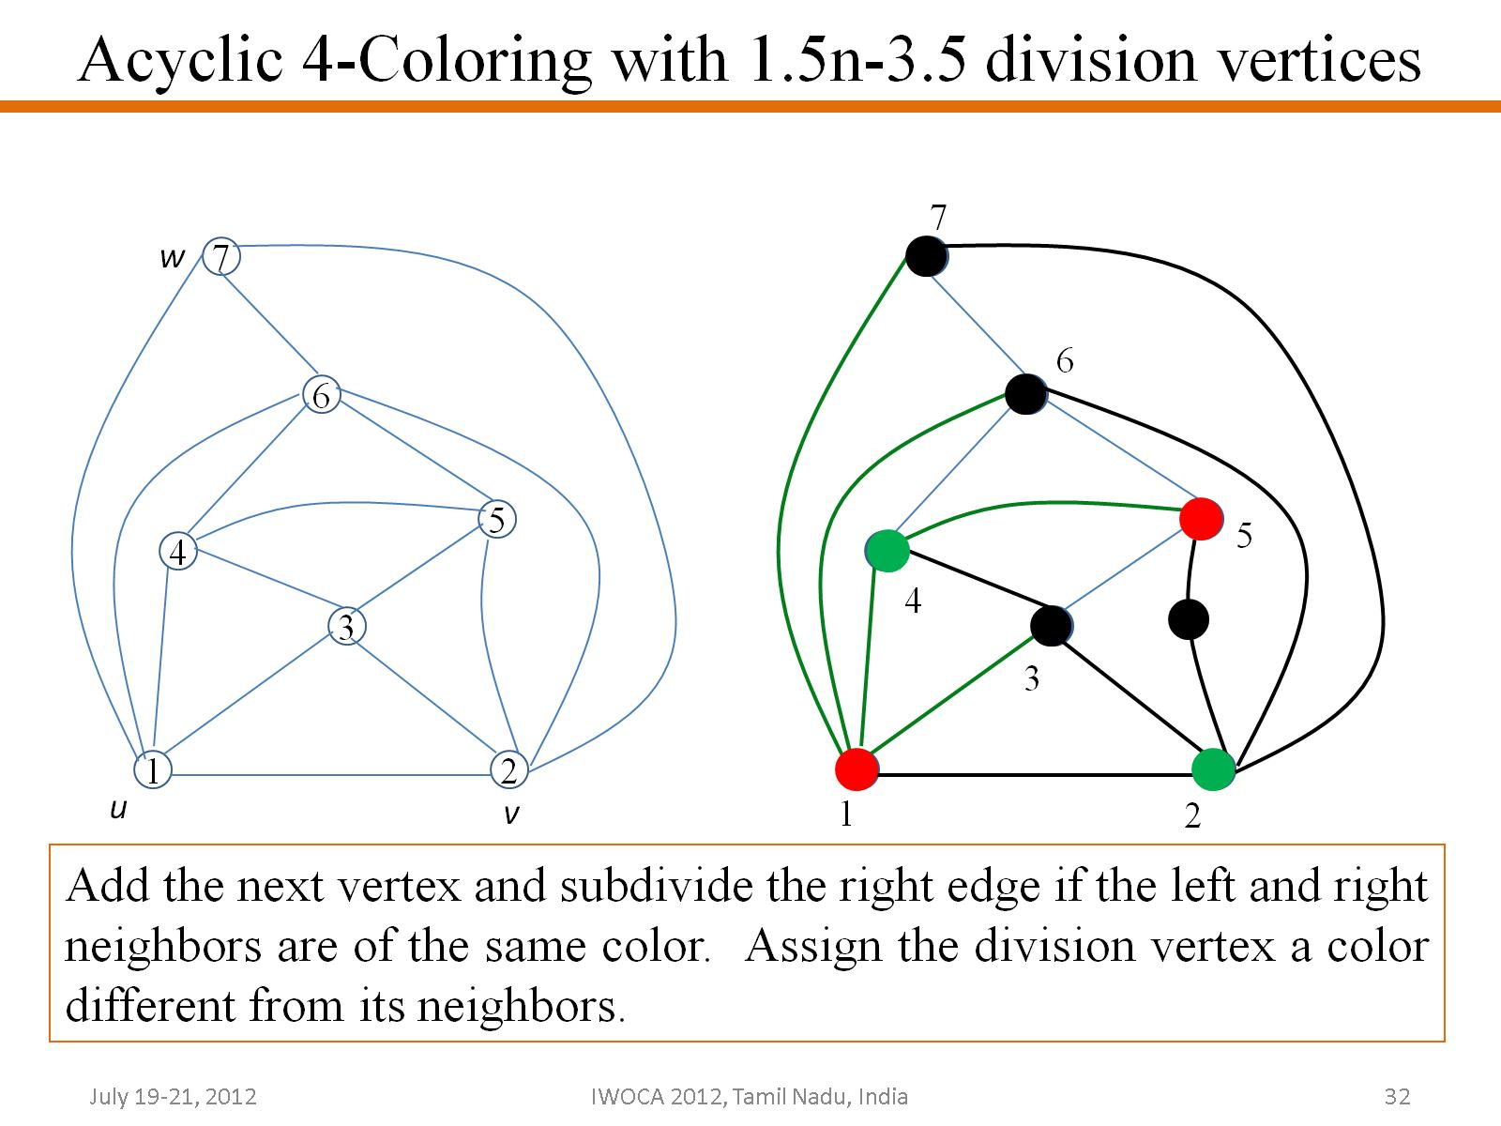
Acyclic 4-Coloring with 1.5n-3.5 division vertices

Slide 33
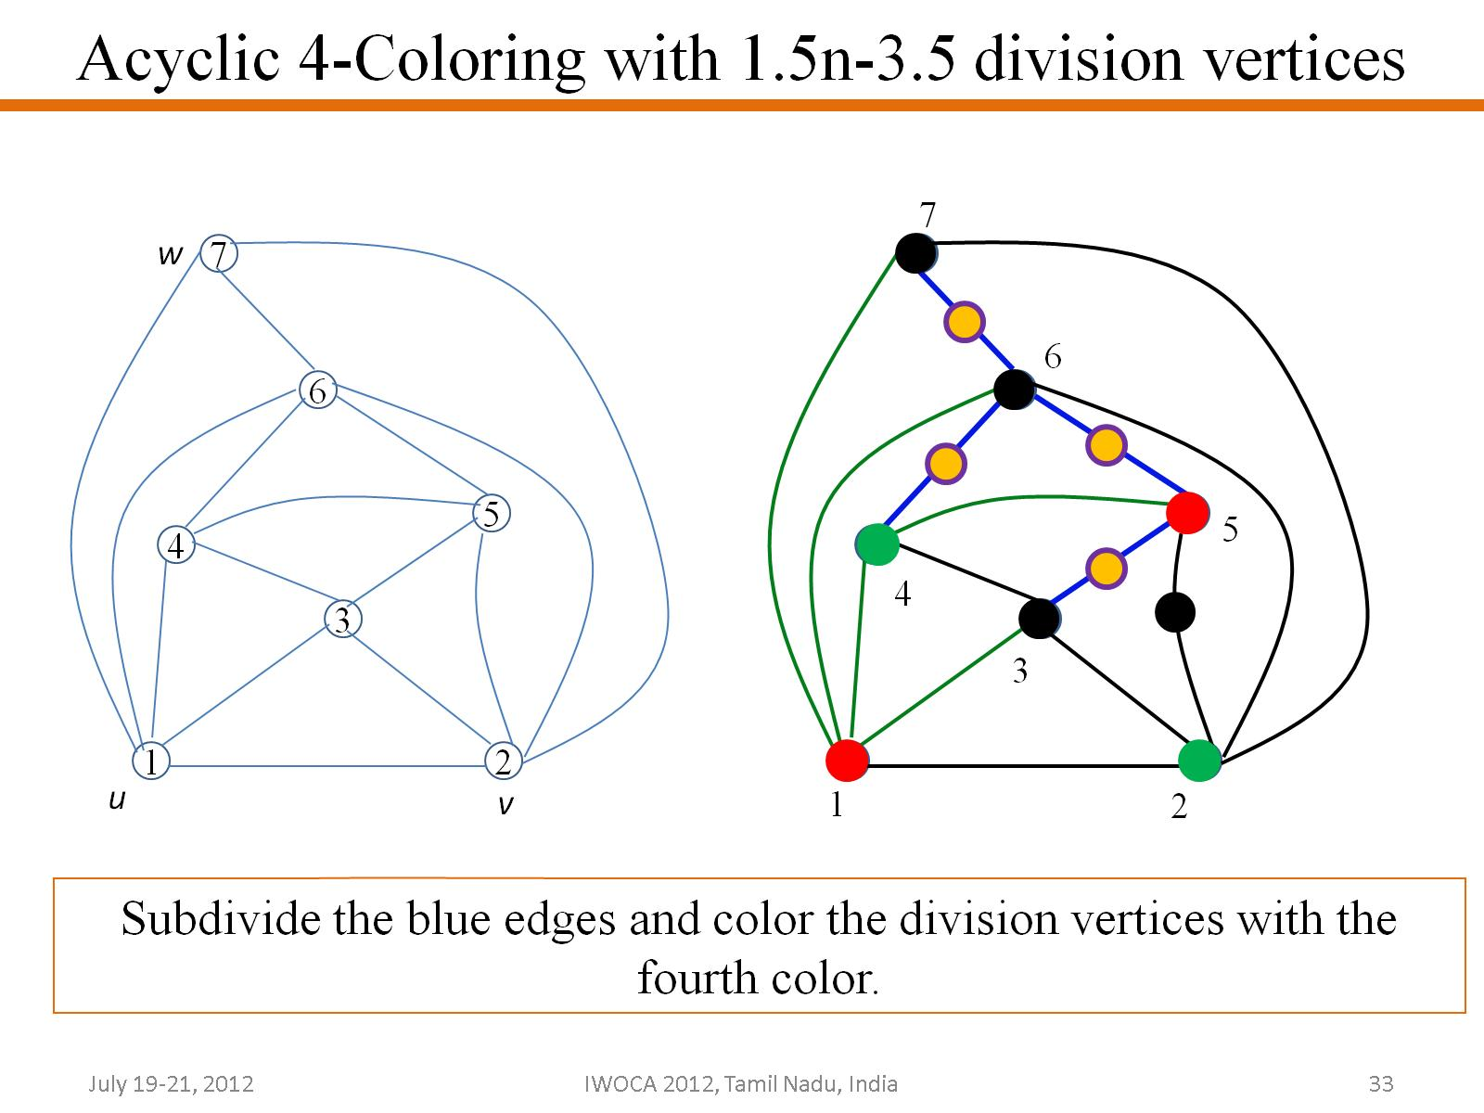
Acyclic 4-Coloring with 1.5n-3.5 division vertices

Slide 34
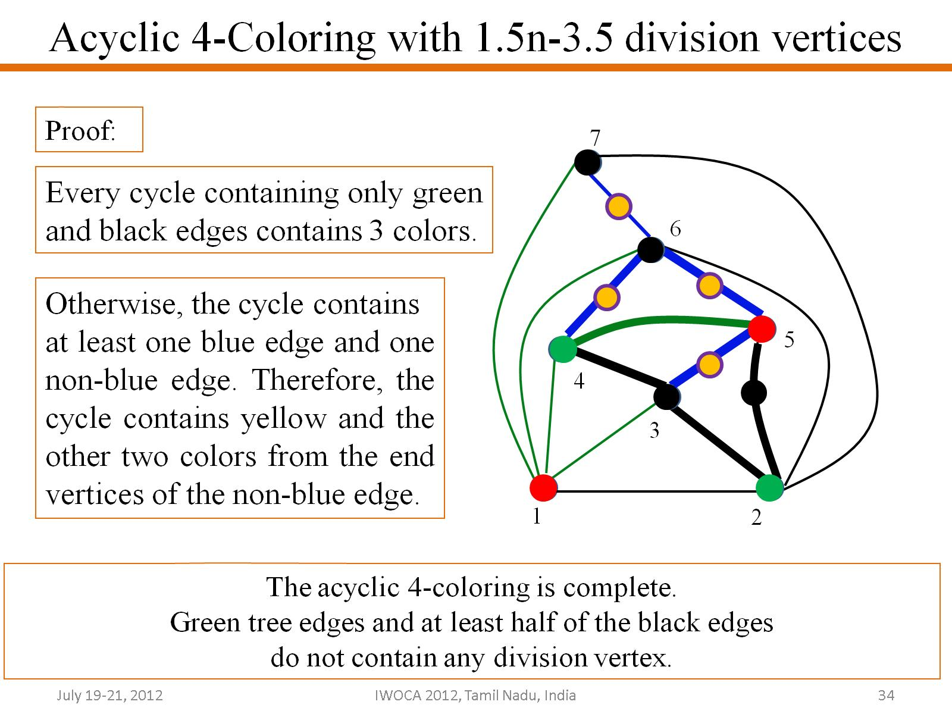
Acyclic 4-Coloring with 1.5n-3.5 division vertices

Slide 35
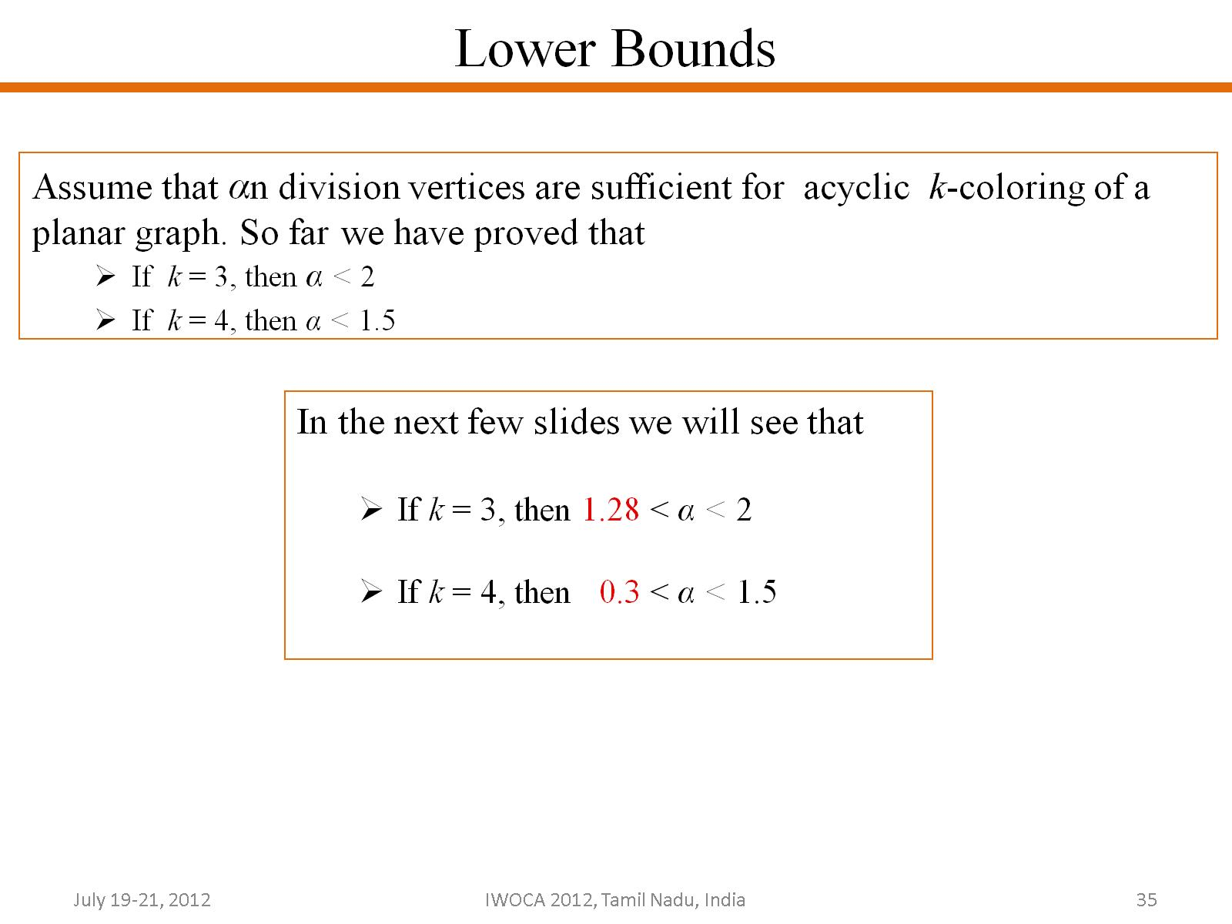
Lower Bounds

Slide 36
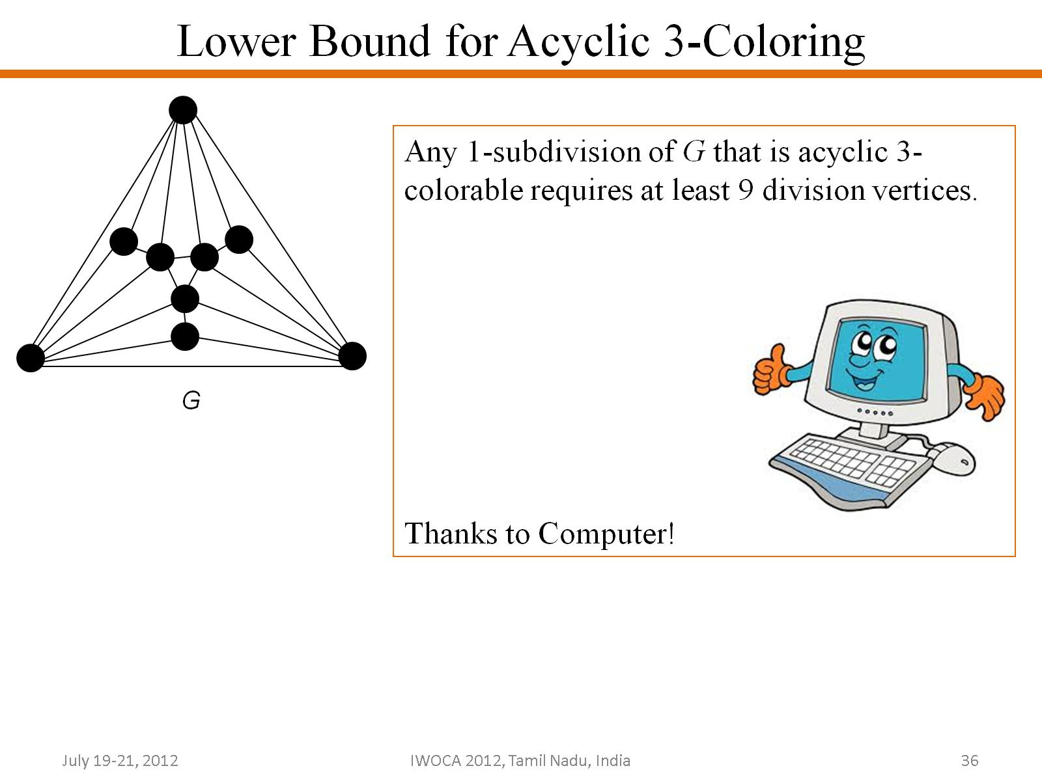
Lower Bound for Acyclic 3-Coloring

Slide 37
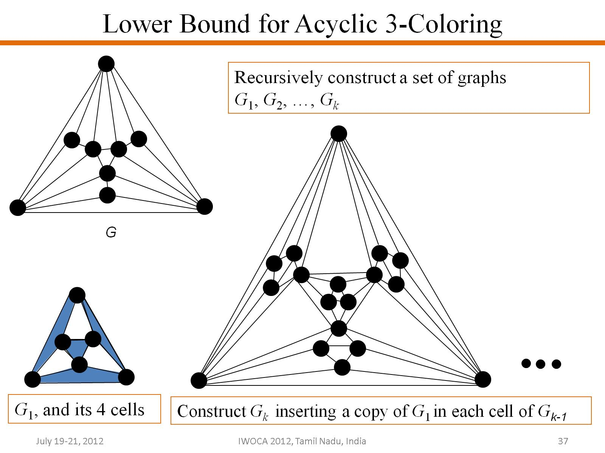
Lower Bound for Acyclic 3-Coloring

Slide 38
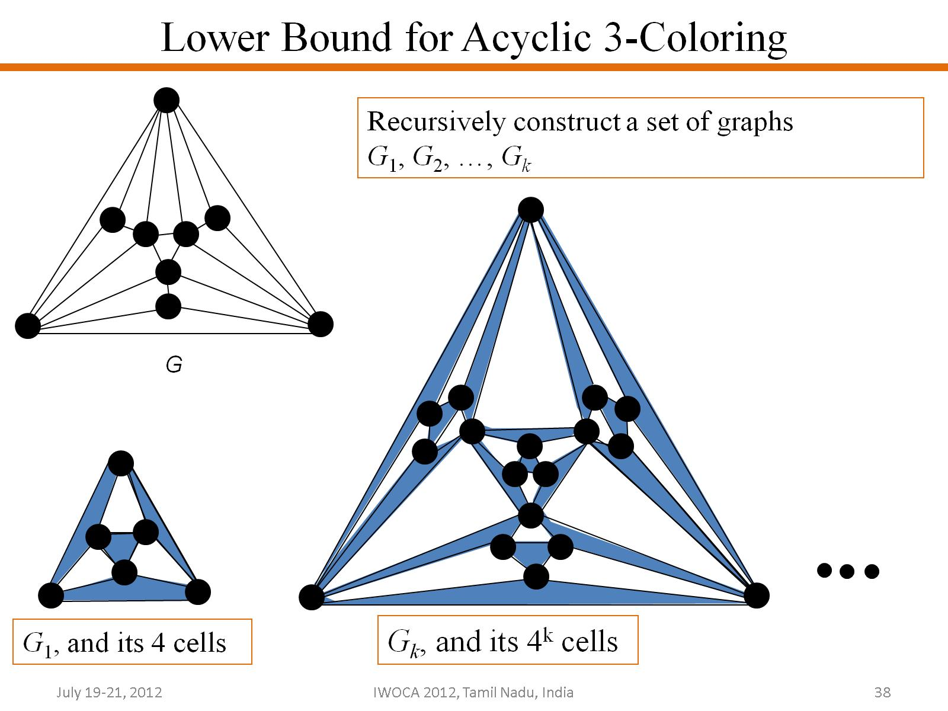
Lower Bound for Acyclic 3-Coloring

Slide 39
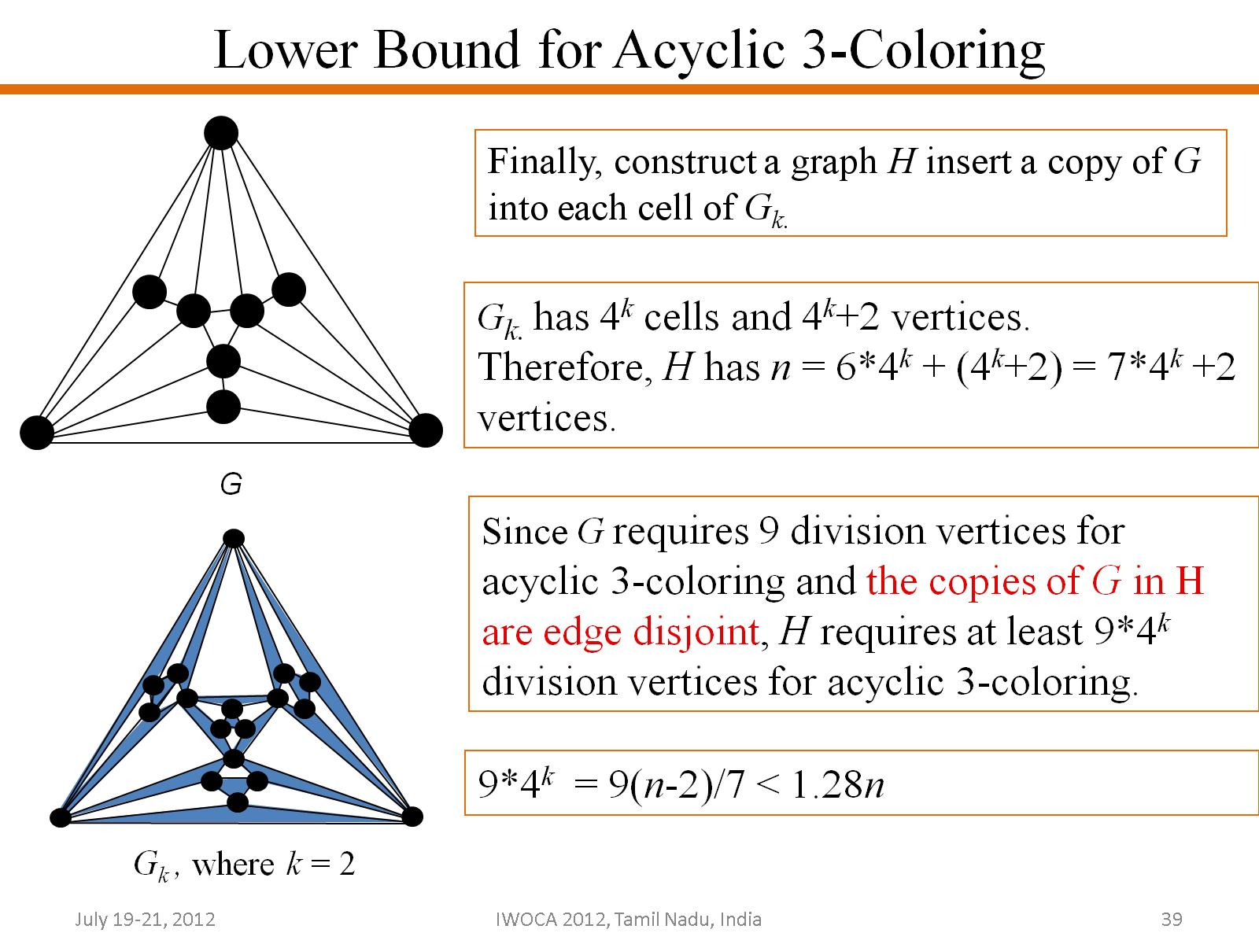
Lower Bound for Acyclic 3-Coloring

Slide 40
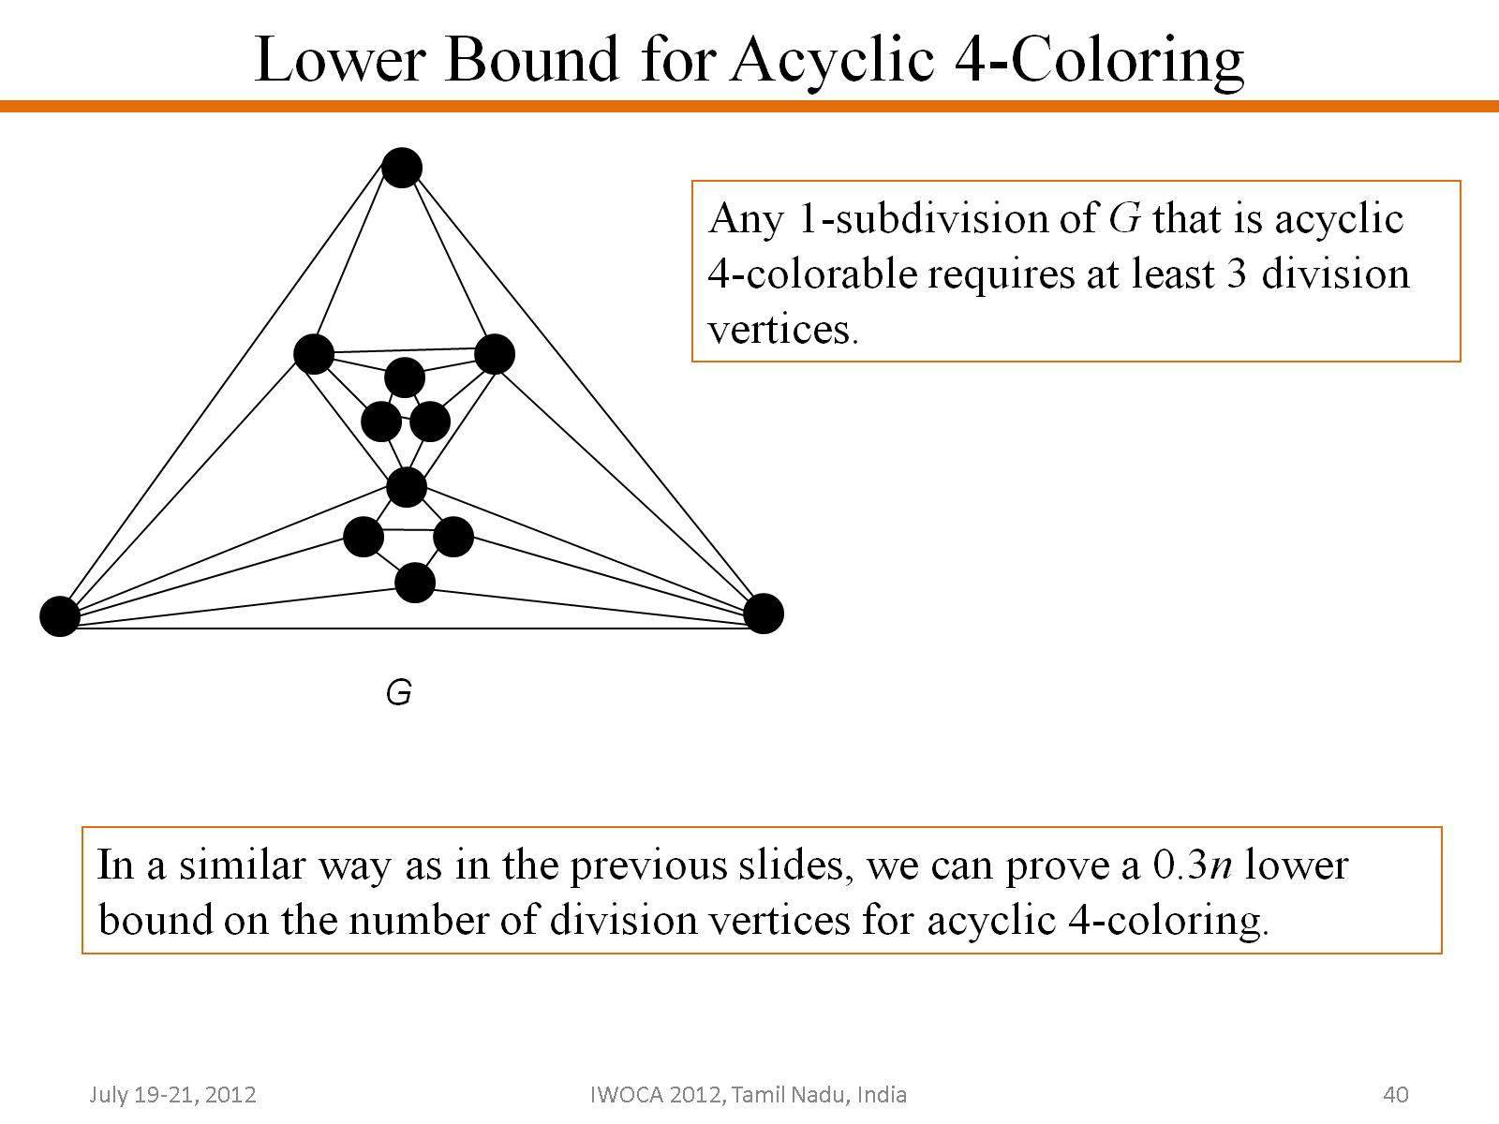
Lower Bound for Acyclic 4-Coloring

Slide 41
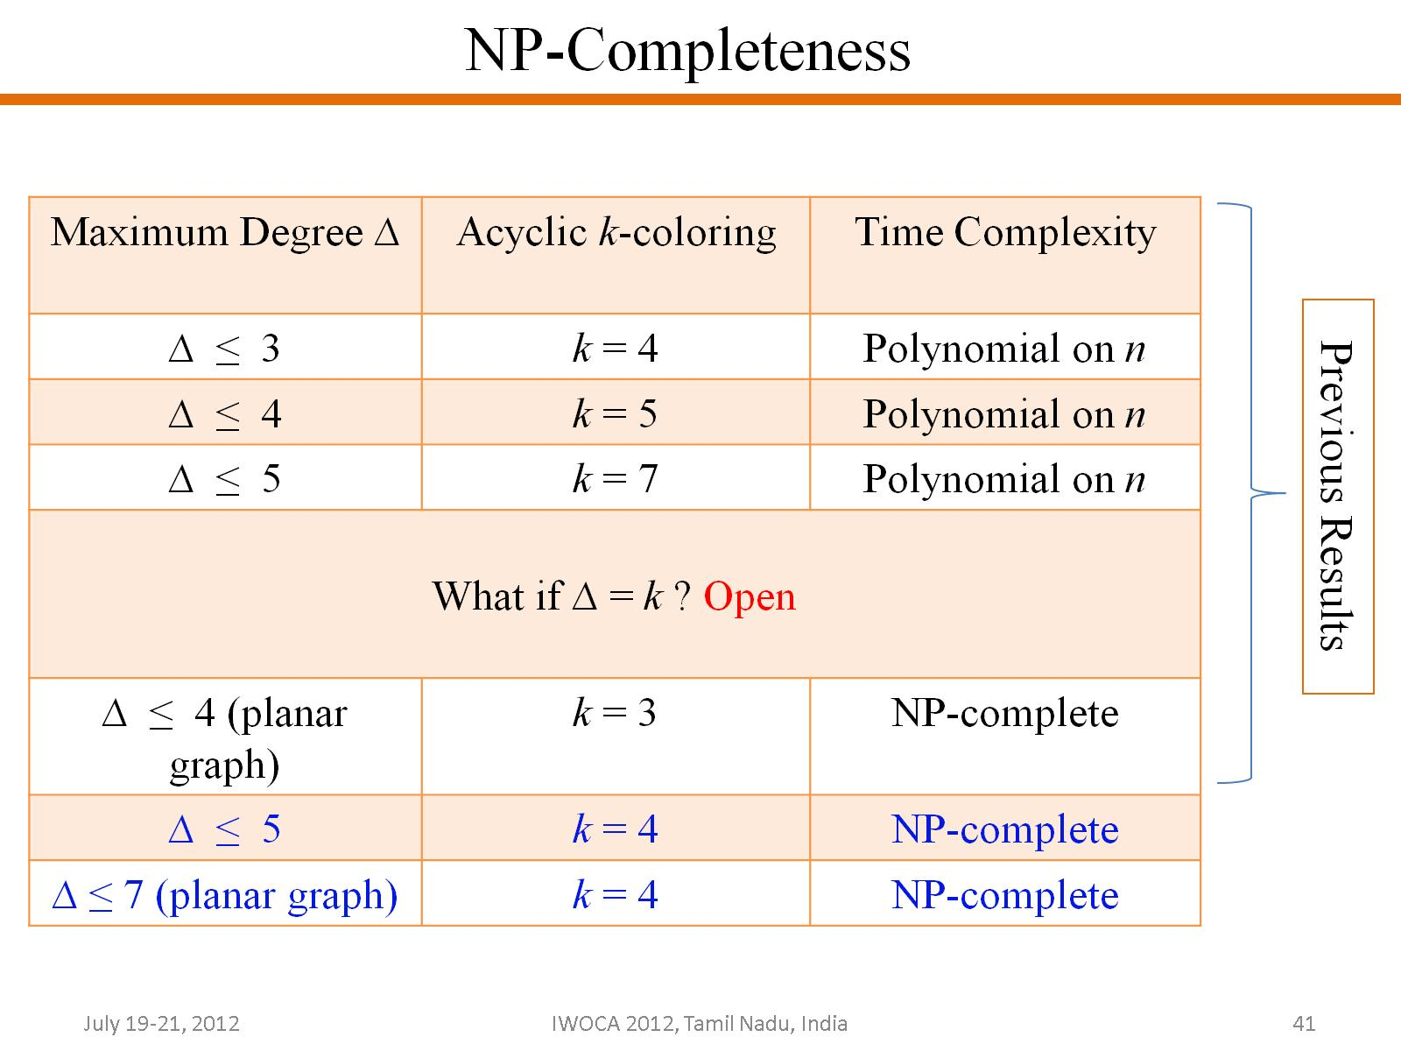

Slide 42
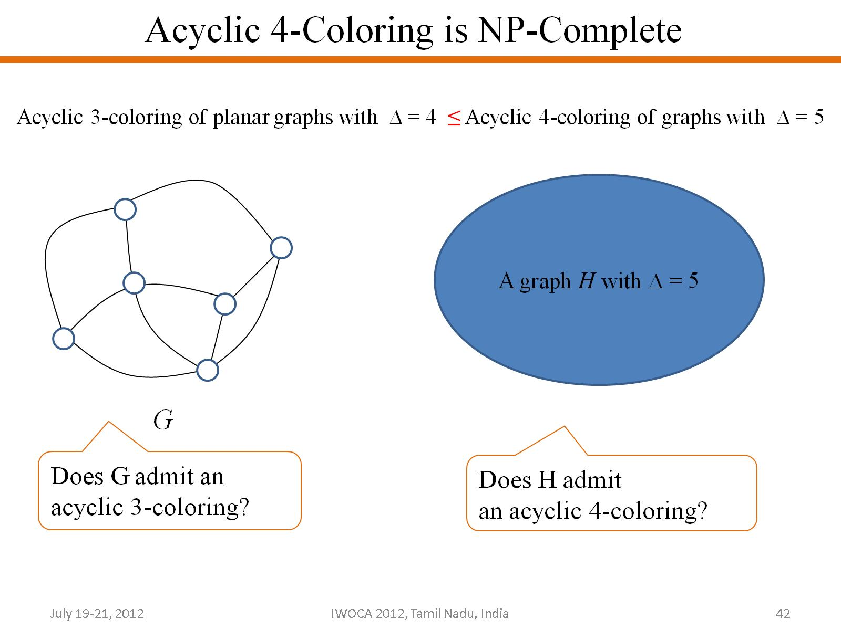

Slide 43
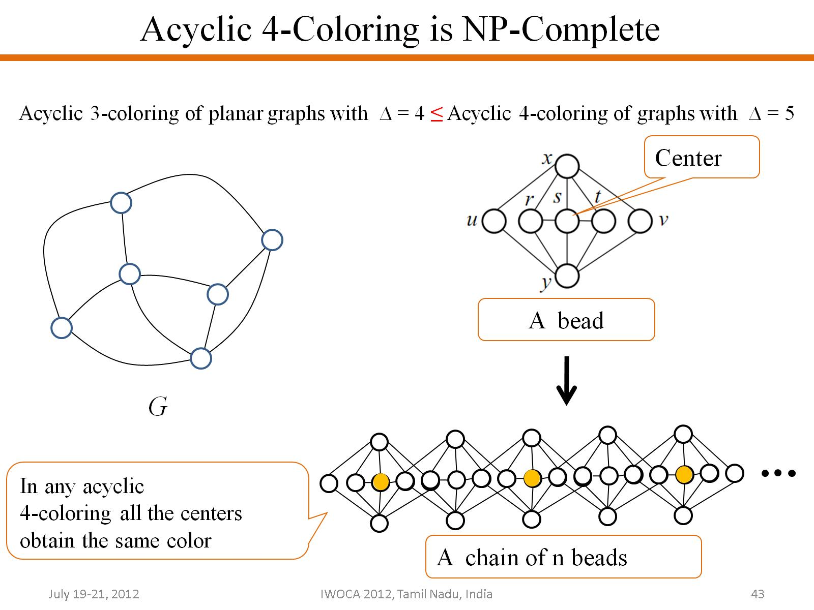

Slide 44
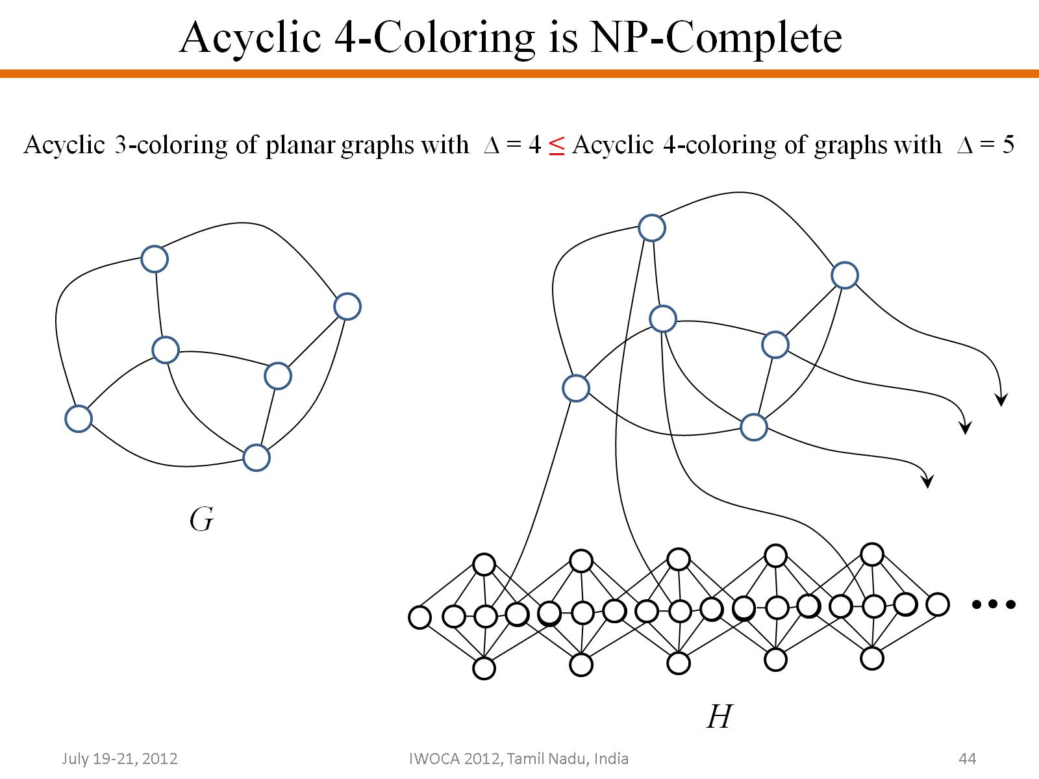

Slide 45
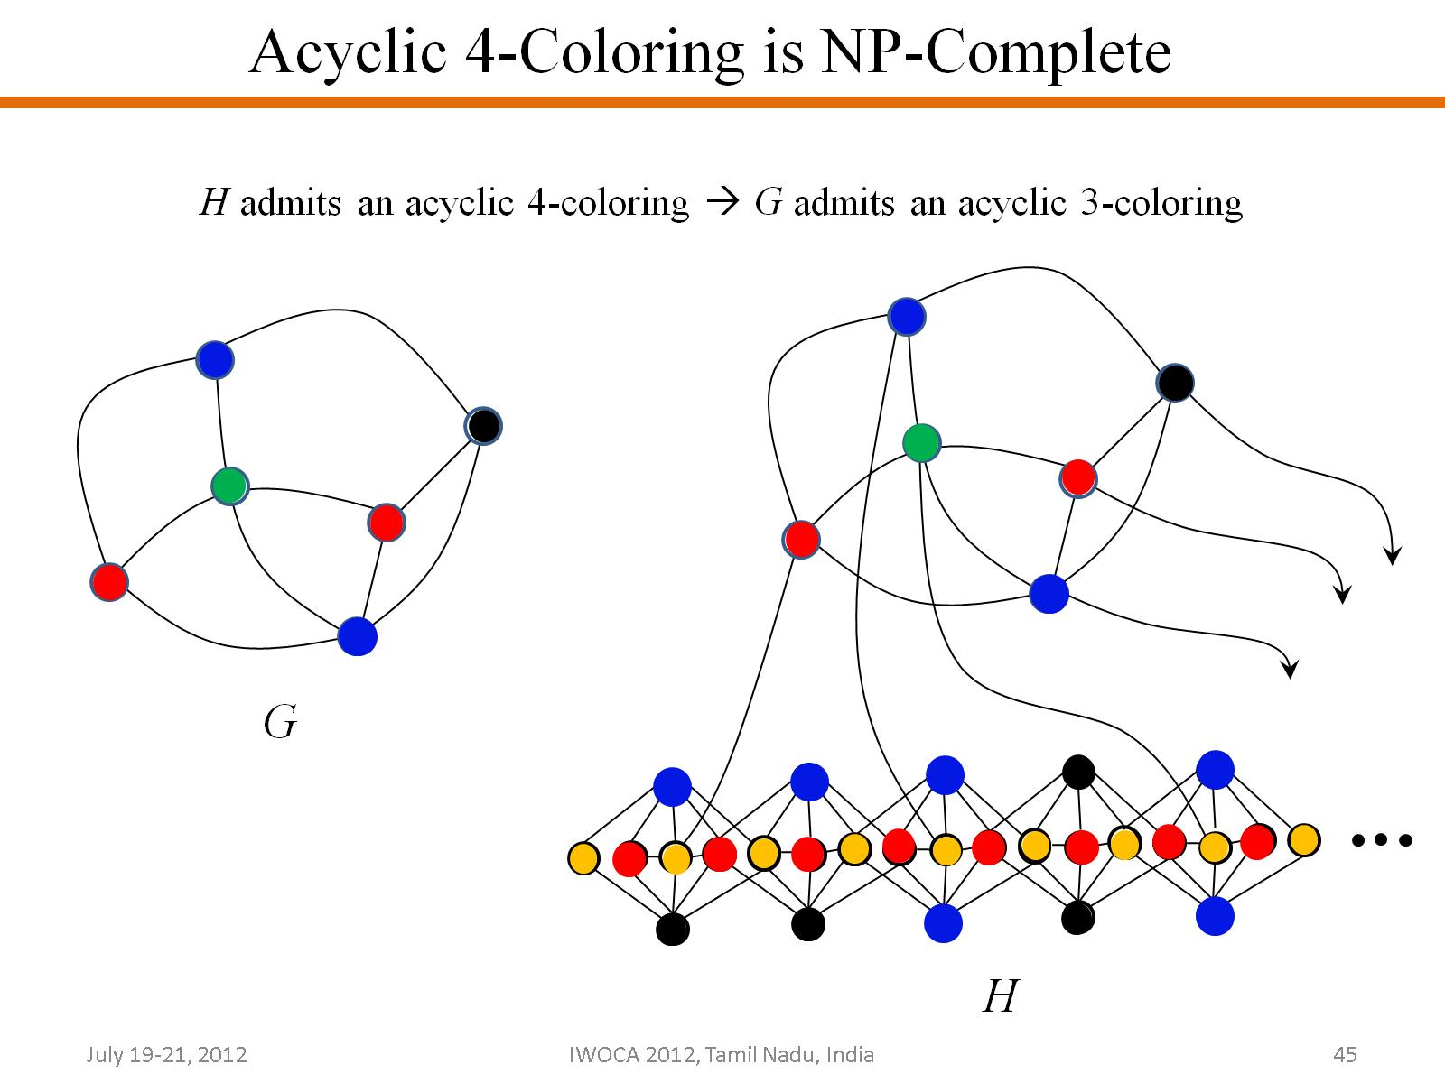

Slide 46
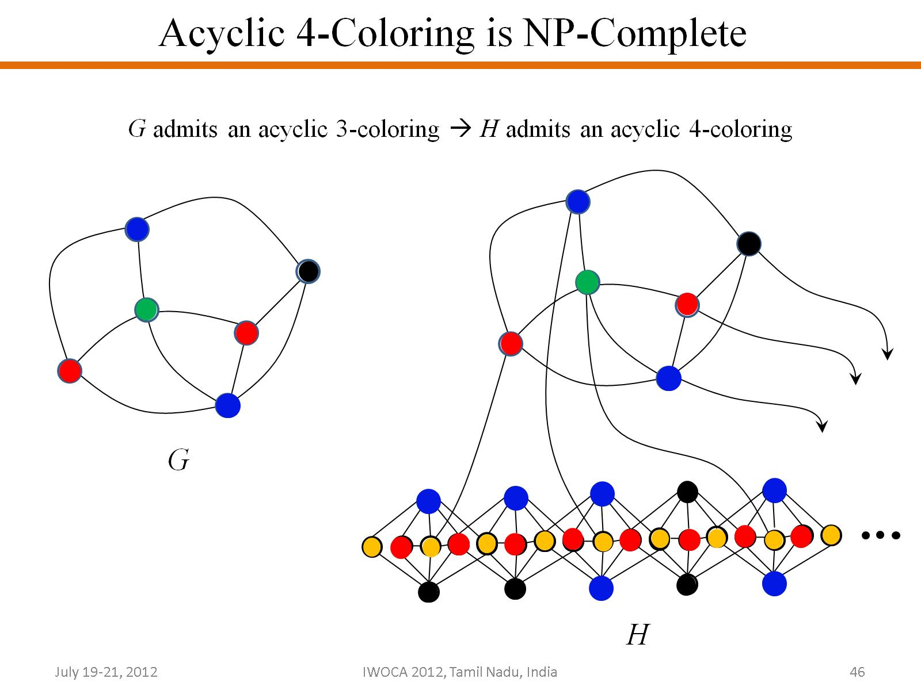

Slide 47
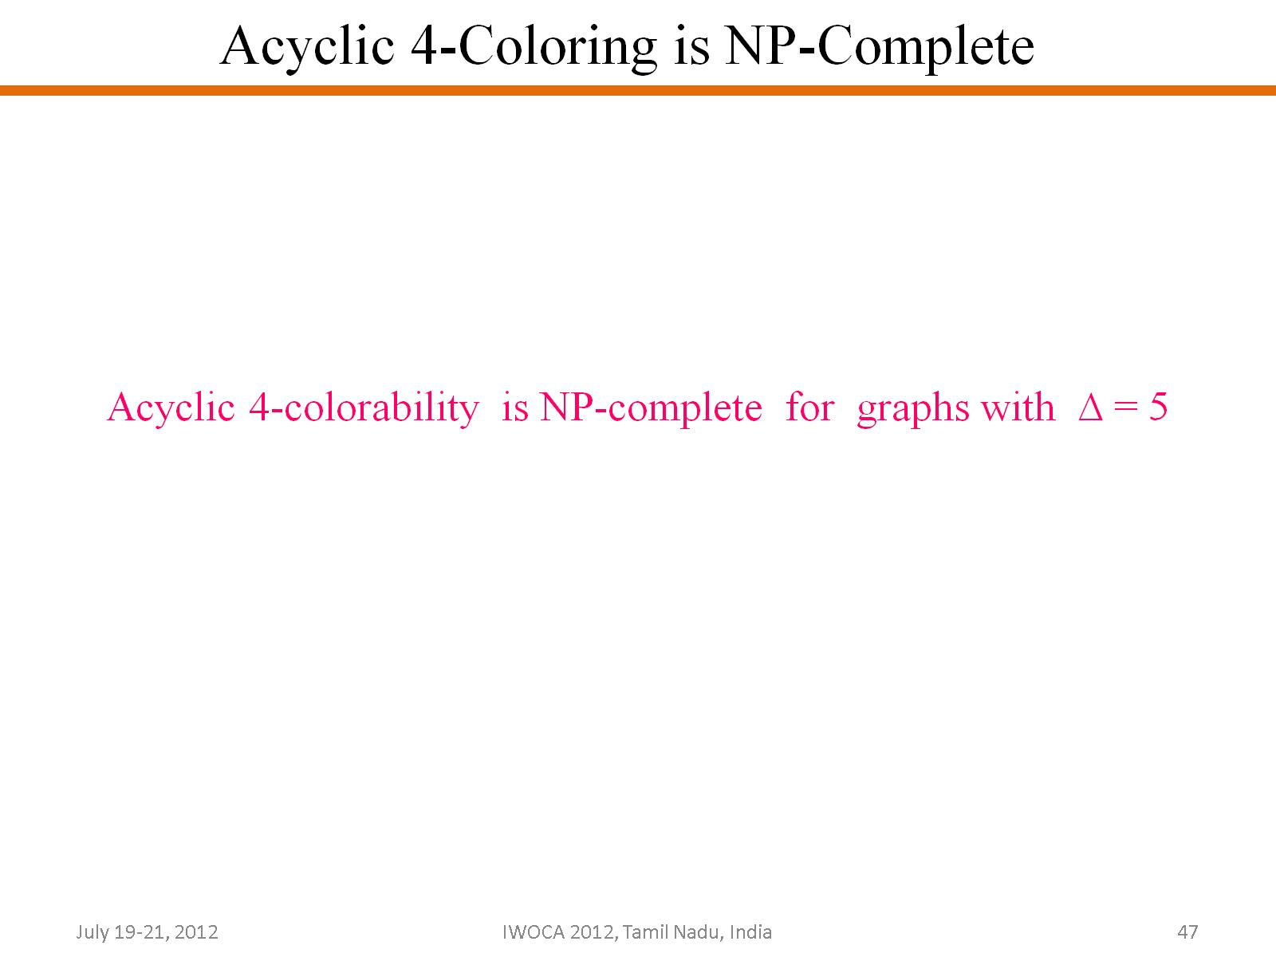

Slide 48
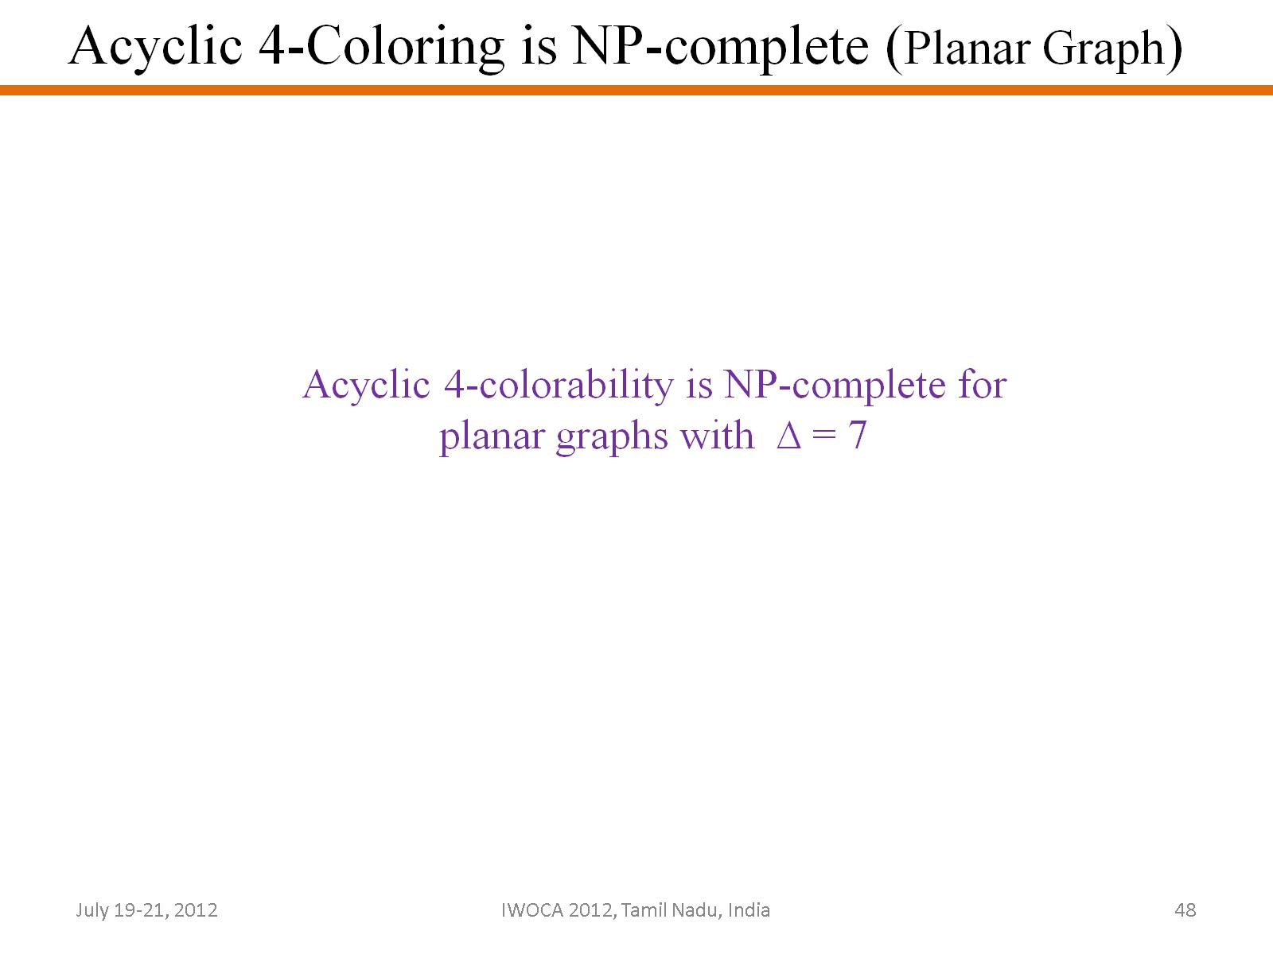

Slide 49
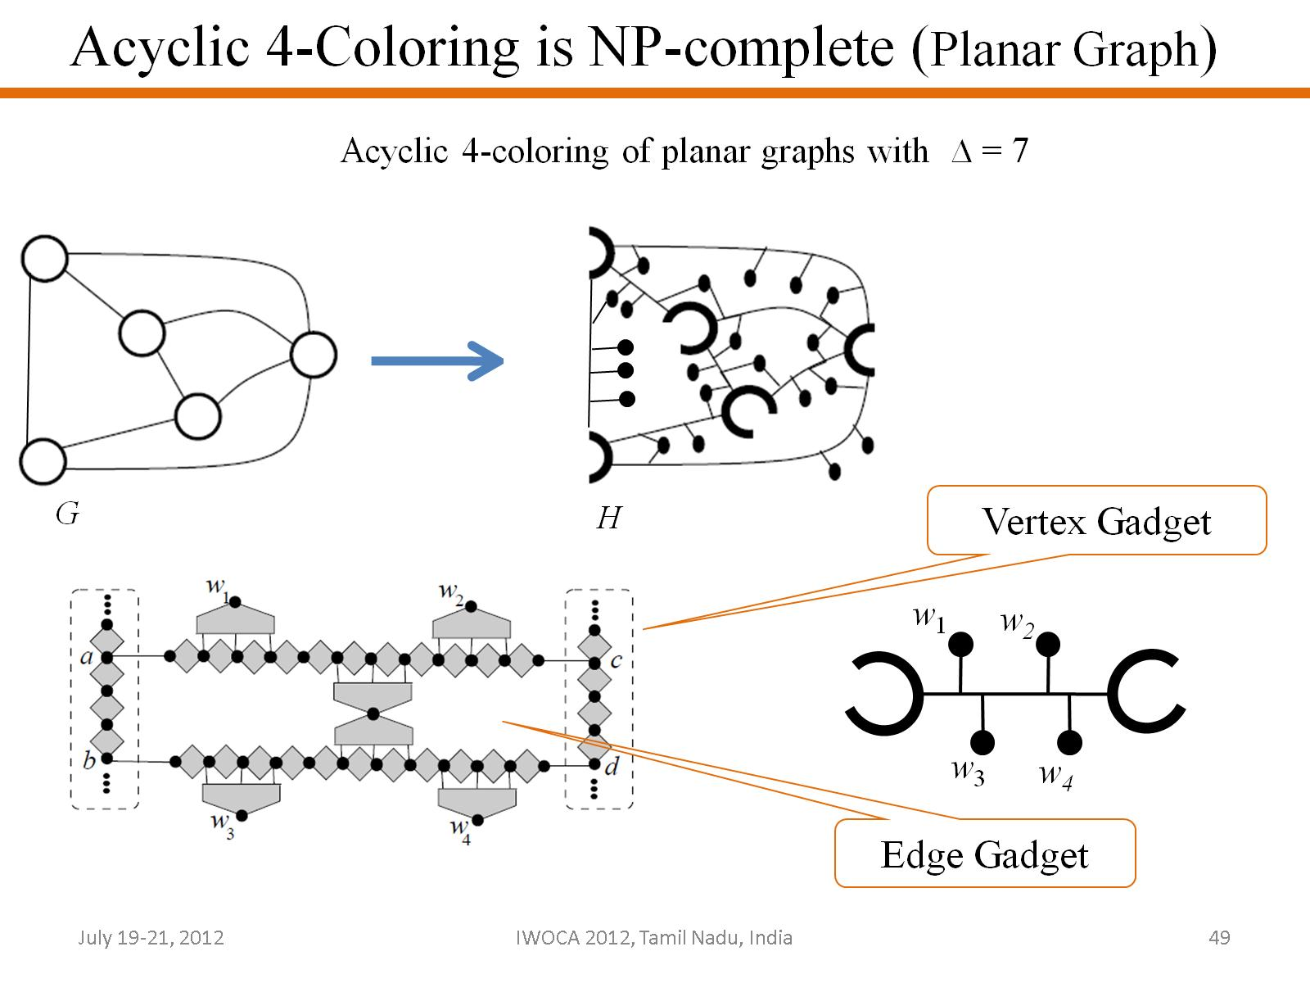

Slide 50
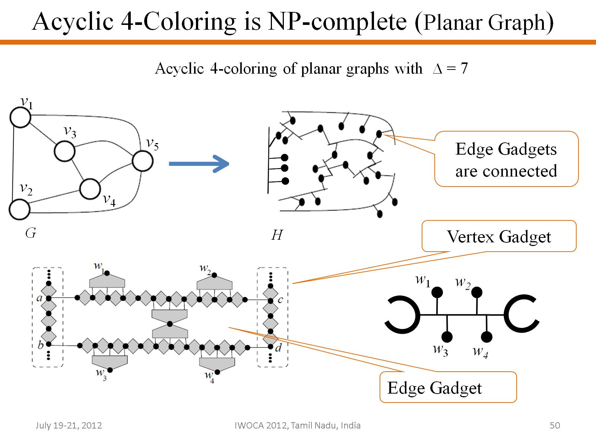

Slide 51
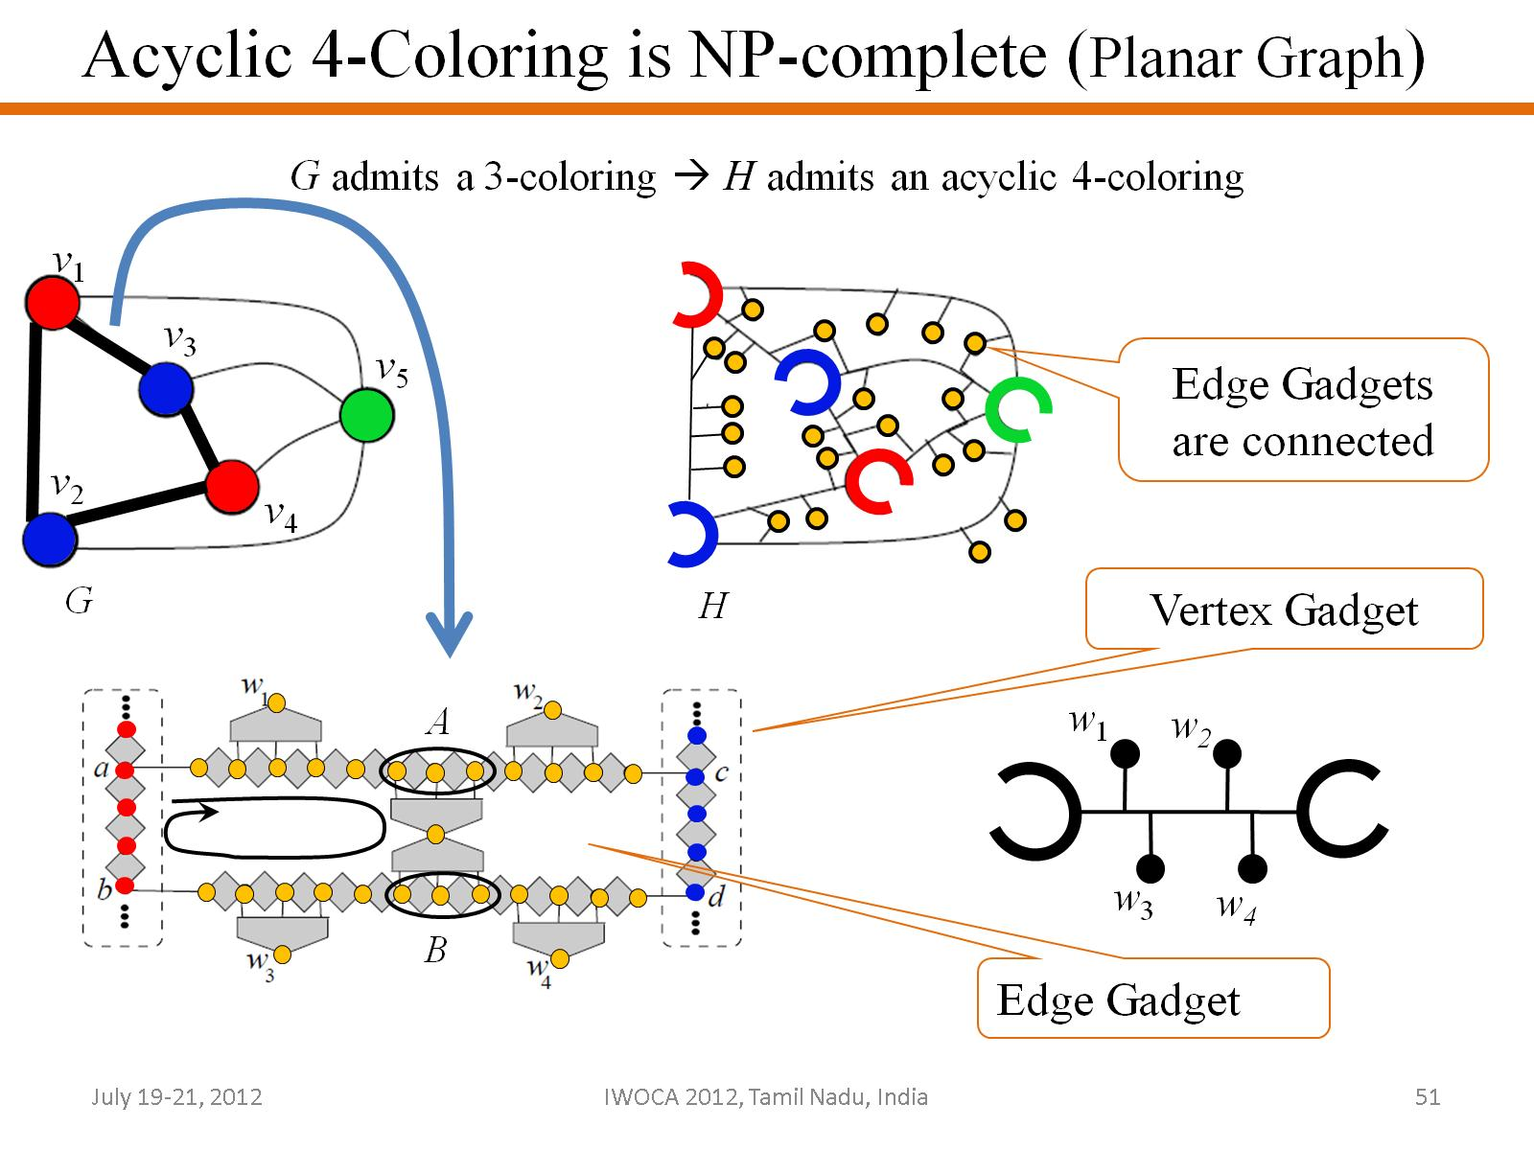

Slide 52


Slide 53


Slide 54


Slide 55


Slide 56


Slide 57


Slide 58


Slide 59


