Slide 1
On Balanced +-Contact Representations
Stephane Durocher & Debajyoti Mondal
University of Manitoba

Slide 2
Contact Graph
Each vertex is represented by a closed region.
The interiors of every pair of vertices are disjoint.
Two vertices are joined by an edge iff the boundaries of their regions touch.
a
a
c
c
e
e
d
b
d
b
Cover Contact Graph (Circle Contact Representation)
Theorem [Koebe 1936] Every planar graph has a circle contact representation.

Slide 3
Other Shapes
a
d
d
d
e
e
a
e
f
f
c
a
c
c
point contact
b
f
g
g
g
b
b
A node-link diagram
Point-contact of disks
(Every Planar Graph)
[Koebe 1936]
Point-contact of triangles
(Every Planar Graph)
[de Fraysseix et al. 1994]
d
a
d
e
f
c
e
a
c
side contact
g
b
Side-contact of polygons
(octagon→hexagon)
[He 1999, Liao et al. 2003,
Duncan et al. 2011]
g
b
g
f
Rectangle contact representation
(Complete Characterization)
[Kozminski & Kinnen 1985,
Kant & He 2003]

Slide 4
+-Contact Representations
Each vertex is represented by an axis-aligned + .
Two + shapes never cross.
Two + shapes touch iff the corresponding vertices are adjacent.
Allowed
Allowed
Not Allowed
Not Allowed
f
g
f
d
a
d
e
g
e
a
c
c
b
b

Slide 5
c-Balanced +-Contact Representations
Each arm can touch at most ⌈c∆⌉ other arms.
f
g
f
d
a
d
e
g
e
a
c
c
b
b
A plane graph G with
maximum degree ∆ = 5
A (1/2)-balanced +-contact
representation of G

Slide 6
c-Balanced +-Contact vs. T- and L-Contact
f
Every planar graph admits a T-contact representation [de Fraysseix et al. 1994]. Several recent attempts to characterize L-contact graphs [Kobourov et al. 2013, Chaplick et al. 2013].
T- and L-contact representations may be unbalanced, but our goal with +-contact is to construct balanced representations.
f
g
f
g
d
a
d
e
g
d
e
e
c
a
c
c
b
b
a
b
A plane graph G
with ∆ = 5
A (1/2)-balanced
+-contact representation
A T-contact
representation

Slide 7
c-Balanced Representations: Applications
f
g
f
a
d
d
e
g
e
c
a
c
b
b
f
f
a
a
d
d
e
g
e
g
c
c
b
b
An 1-bend orthogonal drawing
with boxes of size ⌈c∆⌉×⌈c∆⌉
A transformation into an 1-bend polyline drawing with 2⌈c∆⌉ slopes
[Keszegh et al, 2000]

Slide 8
Results
2-trees have (1/3)-balanced +-contact representations, but not necessarily a (1/4-ϵ)-balanced +-contact representation.
Plane 3-trees have (1/2)-balanced +-contact representations, but not necessarily a (1/3)-balanced +-contact representation.
  Strengthens the result that 2-trees with ∆ = 4, have 1-bend orthogonal (equivalent to (1/4)-balanced +-contact) [Tayu et al., 2009].
  Implies 1-bend polyline drawings of 2-trees with 2⌈∆/3⌉-slopes, and for plane 3-trees with 2⌈∆/2⌉ slopes, which is significantly smaller than the upper bound of 2∆ for general planar graphs [Keszegh et al. 2010].
  It is interesting that with 1-bend per edge, we use roughly 2∆/3 slopes for 2-trees, where the planar slope number of 2-trees is in [∆-3, 2∆] [Lenhart et al., 2013].

Slide 9
2-Trees
A 2-tree (series-parallel graph) G with n ≥ 2 vertices is constructed as follows.
Base Case:
s₁
t₁
G₁
s₁
t₁= s₂
t₂
Series combination :
G₂
s₂
t₂
poles
s₁
t₁
G₁
s₁= s₂
t₁= t₂
Parallel combination:
s₂
G₂
t₂
poles

Slide 10
Series-Parallel Decompositions
a
a
d
e
d
e
f
c
f
c
g
g
b
b
P
P
S
P
P
S
S
S

Slide 11
Series-Parallel Decompositions
a
d
e
f
c
g
b
P
P
S
P
P
S
S
S
Notes:
The sequence of operations in a decomposition of a series-parallel graph is not unique in general.
The decomposition we consider always removes a single edge joining the poles first, if one exists.
Otherwise, a series or parallel decomposition is applied.

Slide 12
(1/2)-Balanced Representation for 2-trees
Let G be a 2-tree, and H=G \ (s,t).
Let f(a) denote the free points of the arm a. Initially, f(a) = ⌈∆/2⌉ or
f(a) = ⌈∆/2⌉ -1 (if there is an edge (s,t) in G).
Claim: Given a rectangle R=abcd such that degree(s,H) ≤ f(a_{d}) + f(a_{r}) and degree(t,H) ≤ f(c_{l}) + f(c_{u}), one can construct a (1/2)-balanced representation of H inside R such that s and t lie on a and c, respectively.
s
s
a_{r}
a
d
R
a_{d}
c_{u}
t
t
b
c
G
H
c_{l}

Slide 13
(1/2)-Balanced Representation for 2-trees
Let G be a 2-tree, and H=G \ (s,t).
Claim: Given a rectangle R=abcd such that degree(s,H) ≤ f(a_{d}) + f(a_{r}) and degree(t,H) ≤ f(c_{l}) + f(c_{u}), one can construct a (1/2)-balanced representation of H inside R such that s and t lie on a and c, respectively.
a (= s)
s
a
d
d
R
R
t
b
c
b
c (= t)
H
Base Case:
H consists of two isolated vertices: s and t.

Slide 14
(1/2)-Balanced Representation for 2-trees
Let G be a 2-tree, and H=G \ (s,t).
Claim: Given a rectangle R=abcd such that degree(s,H) ≤ f(a_{d}) + f(a_{r}) and degree(t,H) ≤ f(c_{l}) + f(c_{u}), one can construct a (1/2)-balanced representation of H inside R such that s and t lie on a and c, respectively.
a (= s)
a₁
f(a_{r})
d
H₁
m ( = t₁)
f(a_{d})-1
R₁
⌈∆/2⌉
m₂
a
d
m₁
⌈∆/2⌉
s = s₁
t₁= s₂
t = t₂
R
R₂
f(c_{u})-1
⌈∆/2⌉ -1
⌈∆/2⌉-1
b
c (= t)
c₂
f(c_{l})
H₂
b
c
Series Combination
Induction: Draw H₁\ (s₁,t₁) and H₂ \ (s₂,t₂) inside R₁ and R₂ , respectively.
H

Slide 15
(1/2)-Balanced Representation for 2-trees
a (= s)
a₁
f(a_{r})
d
m ( = t₁)
f(a_{d})-1
R₁
⌈∆/2⌉
m₂
m₁
⌈∆/2⌉-1
⌈∆/2⌉ -1
⌈∆/2⌉
R₂
f(c_{u})-1
b
c (= t)
c₂
f(c_{l})
a (= s)
a₁
f(a_{r})
d
m ( = t₁)
f(a_{d})-1
R₁
⌈∆/2⌉
m₂
m₁
⌈∆/2⌉
⌈∆/2⌉ -1
⌈∆/2⌉-1
R₂
f(c_{u})
b
c (= t)
c₂
f(c_{l})-1
Series Combination
Induction: Draw H₁\ (s₁,t₁) and H₂ \ (s₂,t₂) inside R₁ and R₂ , respectively.

Slide 16
(1/2)-Balanced Representation for 2-trees
Let G be a 2-tree, and H=G \ (s,t).
Claim: Given a rectangle R=abcd such that degree(s,H) ≤ f(a_{d}) + f(a_{r}) and degree(t,H) ≤ f(c_{l}) + f(c_{u}), one can construct a (1/2)-balanced representation of H inside R such that s and t lie on a and c, respectively.
a₁
a₂
d
d
s₁= s₂
H₁
a
d
R₁
R₂
t₁= t₂
R
b
c₁
b
c (= t₁)
H₂
b
c
Parallel Combination
Distribute the free points of R among
R₁ and R₂.
H

Slide 17
(1/2)-Balanced Representation for 2-trees
Let G be a 2-tree, and H=G \ (s,t).
Claim: Given a rectangle R=abcd such that degree(s,H) ≤ f(a_{d}) + f(a_{r}) and degree(t,H) ≤ f(c_{l}) + f(c_{u}), one can construct a (1/2)-balanced representation of H inside R such that s and t lie on a and c, respectively.
degree (s₁,H₁) = 15
a₁
5
a₂
16
d₁
d₂
21
degree (t₁,H₁) = 3
s₁= s₂
H₁
a
d
10
R₁
3
R₂
t₁= t₂
R
0
2
10
5
b₁
c₁
b₂
c₂
0
0
H₂
b
c
0
Parallel Combination
Distribute the free points of R among
R₁ and R₂.
H
Notes:
s has degree 15 in H_1 and degree at most 16 in H_2
We distribute the edges of s in H_1, starting along a_d.
f(a_d) is 10, therefore the first 10 edges of s in H_1 are assigned to a_d, and a_d has no free points remaining.
The remaining 5 edges of s in H_1 are assigned to a_r. a_r has 21-5 = 16 free points remaining.
All edges of s in H_2 must then be assigned to a_r.
Apply a similar procedure to t and c.
The edges of H_1 are always assigned first, regardless of which has greater degree.

Slide 18
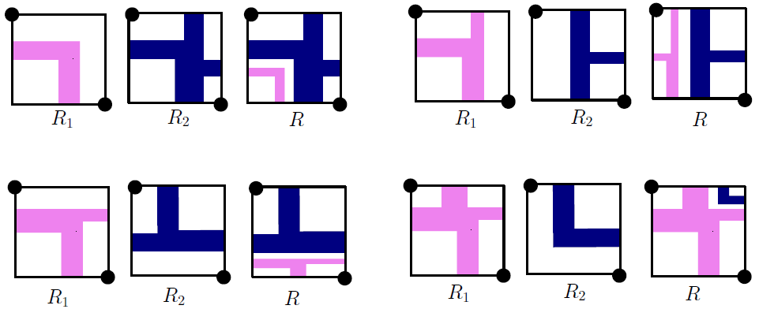
(1/2)-Balanced Representation for 2-trees
Let G be a 2-tree, and H=G \ (s,t).
Claim: Given a rectangle R=abcd such that degree(s,H) ≤ f(a_{d}) + f(a_{r}) and degree(t,H) ≤ f(c_{l}) + f(c_{u}), one can construct a (1/2)-balanced representation of H inside R such that s and t lie on a and c, respectively.
s₁= s₂
H₁
a
d
t₁= t₂
R
H₂
b
c
H
Parallel Combination
Draw H₁ and H₂ using induction, and merge them avoiding edge crossing.

Slide 19
(1/2)-Balanced Representation for 2-trees
Let G be a 2-tree, and H=G \ (s,t).
Claim: Given a rectangle R=abcd such that degree(s,H) ≤ f(a_{d}) + f(a_{r}) and degree(t,H) ≤ f(c_{l}) + f(c_{u}), one can construct a (1/2)-balanced representation of H inside R such that s and t lie on a and c, respectively.
a_{r}
s
s
a
d
a
d
a
d
H
G
R
a_{d}
c_{u}
t
t
b
c
b
c
b
c
G
H
c_{l}
We started with G and proved that H admits a (1/2)-balanced +-contact representation inside R. If the poles of G are adjacent, we initialize
f(a_{d})=⌈∆/2⌉ -1 and f(c_{l})=⌈∆/2⌉ -1, then draw H. Finally, draw (s,t) along abc.

Slide 20
Refinement: (1/3)-Balanced Representation
Why was the previous construction (1/2)-balanced?
  While adding a new arm, we assigned at most ⌈∆/2⌉ free points to it.
  Since ⌈∆/2⌉ + ⌈∆/2⌉ ≥ ∆, we could find a ‘nice’ rectangle partition, i.e., using at most two arms.
  Recall series combination.
a (= s)
a₁
d
R₁
⌈∆/2⌉
m₂
m
m₁
⌈∆/2⌉
⌈∆/2⌉ -1
⌈∆/2⌉-1
R₂
b
c (= t)
c₂

Slide 21
Refinement: (1/3)-Balanced Representation
For (1/3)-balanced we assign at most ⌈∆/3⌉ free points to any arm.
Sometimes we need at least three of the arms of m to lie in the same rectangle. E.g., if degree(m,H₁) > 2⌈∆/3⌉ .
Sometimes we need to share an arm among the rectangles. E.g., assume degree(m,H₁) > ⌈∆/3⌉ and degree(m,H₂) > ⌈∆/3⌉ in the following.
a (= s)
a₁
d
m
⌈∆/3⌉
m₂
m₁
0
⌈∆/3⌉ -1
⌈∆/3⌉
⌈∆/3⌉-1
b
c (= t)
c₂
a (= s)
a₁
d
m
⌈∆/3⌉ -1
m₂
deg(m₂,H₂) – (⌈∆/3⌉-1)
0
m₁
deg(m₁,H₁) – (⌈∆/3⌉-1)
⌈∆/3⌉-1
b
c (= t)
c₂

Slide 22
Refinement: (1/3)-Balanced Representation
Some poles do not lie at the corners.
More case Analysis!
a (= s)
a₁
d
m
⌈∆/3⌉
m₂
m₁
⌈∆/3⌉
⌈∆/3⌉ -1
⌈∆/3⌉
⌈∆/3⌉-1
b
c (= t)
c₂
a (= s)
a₁
d
m
⌈∆/3⌉ -1
m₂
outnDeg(m₂) – (⌈∆/3⌉-1)
0
m₁
deg(m₁) – (⌈∆/3⌉-1)
⌈∆/3⌉-1
b
c (= t)
c₂

Slide 23
(1/3)-Balanced Representation for 2-trees
Some poles do not lie at the corners.
More case Analysis!
a (= s)
a₁
d
m
⌈∆/3⌉
m₂
m₁
⌈∆/3⌉
⌈∆/3⌉ -1
⌈∆/3⌉
⌈∆/3⌉-1
b
c (= t)
c₂
Sometimes flip sub-problems to apply induction.
a (= s)
a₁
d
a₁
m
⌈∆/3⌉ -1
m₂
outnDeg(m₂) – (⌈∆/3⌉-1)
0
m₁
deg(m₁) – (⌈∆/3⌉-1)
⌈∆/3⌉-1
m₁
b
c (= t)
c₂

Slide 24
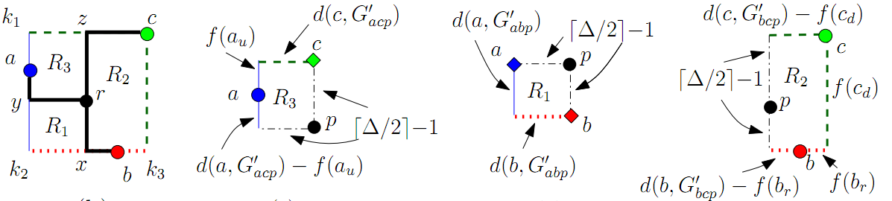
Plane 3-trees: (1/2)-Balanced
a
a
a
p
p
p
b
p
c
b
c
b
c

Slide 25
Conclusion
Summary
  2-trees have (1/3)-balanced +-contact representations, but not necessarily a (1/4-ϵ)-balanced +-contact representation.
  Plane 3-trees have (1/2)-balanced +-contact representations, but not necessarily a (1/3)-balanced +-contact representation.
Open Questions
  Although our representations for planar 3-trees preserve the input embedding, our representations for 2-trees do not have this property. Do there exist algorithms for (1/3)-balanced representations of 2-trees that preserve input embedding?
  Close the gap between the lower and upper bounds.
  Characterize planar graphs that admit c-balanced +-contact representations, for small fixed values c.

Slide 26
Thank You

