Slide 1
A Note on Minimum-Segment
Drawings of Planar Graphs
Stephane Durocher¹ Debajyoti Mondal¹
Rahnuma Islam Nishat² Sue Whitesides²
¹Department of Computer Science, University of Manitoba
²Department of Computer Science, University of Victoria

Slide 2
What is a minimum-segment drawing?
a
a
a
e
f
h
h
h
b
e
b
h
f
g
g
c
c
d
d
d
d
Planar Graph G
A Straight-Line Drawing of G
Segment
Edge

Slide 3
What is a minimum-segment drawing?
a
a
e
h
f
b
e
f
b
h
g
g
c
d
c
d
a
10 Segments
Planar Graph G
f
g
h
c
e
7 Segments
b
d
A Minimum-Segment Drawing of G

Slide 4
Previous Results
Dujmovic et al.
2007
Trees
Minimum segment.
Dujmovic et al.
2007
Outerplanar graphs, plane 2-trees and plane 3-trees
n segments, 2n segments and 2n segments, respectively.
Dujmovic et al.
2007
Planar 3-connected graphs
5n/2 segments.
Samee et al.
2009
Series parallel graph
with the maximum degree 3
Minimum segment.
Biswas et al.
2010
Cubic 3-connected
plane graph
Minimum segment.

Slide 5
Our Results
Given an arbitrary integer k ≥ 3, it is NP-complete to decide if a given plane graph has a straight-line drawing with at most k segments
It is NP-complete to determine whether a given partial drawing of an outerplanar graph G can be extended to a straight-line drawing of G with at most k segments
We introduce a new graph parameter called segment complexity and derive lower bounds on segment complexities of different classes of planar graphs

Slide 6
Pseudoline Arrangements
Simple Arrangement of Pseudolines

Slide 7
Pseudoline Arrangements
Simple Arrangement of Pseudolines

Slide 8
Pseudoline Arrangement Graph
A Simple Pseudoline Arrangement Graph
All the vertices of degree 2 and 3 are on the outer face
k(k-1)/2 vertices
k(k-2) edges

Slide 9
Arrangement Drawing
Pseudoline Arrangement Graph
?
Arrangement Drawing
We prove that, G is an arrangement graph
if and only if G has an arrangement drawing
Arrangement Graph
A drawing is an arrangement drawing if it has exactly k segments such that each segment intersects all the other segments.

Slide 10
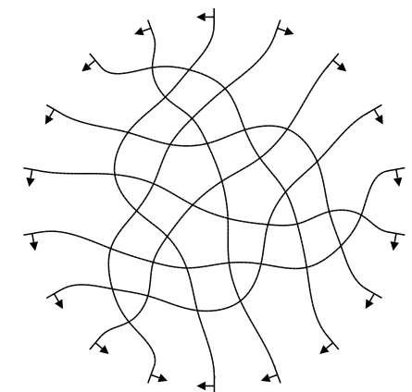
Not every pseudoline arrangement graph
has an arrangement drawing
9(9-1)/2 vertices
9(9-2) edges
NO
Is there a 9 segment drawing of this graph?

Slide 11
Arrangement Graph Recognition is NP-hard
Input : A pseudoline arrangement graph G
Question : Is G an arrangement graph?

Slide 12
Minimum-Segment Drawing
Input : A pseudoline arrangement graph G
Question : Does G admit a straight-line drawing with k segments?
We reduce arrangement graph recognition problem to minimum-segment drawing problem.

Slide 13
Minimum-Segment Drawing is NP-complete
G is an arrangement graph → G has a drawing with k segments.

Slide 14
Minimum-Segment Drawing is NP-complete
G has a k-segment drawing Γ → G is an arrangement graph
Γ is a k-segment drawing
Each segment has k-1 vertices
and k-2 edges
Each segment intersects
all other segments
Assume that this segment contains at least k vertices → k+1 segments, a contradiction
The segments can be extended
to infinity without
creating new vertices
Γ is an arrangement drawing
G is an arrangement graph

Slide 15
Minimum-Segment Drawing is NP-complete
G has a k-segment drawing Γ → G is an arrangement graph
Γ is a k-segment drawing
Each segment has k-1 vertices
and k-2 edges
Each segment intersects
all other segments
The segments can be extended
to infinity without
creating new vertices
Γ is an arrangement drawing
G is an arrangement graph

Slide 16
Relation with layered polyline drawing
a
1
a
2
x
d
d
c
e
b
c
e
b
3
4
5

Slide 17
Relation with layered polyline drawing
a
1
a
2
x
d
d
c
e
b
c
e
b
3
4
5
1
2
3
4
5

Slide 18
Relation with layered polyline drawing
5
4
a
1
a
2
x
d
d
c
e
b
c
e
b
3
3
2
4
5
1
1
2
3
b
4
5

Slide 19
Relation with layered polyline drawing
5
4
a
1
a
2
x
d
d
c
e
b
c
e
b
3
3
2
4
5
1
1
2
x
3
b
4
5

Slide 20
Relation with layered polyline drawing
5
4
a
1
a
2
x
d
d
c
e
b
c
e
b
3
3
2
4
5
1
1
2
x
3
b
4
c
5

Slide 21
Relation with layered polyline drawing
5
4
a
1
a
2
x
d
d
c
e
b
c
e
b
3
3
2
4
5
1
1
2
x
3
b
d
4
c
5

Slide 22
Relation with layered polyline drawing
5
4
a
1
a
2
x
d
d
c
e
b
c
e
b
3
3
2
4
5
1
1
a
a
2
x
a
3
b
d
4
c
5

Slide 23
Relation with layered polyline drawing
5
4
a
1
a
2
x
d
d
c
e
b
c
e
b
3
3
2
4
5
1
1
a
a
2
x
a
3
b
d
e
e
4
c
e
5

Slide 24
Relation with layered polyline drawing
5
4
a
1
a
2
x
d
d
c
e
b
c
e
b
3
3
2
4
5
1
1
a
a
a
2
x
a
3
b
d
e
e
4
c
e
5

Slide 25
Our Results
Given an arbitrary integer k ≥ 3, it is NP-complete to decide if a given plane graph has a straight-line drawing with at most k segment.
It is NP-complete to determine whether a given partial drawing of an outerplanar graph G can be extended to a straight-line drawing of G with at most k segments
We introduce a new graph parameter called segment complexity and derive lower bounds on segment complexities of different classes of planar graphs

Slide 26
Minimum-Segment Drawing with Given Partial Drawing
Input : An outerplanar graph G, a straight-line drawing Γ/ of a subgraph G/ of G and an integer k ≥ 1
Question : Is there a k-segment drawing of G that includes Γ/?
We reduce tri-partition problem to minimum-segment drawing with given partial drawing problem.

Slide 27
Tri-Partition Problem
Input : A set of 3m positive integers S={a₁, a₂, a₃, a₄,…, a_{3m}}
where a₁+a₂+a₃+….+a_{3m} = mB and B/4< a_{i} <B/2 for each a_{i} , 1 ≤ i ≤ 3m
Question : Can S be partitioned into m subsets S₁, S₂, …, S_{m} such that |S₁| = |S₂| = |S₃| = … = |S_{m}|=3 and the sum of
the integers in each subset is equal to B?

Slide 28
NP-Completeness
Can the graph can be drawn in k=mB+m+3+3m segments?
f
m+1 vertices
f₁
(m+1) +mB + 2 segments
f₂
v
f₃
m+1+mB vertices
….
f_{3m}
f /
B
B
B
B
B
B
B
B

Slide 29
NP-Completeness
f
v
f /
The k-segment drawing of G can be obtained if and only if the instance of the tripartition problem has a positive solution

Slide 30
A small example
S={6, 7, 5, 9, 6, 7}, B=20
f
6
7
5
9
v
6
7
f /
20
20

Slide 31
A small example
S={6, 7, 5, 9, 6, 7}, B=20
6
5
9
7
6
7
f
v
f /
20
20

Slide 32
Our Results
Given an arbitrary integer k ≥ 3, it is NP-complete to decide if a given plane graph has a straight-line drawing with at most k segment.
It is NP-complete to determine whether a given partial drawing of an outerplanar graph G can be extended to a straight-line drawing of G with at most k segments, even when the partial drawing can be extended to a straight-line drawing of G
We introduce a new graph parameter called “segment complexity” and derive lower bounds on segment complexities of different classes of planar graphs

Slide 33
Spanning-Tree Segment Complexity
Spanning-tree segment complexity of a planar graph G is the minimum positive integer C such that every spanning tree of G admits a drawing with at most C segments.
a
a
a
a
d
c
d
d
b
c
d
c
c
b
b
b
f
Spanning-Tree Segment complexity of this graph is 3
e
f
f
f
e
e
e
3 segments
2 segments
2 segments
a
a
a
d
c
d
d
b
b
c
b
c
. . . . .
f
f
f
e
e
e
1 segment
1 segment
2 segments

Slide 34
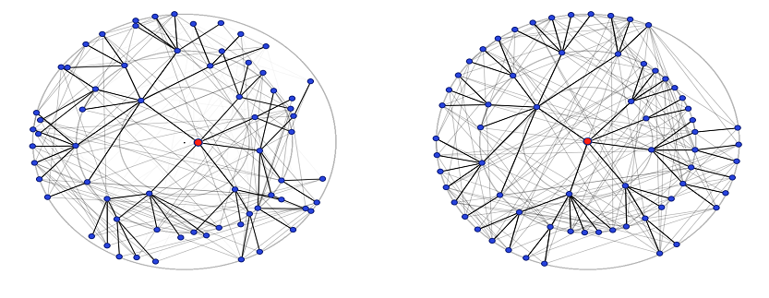
Motivation
In many graph visualization softwares, a graph is drawn emphasizing the drawing of one of its spanning trees, and the other edges are displayed on demand
Figure taken from : C. Homan, A. Pavlo, and J. Schull. Smoother transitions between breadth-first-spanning-tree-based drawings. In Proc. of GD 2006.

Slide 35
Segment Complexity
Graph Class | Lower Bound on C
Maximal outerplanar | n/6
Plane 2-tree | n/6
Plane 3-tree | (2n-5)/6
Plane 3-connected | n/8
Plane 4-connected | n/5

Slide 36
Open Problem
Minimum-line drawing
Open Problem: Compute non-trivial upper bounds on the number of lines required for minimum-line drawings of different classes of planar graphs.

Slide 37
Thank You

