Slide 1
On Graphs that are not PCGs
Stephane Durocher¹ Debajyoti Mondal¹ Md. Saidur Rahman²
¹Department of Computer Science, University of Manitoba
² Department of Computer Science & Engineering,
Bangladesh University of Engineering and Technology (BUET)

Slide 2
Pairwise Compatible Graphs: Easy to Construct
h
f
0.5
0.5
i
1
1
1
3
d_{min}= 4
k
1
j
e
b
a
4
3
d_{max}= 7
d
c
T
A pairwise compatible graph of (T, d_{min} , d_{max} )
has n vertices that correspond to the n leaves of T, and
two vertices are adjacent in G if and only if their tree distance is in [d_{min}, d_{max}]

Slide 3
Pairwise Compatible Graphs: Easy to Construct
5 ∈ [4,7]
h
f
0.5
0.5
i
a
1
1
1
3
d_{min}= 4
5
/
k
1
j
e
b
a
e
b
4
3
d_{max}= 7
/
/
d
c
d
c
/
/
T
G
A pairwise compatible graph of (T, d_{min} , d_{max} )
has n vertices that correspond to the n leaves of T, and
two vertices are adjacent in G if and only if their tree distance is in [d_{min}, d_{max}]

Slide 4
Pairwise Compatible Graphs: Easy to Construct
3 ∉ [4,7]
h
f
0.5
0.5
i
a
1
1
1
3
d_{min}= 4
5
/
k
1
j
3
e
b
a
e
b
4
3
d_{max}= 7
/
/
d
c
d
c
/
/
T
G
A pairwise compatible graph of (T, d_{min} , d_{max} )
has n vertices that correspond to the n leaves of T, and
two vertices are adjacent in G if and only if their tree distance is in [d_{min}, d_{max}]

Slide 5
Pairwise Compatible Graphs: Easy to Construct
7 ∈ [4,7]
h
f
0.5
0.5
i
a
1
1
1
3
d_{min}= 4
5
/
k
1
j
e
b
a
e
7
b
4
3
d_{max}= 7
/
/
d
c
d
c
/
/
T
G
A pairwise compatible graph of (T, d_{min} , d_{max} )
has n vertices that correspond to the n leaves of T, and
two vertices are adjacent in G if and only if their tree distance is in [d_{min}, d_{max}]

Slide 6
Pairwise Compatible Graphs: Easy to Construct
h
How hard is the Reverse Problem?
f
0.5
0.5
i
a
1
1
1
3
d_{min}= 4
/
k
1
j
e
b
a
e
b
4
3
d_{max}= 7
/
/
d
c
d
/
c
/
T
G
A pairwise compatible graph of (T, d_{min} , d_{max} )
has n vertices that correspond to the n leaves of T, and
two vertices are adjacent in G if and only if their tree distance is in [d_{min}, d_{max}]

Slide 7
Pairwise Compatible Graphs: How to Recognize?
(T, d_{min}, d_{max}) ?
h
f
0.5
0.5
i
a
1
1
1
3
d_{min}= 4
/
k
1
j
e
b
a
e
b
2
3
d_{max}= 7
/
/
d
c
d
/
c
/
T
G
Given a graph G, is there an edge weighted tree T and two non-negative integers
d_{min}, d_{max}, such that G is a PCG of (T, d_{min}, d_{max})?
A pairwise compatible graph of (T, d_{min} , d_{max} )
has n vertices that correspond to the n leaves of T, and
two vertices are adjacent in G if and only if their tree distance is in [d_{min}, d_{max}]

Slide 8
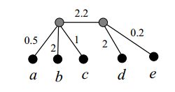
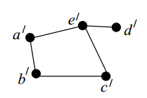
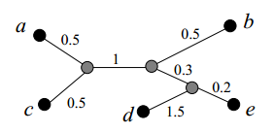
Recognizing PCG by Constructing (T, d_{min}, d_{max})
d_{min} = 2
d_{max} = 3.5
Output
Input
d_{min} = 1.5
d_{max} = 2
Given a graph G, is there an edge weighted tree T and two non-negative integers
d_{min}, d_{max}, such that G is a PCG of (T, d_{min}, d_{max})?
Another possible Output

Slide 9
Pairwise Compatibility Tree Construction
1
1
1
1
1
G
Pairwise-Compatibility Tree
of G for d_{min}=2, d_{max}=2
Complete Graphs
1
1
1
1
1
1
1
G
Complete Bipartite Graphs
Pairwise-Compatibility Tree
of G for d_{min}=3, d_{max}=3
February 14-16
WALCOM 2013
9

Slide 10
Pairwise Compatibility Tree Construction
d_{min} = 3r
d_{max} = 3r
r
r
r
r
r
r
r
r
r
r
r
r
r
r
Trees
r
r
r
r
r
r
r
r
r
r
r
r
r
r
r
r
r
r
r
r
February 14-16
WALCOM 2013
10

Slide 11
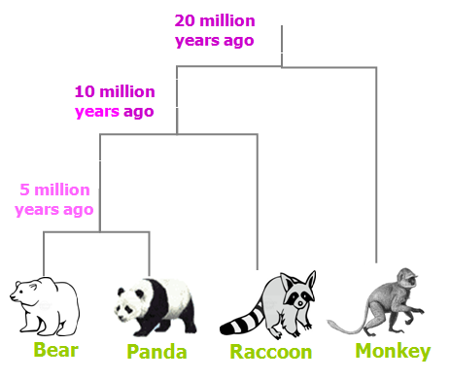
Historical Background
[Kearney, Munro, Phillips 2003]
PCGs are used to model evolutionary relationships among a set of organisms.
20
10
20
20
10
5
Relation Graph
Evolutionary Tree

Slide 12
Historical Background
[Kearney, Munro, Phillips 2003]
PCGs are used to model evolutionary relationships among a set of organisms.
[Kearney, Munro, Phillips 2003]
Given a graph G, if we can construct (T, d_{min} , d_{max} ) in polynomial time, then we can find a maximum clique of G in polynomial time.
[Kearney, Munro, Phillips 2003]
Conjecture: All graphs are PCG.
[Yanhaona, Bayzid, Rahman 2010]
Refuted the Conjecture showing a class of bipartite graphs with n > 14 that are not PCGs.
b₁
b₂
b₃
b₄
b₅
b₆
b₇
b₈
b₉
b₁₀
(
)
=
5
3
10
a₁
a₂
a₃
a₄
a₅

Slide 13
Historical Background
[Kearney, Munro, Phillips 2003]
PCGs are used to model evolutionary relationships among a set of organisms.
[Kearney, Munro, Phillips 2003]
Given a graph G, if we can construct (T, d_{min} , d_{max} ) in polynomial time, then we can find a maximum clique of G in polynomial time.
[Kearney, Munro, Phillips 2003]
Conjecture: All graphs are PCG.
[Yanhaona, Bayzid, Rahman 2010]
Refuted the Conjecture showing a class of bipartite graphs with n > 14 that are not PCGs.
b₁
b₂
b₃
b₄
b₅
b₆
b₇
b₈
b₉
b₁₀
(
)
=
5
3
10
a₁
a₂
a₃
a₅
Not a PCG.
a₄

Slide 14
Historical Background
[Kearney, Munro, Phillips 2003]
PCGs are used to model evolutionary relationships among a set of organisms.
[Kearney, Munro, Phillips 2003]
Given a graph G, if we can construct (T, d_{min} , d_{max} ) in polynomial time, then we can find a maximum clique of G in polynomial time.
[Kearney, Munro, Phillips 2003]
Conjecture: All graphs are PCG.
[Yanhaona, Bayzid, Rahman 2010]
Refuted the Conjecture showing a class of bipartite graphs with n > 14 that are not PCGs.
[Calamoneri, Petreschi, Sinaimeri 2012]
A subclass of split matrogenic graphs are PCGs.
[Salma, Rahman 2012]
Triangle free maximum degree three outerplanar graphs are PCGs.
[Calamoneri, Frascaria, Sinaimeri, 2012]
All graphs with at most seven vertices are PCGs.

Slide 15
Some Natural Questions
What is the smallest graph that is not a PCG?
Is there a planar graph that is not a PCG?
PCG Recognition Problem: Given a graph G, can we determine whether G is a PCG in polynomial time?
Our Contribution
There exists a graph with eight vertices that is not a PCG.
There exists a planar graph with sixteen vertices that is not a PCG
A variant of the PCG Recognition Problem is NP-hard.

Slide 16
Two Useful Lemmas
x
Then either d_{T} (w,x)≤ d_{T} (u,x),
or, d_{T} (w,x)≤ d_{T} (v,x).
T
Lemma 1
u
v
w
u
v
w
x
P_{uv} is the longest path in T_{uvw}
Lemma 1: [Yanhaona et al. 2010] Let P_{uv} be the longest path in T_{uvw}, where u,v,w
are leaves of T. Then for any leaf x ∉ {u,v,w} of T, either d_{T} (w,x)≤ d_{T} (u,x), or,
d_{T} (w,x)≤ d_{T} (v,x).
d_{min} = 2
d_{max} = 3.5
Input
Output

Slide 17
Two Useful Lemmas
x
Then either d_{T} (w,x)≤ d_{T} (u,x),
or, d_{T} (w,x)≤ d_{T} (v,x).
T
Lemma 1
u
v
w
u
v
w
x
P_{uv} is the longest path in T_{uvw}
b/
Then either d_{T} (a,c) < d_{min},
or, d_{T} (b,d) < d_{min}.
a/
c/
T
d_{min}
d_{max}
Lemma 2
d/
a
b
c
d
Lemma 2: (This presentation.) Let G is a PCG of (T, d_{min}, d_{max}), where G is a cycle a/,b/,c/,d/. Then d_{T} (a,c) and d_{T} (b,d) cannot be both greater than d_{max}.

Slide 18
Proof of Lemma 2
b/
Then either d_{T} (a,c) < d_{min},
or, d_{T} (b,d) < d_{min}.
a/
c/
T
d_{min}
d_{max}
Lemma 2
d/
a
b
c
d
G
Proof.
W.l.o.g., assume that T does not have any vertex of degree two.
x
y
a
p
c
a
x+y
q
c
p+q
b
b
d
T
T
d

Slide 19
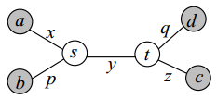
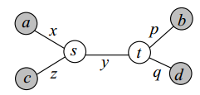
Proof of Lemma 2
b/
Then either d_{T} (a,c) < d_{min},
or, d_{T} (b,d) < d_{min}.
a/
c/
T
d_{min}
d_{max}
Lemma 2
d/
a
b
c
d
G
Proof.
We only need to consider the following tree topologies.
If both d_{T} (a,c) and d_{T} (b,d) are greater
than d_{max}, then x+2y+z+p+q > 2d_{max} .
Since a/and d/ are adjacent, d_{min} ≤ x+y+q ≤ d_{max}
Since b/and c/ are adjacent, d_{min} ≤ p+y+z ≤ d_{max}
x+2y+z+p+q ≤ 2d_{max} .

Slide 20
Proof of Lemma 2
b/
Then either d_{T} (a,c) < d_{min},
or, d_{T} (b,d) < d_{min}.
a/
c/
T
d_{min}
d_{max}
Lemma 2
d/
a
b
c
d
G
Proof.
We only need to consider the following tree topologies.
If both d_{T} (a,c) and d_{T} (b,d) are greater
than d_{max}, then x+2y+z+p+q > 2d_{max} .
If both d_{T} (a,c) and d_{T} (b,d) are greater
than d_{max}, then x+z > d_{max} and p+q > d_{max}.
One of these four conditions must be true. Therefore, G cannot be a cycle. Contradiction!
Since a/and d/ are adjacent, d_{min} ≤ x+y+q ≤ d_{max}
Since b/and c/ are adjacent, d_{min} ≤ p+y+z ≤ d_{max}
x+2y+z+p+q ≤ 2d_{max} .
If x+p > d_{max}, then a/,b/ are non adjacent in G.
If x+q > d_{max}, then a/,d/ are non adjacent in G.
If z+p > d_{max}, then b/,c/ are non adjacent in G.
If z+q > d_{max}, then c/,d/ are non adjacent in G.

Slide 21
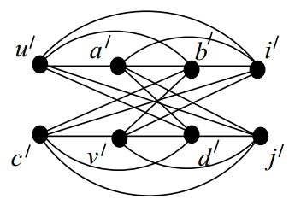
A Graph with Eight Vertices that is Not a PCG
x
Then either d_{T} (w,x)≤ d_{T} (u,x),
or, d_{T} (w,x)≤ d_{T} (v,x).
T
u
v
Lemma 1
w
u
v
w
x
P_{uv} is the longest path in T_{uvw}
b/
Then either d_{T} (a,c) < d_{min},
or, d_{T} (b,d) < d_{min}.
d_{min}
d_{max}
Lemma 2
a/
c/
T
d/
G
a
b
c
d
Lemma 1
G / is not a PCG.
Lemma 2
G /

Slide 22
A Graph with Eight Vertices that is Not a PCG
a/
b/
c/
d/
Lemma 1
G / is not a PCG.
Lemma 2
e/
f /
g/
h/
G /
Proof.
Let G be a graph determined by exactly two edges (u/,v/) and (w/,x/).
Then at least one of d_{T} (u, w), d_{T} (u, x), d_{T} (v, w) and d_{T} (v, x) must
be greater than d_{max}.
Suppose for a contradiction that all those
four distances are less than d_{min}.
u/
v/
T
d_{min}
d_{max}
w/
x/
G
u
v
x
y
Then P_{uv} is the longest path in T_{uvw}.
By Lemma 1, either d_{T} (w,x) ≤ d_{T} (u,x)
or, d_{T} (w,x) ≤ d_{T} (v,x)
x
< d_{min}
< d_{min}
u
v
w
Therefore, w/ and x/ cannot be adjacent!

Slide 23
A Graph with Eight Vertices that is Not a PCG
a/
b/
c/
d/
Lemma 1
G / is not a PCG.
Lemma 2
e/
f /
g/
h/
G /
Proof.
Let G be a graph determined by exactly two edges (u/,v/) and (w/,x/).
Then at least one of d_{T} (u, w), d_{T} (u, x), d_{T} (v, w) and d_{T} (v, x) must
be greater than d_{max}.
a/
b/
e/
f /
Applying this argument on G/, we observe that
at least one of d_{T} (a,e), d_{T} (a, f ), d_{T} (b,e), d_{T} (b,f) is greater than d_{max}, and
at least one of d_{T} (c,g), d_{T} (c, h ), d_{T} (d,g), d_{T} (d,h) is greater than d_{max}.
c/
d/
Without loss of generality assume that
d_{T} (a, f ) > d_{max}, and
d_{T} (d,g)> d_{max}.
a/
g/
h /
d/
f /
g/
But a/,f / and d/,g/ are non-adjacent.
Hence by Lemma 2, both d_{T} (a, f ) and d_{T} (d,g) cannot be greater than d_{max.}

Slide 24
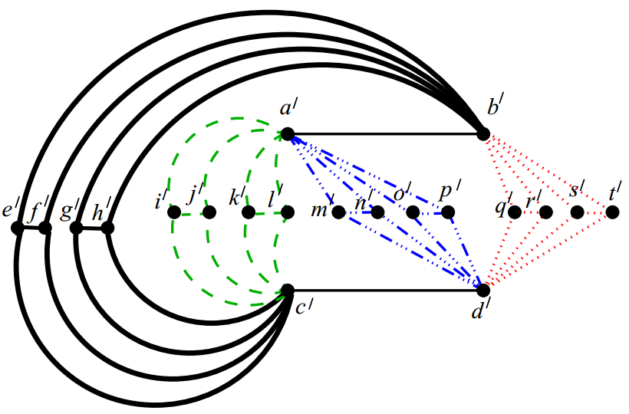
A Planar Graph that is Not a PCG
x /
Lemma 3. The tree distance between the degree
four vertices of H must be less than d_{min}.
Proof. Skip.
H
y /
G
a/
b/
At least one of d_{T} (a,c), d_{T} (a, d ), d_{T} (b,c), d_{T} (b,d) is greater than d_{max.}
c/
d /
a /
a /
b /
b /
m/
n /
o /
p /
k /
e /
g /
q /
r /
s /
i /
j /
l /
f /
h /
t /
d /
c /
c /
d /
By Lemma 3, all of d_{T} (a,c), d_{T} (a, d ), d_{T} (b,c), d_{T} (b,d) must be smaller than d_{min.}

Slide 25
A Planar Graph that is Not a PCG
G has 20 vertices, but can we find such a planar graph with smaller number of vertices?
G

Slide 26
A Planar Graph with 16 Vertices that is Not a PCG
G has 20 vertices, but can we find such a planar graph with smaller number of vertices?
G
Smallest Example?
Open
G₁₆
Yes!
Our proof holds even if we merge (i/,h/), (l/,m/), (p/,q/) and (t/,e/).

Slide 27
Time Complexity of the PCG Recognition Problem?
NP-hard ?
Open
Problem : Generalized-PCG-Recognition
Instance : A graph G, a subset S of the edges of its complement graph.
Question : Is there a PCG G/ = PCG (T, d_{min}, d_{max}) such that G/ contains G as a subgraph,
but does not contain any edge of S?
-------------------------------------------------------------------------------------------------------
Note that if S contains all the edges of the complement graph, then G is a PCG.
We only prove the following variant is NP-hard.
Problem : Max-Generalized-PCG-Recognition
Instance : A graph G, a subset S of the edges of its complement graph, and
a positive integer k.
Question : Is there a PCG G/ = PCG (T, d_{min}, d_{max}) such that G/ contains G as a subgraph,
but does not contain any edge of S; and at least k edges of have distance greater
than d_{max} between their corresponding leaves in T ?

Slide 28
Reduction from Monotone-One-In-Three 3-SAT
Problem : Max-Generalized-PCG-Recognition
Instance : A graph G, a subset S of the edges of its complement graph, and
a positive integer k.
Question : Is there a PCG G/ = PCG (T, d_{min}, d_{max}) such that G/ contains G as a subgraph,
but does not contain any edge of S; and at least k edges of have distance greater
than d_{max} between their corresponding leaves in T ?
Problem : Monotone-One-In-Three-3-SAT
Instance : A set U of variables and a collection C of clauses over U such that
each clause consists of exactly three non-negated literals.
Question : Is there a satisfying truth assignment for U such that each clause
in C contains exactly one true literal?

Slide 29
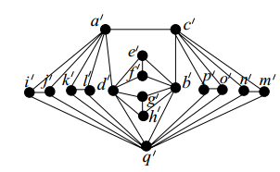
Idea of Reduction
A NOT gate. In any pairwise compatibility tree, if a/,b/ has tree distance greater than d_{max}, then c/,d/ has tree distance smaller than d_{min} and vice versa.

Slide 30
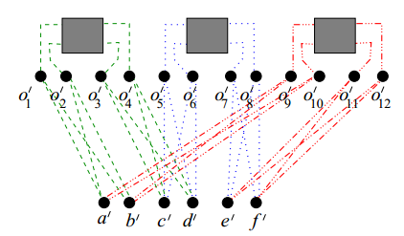
Idea of Reduction
N₁
N₂
N₃
For each clause, build this graph such that no two literals can be realized as True, i.e., tree distance greater than d_{max.} For example, if a/b/ and c/d/ both are realized by tree distance greater than d_{max} , then by Lemma 2, both of the inputs of N₁ are realized by tree distance smaller than d_{min}, which violates the property of a not gate.

Slide 31
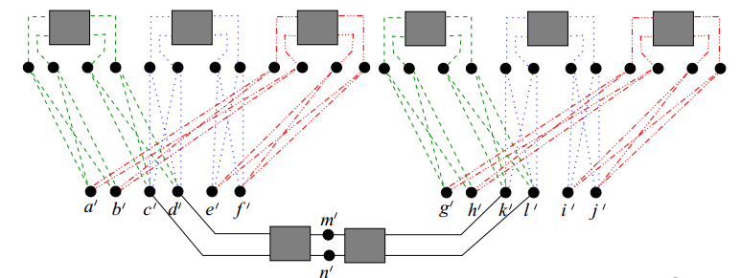
Idea of Reduction
For a variable that appears in different clauses, make such a chain such that their truth values are consistent. For example, here c/d/ and k/l/ are representing the same literal. Therefore, if c/d/ is realized by tree distance greater than d_{max}, m/n/ is realized by tree distance less than d_{min}, and hence k/l/ and has the same tree distance realization as c/d/.

Slide 32
Open Problems
Does there exist a split matrogenic graph that is not a PCG?
What is the smallest planar graph that is not a PCG?
Does there exist an outer planar graph that is not a PCG?
What is the complexity of (generalized) PCG recognition?

Slide 33
Thank you.

