Slide 1
The Maximum Clique Problem in a Disk Graph Made Easy
J. Mark Keil and Debajyoti Mondal
Department of Computer Science

Slide 2
Finding a Maximum Clique in a Disk Graph
Input: A set of disks
Output: A maximum clique --- a largest set of disks where every pair intersects

Slide 3
Known Results – Unit Disk Graphs – O(n^{4.5}) [CCJ 1990]
a
a
b
b
clique
clique
Guess the farthest pairs
and consider the points
Inside the lens
The complement of this
subgraph is a bipartite graph
Input unit disks
Compute the clique by
solving the maximum matching
n² pairs × Time to solve matching = O(n^{4.5})

Slide 4
Known Results – Unit Disk Graphs
O(n^{4.5})-time [Clark, Colbourn, Johnson. DM 1990] – find matching in each lens
O(n^{3.5} log n)-time [Aggarwal, Imai, Katoh, Suri. JA 1991] - faster matching
O(n³ log n)-time [Eppstein, Erickson. DCG 1994] – update instead of recompute
O(n^{2.5})-time [Espenant, Keil, Mondal. SoCG 2023] – many lenses can be ignored
This can be made faster O(n^{2.33})-time by combining small biclique cover and maximum flow - observed by Timothy Chan 2023

Slide 5
Known Results – Unit Disk Graphs
O(n^{4.5})-time [Clark, Colbourn, Johnson. DM 1990] – find matching in each lens
O(n^{3.5} log n)-time [Aggarwal, Imai, Katoh, Suri. JA 1991] - faster matching
O(n³ log n)-time [Eppstein, Erickson. DCG 1994] – update instead of recompute
O(n^{2.5})-time [Espenant, Keil, Mondal. SoCG 2023] – many lenses can be ignored
This can be made faster O(n^{2.33})-time by combining biclique cover and recent maximum flow idea - observed by Timothy Chan 2023
General Disk Graphs and Other Extensions
Time complexity question is a long-standing open question for disk graphs
QPTAS and Randomized EPTAS for disk graphs and unit ball graphs [Bonamy, Bonnet, Bousquet, Charbit, Thomassé. FOCS 2018]
Poly-time algo. for translates of any fixed convex polygon [Bonnet, Grelier, and Miltzow. FSTTCS 2020]
Poly-time algo. for t-directional convex polygons (fixed t) [Brimkov, Junosza-Szaniawski, Kafer, Kratochvíl, Pergel, Rzążewski, Szczepankiewicz, Terhaar. DAM 2018]

Slide 6
Can we find polynomial-time solutions for
slightly larger classes of disk graphs
than unit disk graphs?
Find good approximation algorithm for disk graphs with at most two different sizes of radii --- Sergio Cabello [CG Week Workshop, Eindhoven, 2015 and Adriatic Coast workshop, 2015]

Slide 7
Our Contributions
O∗(n^{2k})-time algorithm for disk graphs with k different sizes of radii, O∗ hides a polynomial factor
O∗(n^{2rk})-time algorithm for ball graphs with k different sizes of radii, where the centers lie on r planes that are perpendicular to a given plane
O∗(n^{2k})-time algorithm for L-visible convex polygons with k different shapes
Fast rectangular range query for unit disks, where a maximum clique needs to be reported over disks with centers in the query rectangle

Slide 8
Our Contributions
O∗(n^{2k})-time algorithm for disk graphs with k different sizes of radii, O∗ hides a polynomial factor
O∗(n^{2rk})-time algorithm for ball graphs with k different sizes of radii, where the centers lie on r planes that are perpendicular to a given plane
O∗(n^{2k})-time algorithm for L-visible convex polygons with k different shapes
Fast rectangular range query for unit disks, where a maximum clique needs to be reported over disks with centers in the query rectangle

Slide 9
From Unit Disk Graphs to k Types of Radii
a
a
b
b
clique
clique
Guess the farthest pair and consider the points inside the lens
The complement of this subgraph is a bipartite graph. Compute a maximum clique from max bipartite matching
Input unit disks
?
k = 2

Slide 10
From Unit Disk Graphs to k Types of Radii
a
a
b
b
clique
clique
Guess the farthest pair and consider the points inside the lens
The complement of this subgraph is a bipartite graph. Compute a maximum clique from max bipartite matching
Input unit disks
a
?
Arrangement of these lenses
can be arbitrary – difficult to
understand whether the subgraph admits a polynomial time algorithm for cliques
d
c
b
k = 2

Slide 11
Getting Rid of Lenses (k = 2)
Upper
Slab
U_{small}
Guess the
leftmost small
disk center
Guess the
rightmost small
disk center
b
a
Lower
Slab
L_{small}

Slide 12
Getting Rid of Lenses (k = 2)
U_{small}
U_{big}
clique
c
b
Claim: The union of upper slabs corresponds to a clique
and the same holds for the union of lower slabs.
The complement is bipartite and the clique is obtained
from max bipartite matching
a
d
L_{small}
L_{big}
Guess the slabs
of the small disks
and large disks
clique

Slide 13
Union of Upper Slabs Corresponds to a Clique
clique
q
p and q both are adjacent to a and b
Assume q is higher than p
Prove that p and q are adjacent
p
?
b
a

Slide 14
Union of Upper Slabs Corresponds to a Clique
clique
q
p and q both are adjacent to a and b
Assume q is higher than p
Prove that p and q are adjacent
p
?
b
a
q
q
q
q
p
p
p
p
b
b
b
b
a
a
a
a
Extend the segment pq and move p to reach on of the corner points. Since q is adjacent to the corner points, p and q are adjacent
The argument works even when q is a big disk

Slide 15
Union of Upper Slabs Corresponds to a Clique
clique
q
p and q both are adjacent to a and b
Assume q is higher than p
Prove that p and q are adjacent
p
?
b
a
p
p
Use the slab of the big
disks and apply the same argument of extending the segment pq
?
q
c
q
b
a
d

Slide 16
Disk Graphs with k Types of Radii
clique
Guess the leftmost and rightmost
disks for each type: O(n^{2k}) guesses
Only keep the points that are
Adjacent to all the guessed disks
Compute the max clique from the
max matching in the complement
Running time: O∗(n^{2k})
clique

Slide 17
Our Contributions
O∗(n^{2k})-time algorithm for disk graphs with k different sizes of radii, O∗ hides a polynomial factor
O∗(n^{2rk})-time algorithm for ball graphs with k different sizes of radii, where the centers lie on r planes that are perpendicular to a given plane
O∗(n^{2k})-time algorithm for L-visible convex polygons with k different shapes
Fast rectangular range query for unit disks, where a maximum clique needs to be reported over disks with centers in the query rectangle

Slide 18
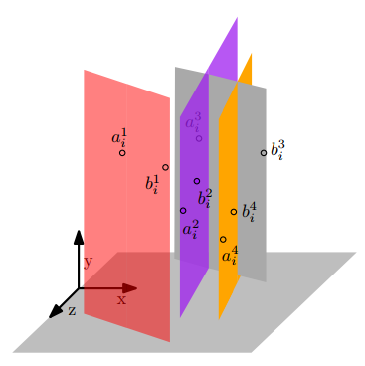
Ball Graphs
k types of radii
Centers on r planes which are
perpendicular to a given plane

Slide 19
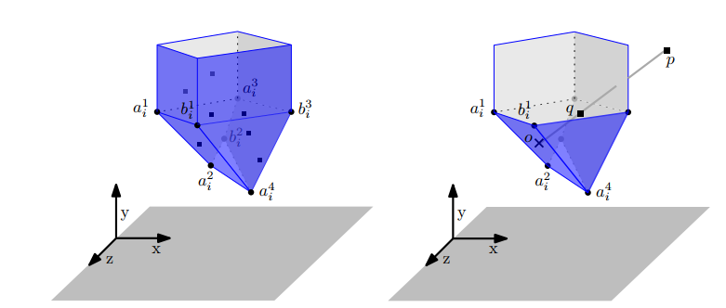
Ball Graphs
Guess leftmost and rightmost points at each plane
Define extended upper (lower) hull for each type
Union of all upper (lower) hulls corresponds to clique

Slide 20
Our Contributions
O∗(n^{2k})-time algorithm for disk graphs with k different sizes of radii, O∗ hides a polynomial factor
O∗(n^{2rk})-time algorithm for ball graphs with k different sizes of radii, where the centers lie on r planes that are perpendicular to a given plane
O∗(n^{2k})-time algorithm for L-visible convex polygons with k different shapes
Fast rectangular range query for unit disks, where a maximum clique needs to be reported over disks with centers in the query rectangle

Slide 21
L-Visible Convex Polygons of k Types
p
c
Every point p is L-visible from a center point c
(the rectangle pc is inside the shape)
k = 4

Slide 22
L-Visible Convex Polygons of k Types
q
q
q
q
p
p
p
b
p
b
a
a
a
b
b
a
q
q
p
p
b
b
a
a
The distance argument works also for L-visibility

Slide 23
Summary and Open Questions
O∗(n^{2k})-time algorithm for disk graphs with k different sizes of radii, O∗ hides a polynomial factor
O∗(n^{2rk})-time algorithm for ball graphs with k different sizes of radii, where the centers lie on r planes that are perpendicular to a given plane
O∗(n^{2k})-time algorithm for L-visible convex polygons with k different shapes
Fast rectangular range query for unit disks, where a maximum clique needs to be reported over disks with centers in the query rectangle

Slide 24
Summary and Open Questions
O∗(n^{2k})-time algorithm for disk graphs with k different sizes of radii, O∗ hides a polynomial factor
- Faster running time? FPT parameterized by radii types?
O∗(n^{2rk})-time algorithm for ball graphs with k different sizes of radii, where the centers lie on r planes that are perpendicular to a given plane
- Remove the dependency on r ?
O∗(n^{2k})-time algorithm for L-visible convex polygons with k different shapes
- Replace convexity with something more general?
Fast rectangular range query for unit disks, where a maximum clique needs to be reported over disks with centers in the query rectangle
- Less explored – scope for better data structures

Slide 25
Summary and Open Questions
O∗(n^{2k})-time algorithm for disk graphs with k different sizes of radii, O∗ hides a polynomial factor
- Faster running time? FPT parameterized by radii types?
O∗(n^{2rk})-time algorithm for ball graphs with k different sizes of radii, where the centers lie on r planes that are perpendicular to a given plane
- Remove the dependency on r ?
O∗(n^{2k})-time algorithm for L-visible convex polygons with k different shapes
- Replace convexity with something more general?
Fast rectangular range query for unit disks, where a maximum clique needs to be reported over disks with centers in the query rectangle
- Less explored – scope for better data structures
Thank You!

