Slide 1





Thickness and Colorability of Geometric Graphs
Stephane Durocher
Ellen Gethner
Debajyoti Mondal
Department of Computer Science
University of Manitoba
Department of Computer Science
University of Colorado Denver
Department of Computer Science
University of Manitoba

Slide 2
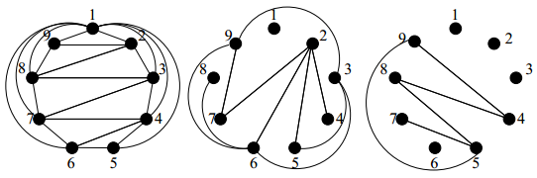
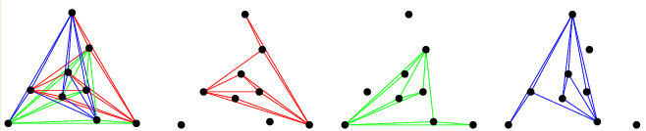
Thickness & Geometric Thickness
Thickness θ(G):
The smallest number k such that G can be decomposed into k planar graphs.
θ(K₉) = 3
Geometric Thickness θ(G):
The smallest number k such that
  G can be decomposed into k planar straight-line drawings (layers), and
  the position of the vertices in each layer is the same.
http://www.sis.uta.fi/cs/reports/dsarja/D-2009-3.pdf
θ(K₉) = 3
http://mathworld.wolfram.com/GraphThickness.html

Slide 3
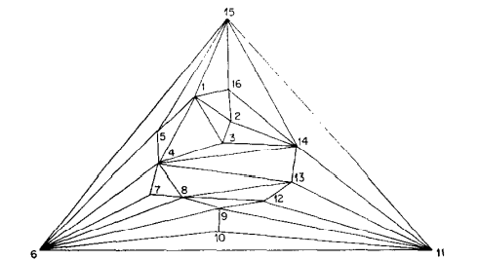
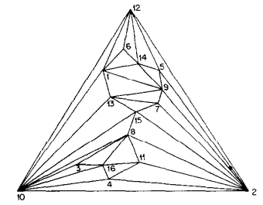
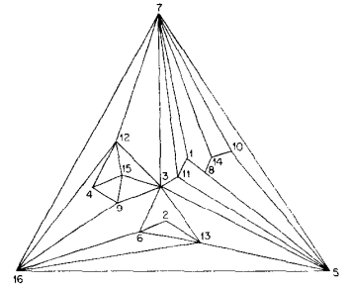
Thickness & Geometric Thickness
Thickness θ(G):
The smallest number k such that G can be decomposed into k planar layers.
θ(K₁₆) = 3 [Mayer 1971]
Geometric Thickness θ(G):
The smallest number k such that
  G can be decomposed into k planar straight-line drawings (layers), and
  the position of the vertices in each layer is the same.
θ(K₁₆) = 4 [Dillencourt, Eppstein, and Hirschberg 2000]

Slide 4
Known Results
1950 Ringel Thickness t graphs are 6t colorable
^{θ(Kn,n)} ⁼ ⌊ ^{(n+5)}/₄ ⌋
^{θ(K9) = θ(K10) =3, θ(Kn)} ⁼ ⌊ ^{(n+7)}/₆ ⌋
1964 Beineke, Harary and Moon
1976 Alekseev and Gonchakov
Vasak
1971 Mansfield Thickness-2-graph recognition is NP-hard
... 2013 Extensive research exploring similar properties of geometric graphs
1999 Hutchinson, Shermer, Vince For θ(G)=2, 6n-20 ≤ |E(G)| ≤ 6n-18
2000 Dillencourt, Eppstein, Hirschberg θ(K_{n}) ≤ ⌈ ^{n}/₄ ⌉
2002 Eppstein θ(G) = 3, but θ(G) arbitrarily large

Slide 5
Our Results
Hutchinson, Shermer, Vince
For θ(G)=2, 6n-20 ≤ |E(G)| ≤ 6n-18. (Tight bounds?)
  6n-19 ≤ |E(G)| ≤ 6n-18
Dillencourt, Eppstein, Hirschberg
θ(K₁₅) = 4 > θ(K₁₅) = 3. (What is the smallest graph G with θ(G) > θ(G) ?)
The smallest such graph contains 10 vertices.
Mansfield
Thickness-2-graph recognition is NP-hard. (For geometric thickness?)
Geometric thickness-2-graph recognition is NP-hard.
1980 Dailey
Coloring planar graphs with 3 colors is NP-hard. (For thickness t>1?)
Coloring graphs with geometric thickness t with 4t-1 colors is NP-hard.

Slide 6
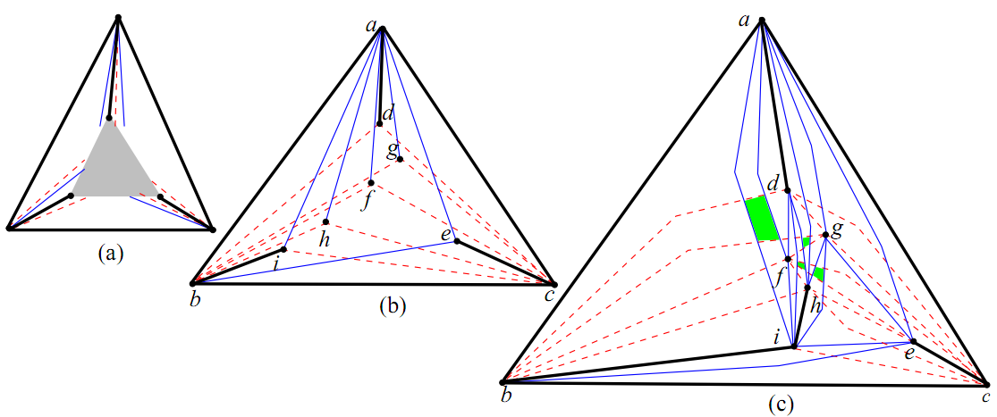
Geometric-Thickness-2-Graphs with 6n-19 edges
What if n > 9 ?
K₉-(d,e)
(3n-6)+(3n-6)-7 = 6n-19

Slide 7
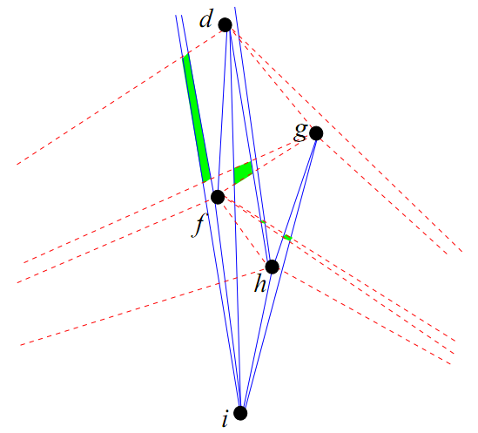
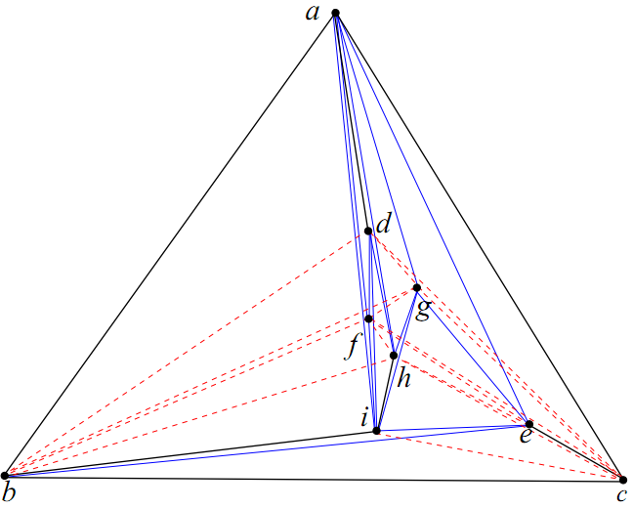
Geometric-Thickness-2-Graphs with 6n-19 edges
K₉-(d,e)

Slide 8
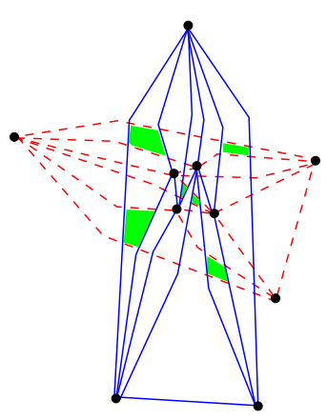
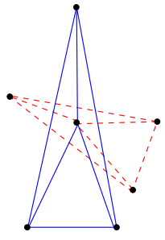
Geometric-Thickness-2-Graphs with 6n-19 edges
θ(G) =2, n = 9 and 6n-19 edges.
θ(G) =2, n = 13 and 6n-19 edges.
θ(G) =2, n = 10 and 6n-19 edges.
θ(G) =2, n = 14 and 6n-19 edges.
θ(G) =2, n = 11 and 6n-19 edges.
θ(G) =2, n = 15 and 6n-19 edges.
θ(G) =2, n = 12 and 6n-19 edges.
θ(G) =2, n = 16 and 6n-19 edges.

Slide 9
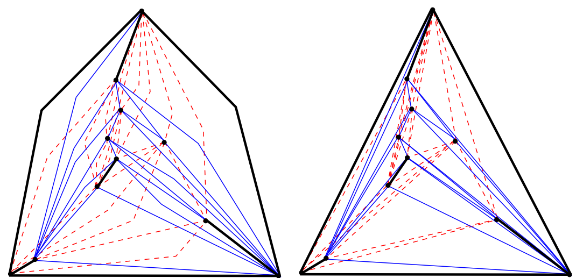
Geometric-Thickness-2-Graphs with 6n-19 edges
θ(G) =2, n =11, 6n-19 edges ,
but does not contain K₉-(d,e).

Slide 10
All Geometric-Thickness-2-Drawings of K₉-one edge
For each distinct point configuration P of 9 points,
construct K₉ on P, and
for each edge e / in K₉ , check whether K₉ –e / is a thickness two representation.

Slide 11
All Geometric-Thickness-2-Drawings of K₉-one edge
For each distinct point configuration P of 9 points,
construct K₉ on P, and
for each edge e / in K₉ , check whether K₉ –e / is a thickness two representation.

Slide 12
All Geometric-Thickness-2-Drawings of K₉-one edge
For each distinct point configuration P of 9 points,
construct K₉ on P, and
for each edge e / in K₉ , check whether K₉ –e / is a thickness two representation.

Slide 13
All Geometric-Thickness-2-Drawings of K₉-one edge
For each distinct point configuration P of 9 points,
construct K₉ on P, and
for each edge e / in K₉ , check whether K₉ –e / is a thickness two representation.

Slide 14
All Geometric-Thickness-2-Drawings of K₉-one edge
For each distinct point configuration P of 9 points,
construct K₉ on P, and
for each edge e / in K₉ , check whether K₉ –e / is a thickness two representation.

Slide 15
All Geometric-Thickness-2-Drawings of K₉-one edge
For each distinct point configuration P of 9 points,
construct K₉ on P, and
for each edge e / in K₉ , check whether K₉ –e / is a thickness two representation.

Slide 16
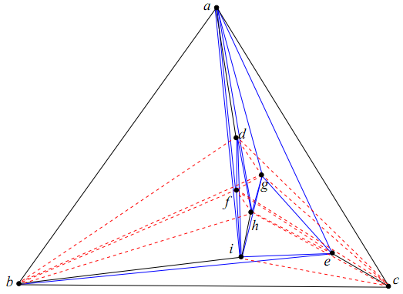
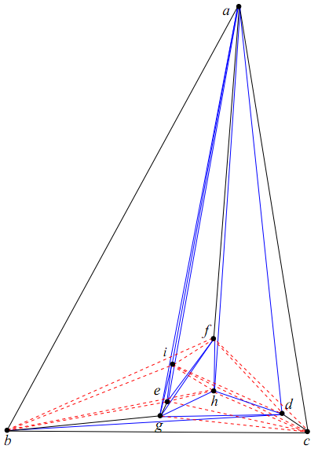
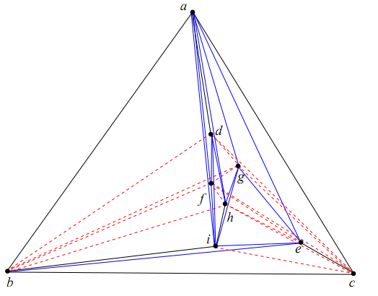
All Geometric-Thickness-2-Drawings of K₉-one edge

Slide 17
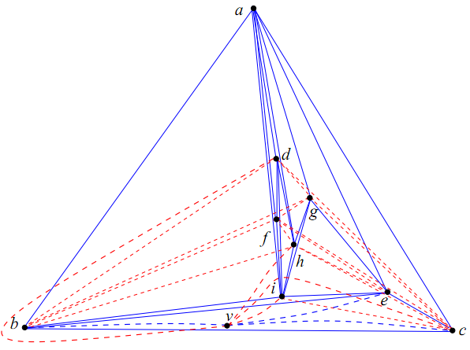
Smallest G with θ(G) > θ(G)
unsaturated vertices
K₉- (d,e)
H, where θ(H) = 2

Slide 18
θ(H) = 3> θ(H) = 2
v
v
No suitable position for v in the thickness-2-representations of K₉- (d,e)

Slide 19
Schematic Representation of K₉-one edge

Slide 20
Schematic Representation of K₉-one edge

Slide 21
Schematic Representations: Paths and Cycles

Slide 22
Schematic Representations: Paths and Cycles

Slide 23
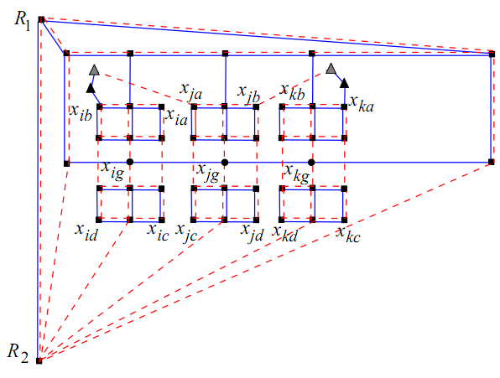
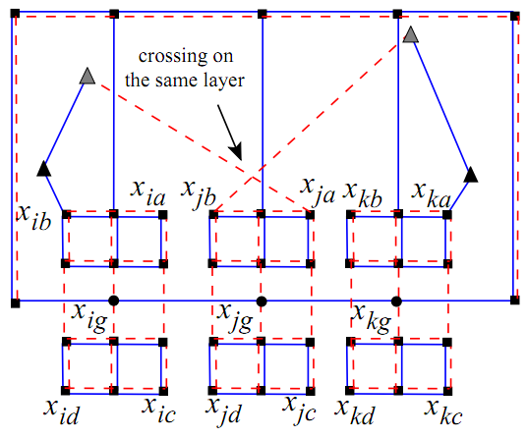
Geometric-Thickness-2-Graph Recognition is NP-hard
Reduction from 3SAT; similar to Estrella-Balderrama et al. [2007]
C₂
C₃
C₄
True
False
c
d
d
c

Slide 24
Coloring with 4t-1 colors is NP-hard
Reduction from the problem of coloring geometric-
thickness-t-graphs with 2t +1 colors, which is NP-hard (skip).
Without loss of generality assume that t ≥ 2.
Given a graph H with geometric thickness (t-1), we construct a graph G with thickness t such that G is 4t-1 colorable if and only if H is 2(t-1)+1 colorable.

Slide 25
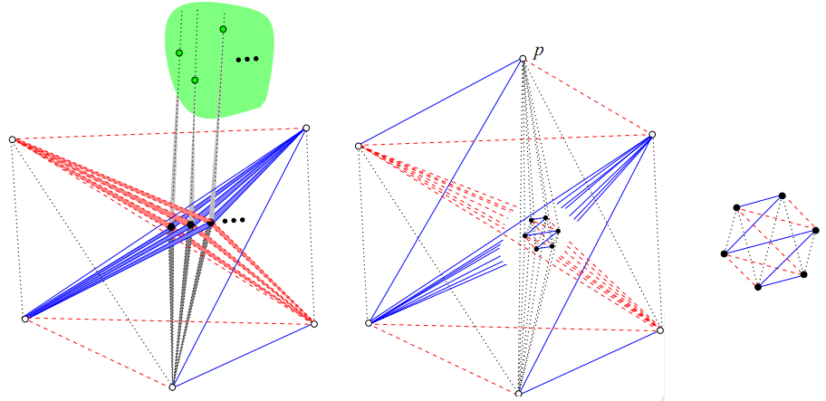
Coloring with 4t-1 colors is NP-hard
Given a graph H with geometric thickness (t-1), we construct a graph G with thickness t such that G is 4t-1 colorable if and only if H is 2(t-1)+1 colorable.
H
2t vertices
G
2t-1 vertices
= 2(t-1)+1 vertices
Construction of K_{4t} = K₁₂
[Dillencourt et al. 2000]

Slide 26
Future Research
Does there exist a geometric thickness two graph with 6n-18 edges?
Can every geometric-thickness-2-graph be colored with 8 colors?
Does there exist a polynomial time algorithm for recognizing geometric thickness-2-graphs with bounded degree?

Slide 27
Thank You

