Slide 1

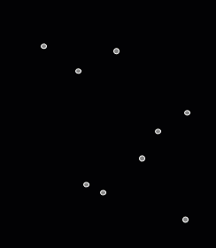




Burning Number for the Points in the Plane
J. Mark Keil, Debajyoti Mondal, Ehsan Moradi
Department of Computer Science

Slide 2
Burning Number for Graphs
Introduced by Anthony Bonato et al. in 2014.
Input: A graph
Task: Burn one vertex at each timestamp and propagate the burning through neighbors.
Output:
Minimum number of rounds to burn all the vertices (and a burning sequence)

Slide 3
Burning Number for Graphs
g
Output:
A burning sequence with minimum length (burning number)
Input: A graph
Task: Burn one vertex at each timestamp and propagate the burning through neighbors.
h
a
b
c
d
e
f

Slide 4
Burning Number for Graphs
g
Output:
Minimum number of rounds to burn all the vertices (and a burning sequence)
Input: A graph
Task: Burn one vertex at each timestamp and propagate the burning through neighbors.
h
a
b
c
d
e
f
g
h
t = 1
a
b
c
d
e
f

Slide 5
Burning Number for Graphs
g
Output:
Minimum number of rounds to burn all the vertices (and a burning sequence)
Input: A graph
Task: Burn one vertex at each timestamp and propagate the burning through neighbors.
h
a
b
c
d
e
f
g
h
t = 1
a
b
c
d
e
f
g
h
t = 2
a
b
c
d
e
f

Slide 6
Burning Number for Graphs
g
Output:
Minimum number of rounds to burn all the vertices (and a burning sequence)
Input: A graph
Task: Burn one vertex at each timestamp and propagate the burning through neighbors.
h
a
b
c
d
e
f
g
h
t = 1
a
b
c
d
e
f
Burning number = 3
A burning sequence is
b
e
g
h
t = 2
a
b
c
d
e
f
g
h
t = 3
a
b
c
d
e
f

Slide 7

Burning Number for Graphs
Motivation
Model how quickly influence may spread in a graph.
If you want to spread an information a social network and want to spend a day to reach one person, then burning number is the minimum number of days you need to spread the message

Slide 8
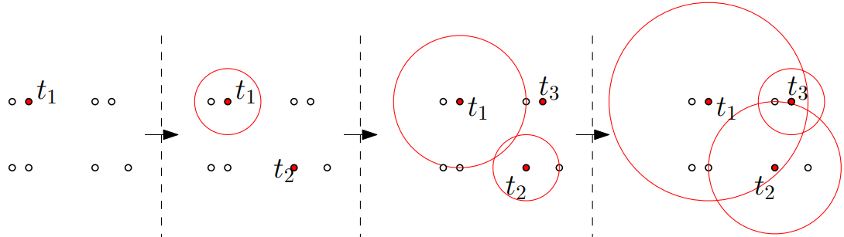
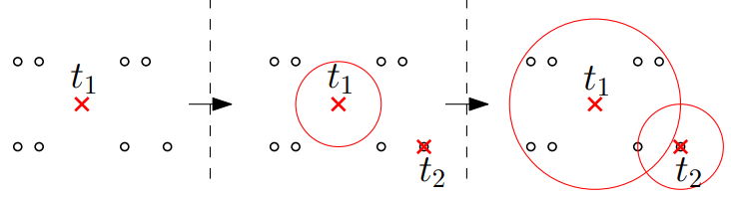
Burning Number for the Points in the Plane
Burn one point at each timestamp and propagate the burning to all points within unit distance to a burnt point. Find the minimum number of steps (burning number).
Point Burning: Burning can only be initiated at given points
Anywhere Burning: Burning can be initiated at any point in the plane

Slide 9
Burning Number for the Points in the Plane
Burn one point at each timestamp and propagate the burning to all points within unit distance to a burnt point. Find the minimum number of steps (burning number).
Point Burning: Burning can only be initiated at given points
Anywhere Burning: Burning can be initiated at any point in the plane

Slide 10
Burning Number for the Points in the Plane
Burn one point at each timestamp and propagate the burning to all points within unit distance to a burnt point. Find the minimum number of steps (burning number).
Point Burning: Burning can only be initiated at given points
Anywhere Burning: Burning can be initiated at any point in the plane

Slide 11
Burning Number for the Points in the Plane
Burn one point at each timestamp and propagate the burning to all points within unit distance to a burnt point. Find the minimum number of steps (burning number).
Point Burning: Burning can only be initiated at given points
Anywhere Burning: Burning can be initiated at any point in the plane

Slide 12
Burning Number for the Points in the Plane
Burn one point at each timestamp and propagate the burning to all points within unit distance to a burnt point. Find the minimum number of steps (burning number).
Point Burning: Burning can only be initiated at given points
Anywhere Burning: Burning can be initiated at any point in the plane

Slide 13
Burning Number for the Points in the Plane
Burn one point at each timestamp and propagate the burning to all points within unit distance to a burnt point. Find the minimum number of steps (burning number).
Point Burning: Burning can only be initiated at given points
Anywhere Burning: Burning can be initiated at any point in the plane

Slide 14


Burning Number for the Points in the Plane
Motivation
Model supply chain management.
Maintain a continuous supply of perishable goods to a set of locations, where each day one shipment is sent to a hub location that distributes the goods further to the nearby locations over time.
Day 1
Day 2
Day 3
Day 4

Slide 15
Results
Graph Burning (Known)
Finding the burning number is NP-hard even for a forest of paths [Bonato et al. ’14]
3-approximable [Bonato and Kamali ’19]
APX-hard for max-deg-3 graphs [Mondal et al. ’21]
Point Burning and Anywhere Burning (new)
Both are NP-hard
Both are (2 + ε)-approximable for every ε > 0.
Given a restriction on the number of burning sources, anywhere burning is NP-hard to approximate within a factor of (1.15 - ε).

Slide 16
Results
Graph Burning (Known)
Finding the burning number is NP-hard even for a forest of paths [Bonato et al. ’14]
3-approximable [Bonato and Kamali ’19]
APX-hard for max-deg-3 graphs [Mondal et al. ’21]
Point Burning and Anywhere Burning (new)
Both are NP-hard
Both are (2 + ε)-approximable for every ε > 0.
Given a restriction on the number of burning sources, anywhere burning is NP-hard to approximate within a factor of (1.15 - ε).

Slide 17
NP-hardness of Point Burning
Reduce from graph burning (restricted to path forest)
Instance of graph burning: A set of paths and an integer b, decide whether all vertices can be burned in b steps.
Example: (a,b,c,d,e,f) (g,h,i) (j,k)
Instance of point burning: Given a set of points and an integer b, decide whether all points can be burned in b steps.
a
b
c
d
e
f
g
h
i
j
k
1 unit
Sufficiently large gap (2n+1)
Sufficiently large gap (2n+1)

Slide 18
NP-hardness of Point Burning
Reduce from graph burning (restricted to path forest)
Instance of graph burning: A set of paths and an integer b, decide whether all vertices can be burned in b steps.
Example: (a,b,c,d,e,f) (g,h,i) (j,k)
Instance of point burning: Given a set of points and an integer b, decide whether all points can be burned in b steps.
a
b
c
d
e
f
g
h
i
j
k
1 unit
Sufficiently large gap (2n+1)
Sufficiently large gap (2n+1)

Slide 19
NP-hardness of Anywhere Burning
Reduce from graph burning (restricted to path forest)
Instance of graph burning: A set of paths and an integer b, decide whether all vertices can be burned in b steps.
Example: (a,b,c,d,e,f) (g,h,i) (j,k)
Instance of point burning: Given a set of points and an integer b, decide whether all points can be burned in b steps.
a
b
c
d
e
f
g
h
i
j
k
1 unit
Sufficiently large gap (2n+1)
Sufficiently large gap (2n+1)

Slide 20
NP-hardness of Anywhere Burning
Reduce from graph burning (restricted to path forest)
Instance of graph burning: A set of paths and an integer b, decide whether all vertices can be burned in b steps.
Example: (a,b,c,d,e,f) (g,h,i) (j,k)
Instance of point burning: Given a set of points and an integer b, decide whether all points can be burned in b steps.
a
b
c
d
e
f
g
h
i
j
k
1 unit
Sufficiently large gap (2n+1)
Sufficiently large gap (2n+1)

Slide 21
Results
Graph Burning (Known)
Finding the burning number is NP-hard even for a forest of paths [Bonato et al. ’14]
3-approximable [Bonato and Kamali ’19]
APX-hard for max-deg-3 graphs [Mondal et al. ’21]
Point Burning and Anywhere Burning (new)
Both are NP-hard
Both are (2 + ε)-approximable for every ε > 0.
Given a restriction on the number of burning sources, anywhere burning is NP-hard to approximate within a factor of (1.15 - ε).

Slide 22
(2 + ε)-Approximation for Point Burning
Discrete unit disk cover problem: Given a set of points and a set of unit disks, select the smallest subset of the unit disks to cover all points. This problem admits a PTAS [Mustafa and Ray ’10]

Slide 23
(2 + ε)-Approximation for Point Burning
Algorithm for point burning
Guess the burning number b from 1 to n
  For each given point, construct a disk of radius b units
  Compute a (1 + ε)-approximate solution for D for the
  discrete unit disk cover
  Stop as soon as |D| ≤ (1 + ε).b
  Burn all the centers of D and then
  keep burning b more
  steps to ensure all
  points are burned

Slide 24
(2 + ε)-Approximation for Anywhere Burning
Algorithm for anywhere burning
Guess the burning number b from 1 to n
  For each given point, construct a disk of radius b units
  Compute a (1 + ε)-approximate solution for D for the
  discrete unit disk cover
  Stop as soon as |D| ≤ (1 + ε).b
  Burn all the centers of D and then
  keep burning b more
  steps to ensure all
  points are burned
candidate
x
x

Slide 25
Results
Graph Burning (Known)
Finding the burning number is NP-hard even for a forest of paths [Bonato et al. ’14]
3-approximable [Bonato and Kamali ’19]
APX-hard for max-deg-3 graphs [Mondal et al. ’21]
Point Burning and Anywhere Burning (new)
Both are NP-hard
Both are (2 + ε)-approximable for every ε > 0.
Given a restriction on the number of burning sources, anywhere burning is NP-hard to approximate within a factor of (1.15 - ε).

Slide 26
Anywhere Burning with at most k burning sources
Anywhere Burning with at most k burning sources is NP-hard to approximate within a factor of (1.15 - ε)
IDEA
Show that it is NP-complete to decide whether all points can be burned with at most k burning sources in b steps
Show that the NP-hardness holds even when we allow to burn (1.15 - ε).b steps

Slide 27
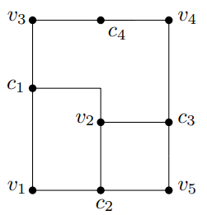
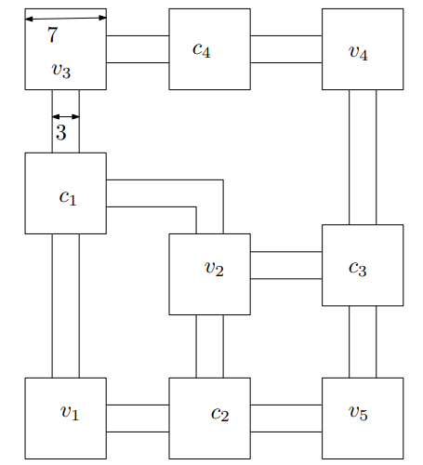
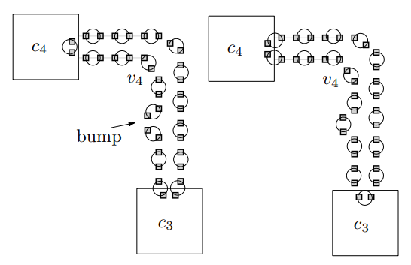
Anywhere Burning with at most k burning sources
Show that it is NP-complete to decide whether all points can be burned with at most k burning sources in b steps
Reduce from 3-bounded planar 3-SAT
Instance of 3-SAT
Instance of anywhere
burning
Two types of burning for the edge gadgets

Slide 28
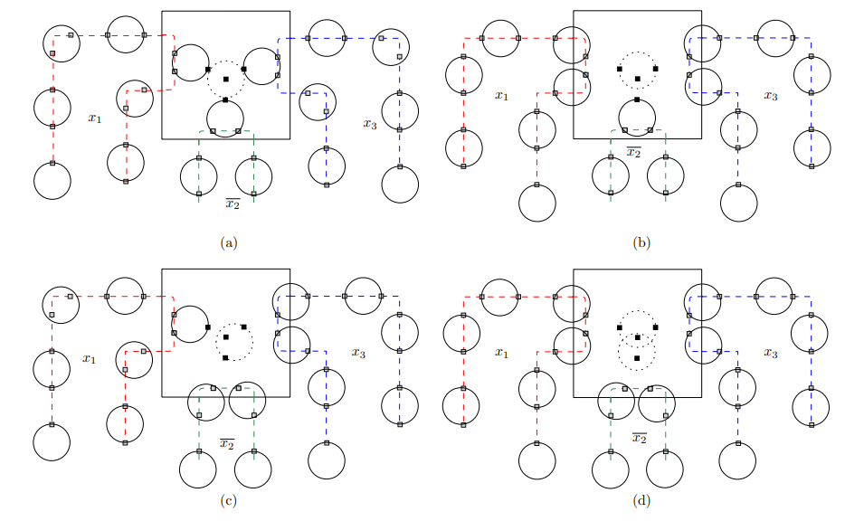
Anywhere Burning with at most k burning sources
Show that it is NP-complete to decide whether all points can be burned with at most k burning sources in b steps
Reduce from
3-bounded
planar 3-SAT

Slide 29
Anywhere Burning with at most k burning sources
Show that it is NP-complete to decide whether all points can be burned with at most k burning sources in b steps
Reduce from
3-bounded
planar 3-SAT
But why all the
disks here are
of same radii?

Slide 30
Anywhere Burning with at most k burning sources
Show that it is NP-complete to decide whether all points can be burned with at most k burning sources in b steps
Reduce from 3-bounded planar 3-SAT
But why all the disks here are of same radii?
In fact they are all different radii, but we
can ensure all of them to have large radii
by adding some remote isolated points in the
construction that must be burned
later (with small radii)
Show that the NP-hardness holds even when we allow to burn (1.15 - ε).b steps

Slide 31
Directions for Future Research
Graph Burning (Known)
Finding the burning number is NP-hard even for a forest of paths [Bonato et al. ’14]
3-approximable [Bonato and Kamali ’19]
APX-hard for max-deg-3 graphs [Mondal et al. ’21]
Point Burning and Anywhere Burning (new)
Both are NP-hard
Both are (2 + ε)-approximable for every ε > 0.
Given a restriction on the number of burning sources, anywhere burning is NP-hard to approximate within a factor of (1.15 - ε).

Slide 32
Directions for Future Research
Graph Burning (Known)
Finding the burning number is NP-hard even for a forest of paths [Bonato et al. ’14]
3-approximable [Bonato and Kamali ’19]
APX-hard for max-deg-3 graphs [Mondal et al. ’21]
Point Burning and Anywhere Burning (new)
Both are NP-hard
Both are (2 + ε)-approximable for every ε > 0.
Given a restriction on the number of burning sources, anywhere burning is NP-hard to approximate within a factor of (1.15 - ε).
APX-hard?
Recent progress (1.9+ε)
Better approximation?
Better inapproximability?

Slide 33

Directions for Future Research
Graph Burning (Known)
Finding the burning number is NP-hard even for a forest of paths [Bonato et al. ’14]
3-approximable [Bonato and Kamali ’19]
APX-hard for max-deg-3 graphs [Mondal et al. ’21]
Point Burning and Anywhere Burning (new)
Both are NP-hard
Both are (2 + ε)-approximable for every ε > 0.
Given a restriction on the number of burning sources, anywhere burning is NP-hard to approximate within a factor of (1.15 - ε).
APX-hard?
Recent progress (1.9+ε)
Better approximation?
Thank You!
Better inapproximability?

