Slide 1
Task-Centered User Interface Design
CMPT 281

Slide 2
Outline
What is TCUID?
TCUID process
Finding and working with users
Developing task examples
Evaluation with task-centered walkthrough
Example: the Cheap Shop interface

Slide 3
What is TCUID?
A design process
one type of user-centred design
structured around specific tasks that users want to accomplish with the system
emphasis on early consideration of tasks in design
emphasis on concrete detail
Tasks are used to:
aid in making design decisions
evaluate the design as it is developed

Slide 4
The TCUID process
figure out who's going to use the system to do what
choose representative tasks for task-centered design
borrow
rough out a design
think about it
create a mock-up or prototype
test it with users
iterate
build it
track it
change it

Slide 5
The TCUID process
figure out who's going to use the system to do what
choose representative tasks for task-centered design
borrow (look for inspiration)
rough out a design (paper prototype)
think about it (walkthrough)
create a mock-up or prototype
test it with users
iterate
build it
track it
change it

Slide 6
Finding potential users
Who would use the system to do what?
Exactly who, and exactly what?
Find potential users of your system
Real people! - not managers or other designers
If you can’t find them, who will actually buy/use your system?
Consider typical and atypical users
Find out how the system would fit with their work
Are they interested? Why or why not?
Learn about the user’s tasks
Develop concrete, detailed examples of tasks they perform or want to perform that your system should support

Slide 7
Choose representative tasks
What are the core tasks the system must support?
Consider importance and frequency
Start with 3-5 core tasks
check your decisions with users
Write out task descriptions for these tasks

Slide 8
Task descriptions
“Change the speed limit on Canyon Boulevard eastbound between Arapahoe and 9th. Calculate projected traffic flows on Arapahoe west of 6th assuming Canyon speeds between 25 and 55 in increments of 5 mph.”
Read Chapters 0,1,2, 4.1:
Task-Centered User Interface Design: A Practical Introduction
http://hcibib.org/tcuid/

Slide 9
Task descriptions
Says what the user wants to do but not how they would do it
no assumptions made about the interface
can compare different design alternatives in a fair way
Are very specific
says exactly what the user wants to do
specifies actual items the user would eventually want to enter, identify, or manipulate
states constraints or goals in task completion
e.g. time: as fast as possible; less than 15 seconds
e.g. quality: how much room for error?

Slide 10
Task descriptions
Describe a complete job
not just a list of simple things the system should do
does more than present sub-goals
forces designer to consider how features will work together
considers the flow of information over a time period
where does information come from?
where does it go?
what has to happen next?
What is a complete job?
consider temporal and spatial breaks
check your decisions with users

Slide 11
Task descriptions
Say who the users are
be specific – important details are easy to overlook
design success is strongly influenced by what users know
reflect the real interests of real users
Are evaluated
Circulate descriptions to users, and rewrite if needed
ask users for:
omissions
corrections
clarifications
suggestions
Remember users aren’t always right
conflict can tell you that you are missing something

Slide 12
Borrow ideas
Tough to be beat existing interfaces
Helps learning
Saves time in designing and building
Don’t actually steal, just look for inspiration

Slide 13
Borrow ideas
How to actually design the UI?
Look for existing interfaces that work
Build ideas from those interfaces into your systems
e.g. high-level interaction paradigms
e.g. low-level control/display decisions
Work within existing interface frameworks
e.g., GUI toolkits
make use of existing applications

Slide 14
Rough out a design
Low-fidelity prototyping
paper & pencil
just draw the interface on paper
don’t worry about consistency or aesthetics
Focus on the core tasks
don’t add extra functionality
make sure the prototype covers all of the tasks

Slide 15
Think about it (= evaluate)
Evaluate your rough design
in terms of the tasks you were trying to support
without a user!
can catch errors that testers wouldn’t catch
Could use existing evaluation methods:
Cognitive Walkthrough
Heuristic Evaluation

Slide 16
Cognitive Walkthrough
Cognitive walkthrough
a UI evaluation technique where designers step through a task and attempt to complete the task with a prototype
“simulated realistic user” based on the detailed user description
goal is to identify obvious problems with the design
Stages:
create ‘runnable’ task scenarios
do a walkthrough for each scenario
Reading: “Performing a cognitive walkthrough”: www.cc.gatech.edu/classes/cs3302/documents/cog.walk.html

Slide 17
Task Scenarios
All the information needed to test the design
all task information
detailed sketches of all needed screens
Create a scenario for each task
design specific
what the user would have to do to carry out the task with this particular design
what the user would see step-by-step and at key moments in performing the task
Forces us to:
get specific about our design
consider how the various features work together to accomplish real work

Slide 18
Walkthroughs
Select one of the task scenarios
For each user step or action in the task:
Carry out the action with the interface
Ask:
would the user have done this action in this way?
would the user’s expected knowledge be sufficient
would the user know what to do, be able to find control/command, and know that the control would have the desired effect?
would the action be possible given the user’s situation?
is the feedback understandable and sufficient?
if no:
you’ve located a problem in the interface
once a problem is identified, assume it has been repaired
go to the next step in the task

Slide 19
Example: Cheap Shop
At Cheap Shop, people browse a catalog and then order goods from a clerk.
Task example 1:
A man caring for a demanding toddler buys an umbrella stroller (red is preferred, but blue is acceptable), pays for it in cash, and uses it immediately.
Task example 2:
An elderly arthritic woman is comparing prices for a child’s bedroom set, consisting of a wooden desk, a chair, a single bed, a mattress, a bedspread, and a pillow. She takes the description and total cost away with her, to check against other stores. Two hours later, she returns and decides to buy everything but the chair.

Slide 20
Example: Cheap Shop
Task example 3:
A “Cheap Shop” clerk, who is the sole salesperson in the store, is given a list of 10 items by a customer who does not want to use the computer.
4 pine chairs, 1 pine table, 6 blue place mats, 6 “duo” forks, 6 “duo” table spoons, 6 “duo” teaspoons, 6 “duo” knives, 1 “tot” tricycle, 1 red ball, 1 “silva” croquet set
After seeing the total, the customer decides to take all but the silverware, and then adds 1 blue ball to the list.
The customer then changes their mind about paying by credit card, and decides to pay cash. The customer wants the items delivered to his home the day after tomorrow.
While this is occurring, 6 other customers are waiting for the salesperson.

Slide 21
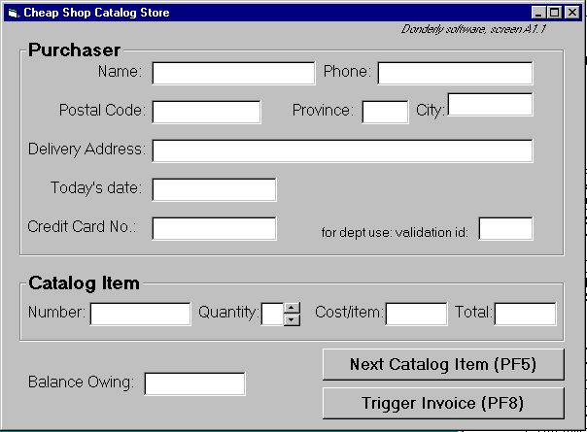
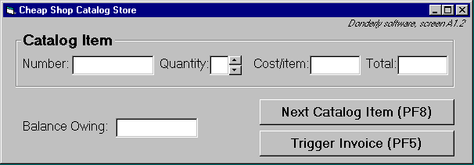
Screen 1
Screen 2

Slide 22
Prototype specifications
Basic usage:
Shoppers enter item codes from a catalog onto the screen.
To create an order
screen 1: shopper enters personal information and first order
text is entered via keyboard
the tab key or mouse is used to go between fields.
Further orders
shoppers go to screen 2 by pressing the ‘Next Catalog Item’ button
Order completion
shoppers select ‘Trigger Invoice’.
the system sends the order to shipping and billing
the system returns to a blank screen #1

Slide 23
Prototype specifications
To cancel an order
Shoppers do not enter any input for 30 seconds (as if they walk away)
The system will then clear all fields and return to the main screen
Input checking
all input fields checked when either button is pressed.
erroneous fields will blink for 3 seconds, and will then be cleared.
the shopper can then re-enter the correct values in those fields.

